Slide 1
REC ISSues group
09 August 2024

Slide 2
1. Introduction and agreement of agenda
Paul Witton-Dauris

Slide 3
Agenda For today
 | TITLE | TIME | LEAD
1 | Introductions and Agreement of Agenda | 10:00 | Chair
2 | Actions Log | 10:05 | Chair
3 | Data Cleanse Update | 10:20 | REC Performance Assurance Team
4 | Performance Assurance Operating Plan | 10:35 | REC Performance Assurance Team
5 | Pre-payment Incorrect Mode Change Upon Switching | 10:50 | REC Professional Services Team
6 | Multiple Switch Requests Impacting Consumer Experience and Party Performance | 11:05 | REC Professional Services Team
7 | Import & Export Indicators for MAP’s | 11:20 | REC Professional Services Team
8 | AOB | 11:35 | All
9 | Close | 11:50 | Chair

Slide 4
2. Actions log
Chair

Slide 5
Actions log
ACTION REF. | ACTION | OWNER(S) | UPDATE | STATUS
RECRIG_24_0712_02_01 | The Chair to raise the issue of de-energising a disconnected meter as a formal REC issue | REC Professional Services Team | The issue was raised following last month's meeting, issue number: I0191. | Open

Slide 6
3. data cleanse update
Rec performance assurance team

Slide 7
4. performance assurance operating plan
Rec performance assurance team

Slide 8
Developing the Scope
In line with the REC Performance Assurance Schedule (Schedule 6), the Performance Assurance Board (PAB) are responsible for overseeing the delivery of the Performance Assurance Operating Plan (PAOP) every year. Within this document, the PAB set the performance assurance priorities for the upcoming performance year and plan Code Manager activities to deliver those priorities. The PAOP is published in September every year. This plan is used to track performance assurance activities through the year and the plan is updated, as and when required, to respond to emerging and evolving risks within the retail energy market.
The Code Manager has identified key priorities for Performance Assurance and proposed suitable assurance strategies to support these based on:
Performance across the market over previous years.
View of changes and innovation planned across the industry that intersects with the Code boundaries.
Feedback from various REC stakeholders we have engaged with through the development process, e.g. through the PA webinar, sessions with PAB members, etc.

Slide 9
Strategic Assurance Priorities for 2024-25
Key goals
Other areas of focus
Managing the magnitude of change and innovation
Enhancing consumer input
Demonstrating value
Metering Operations
Energy Theft
Switching related processes
Industry Data Quality
REC Services

Slide 10
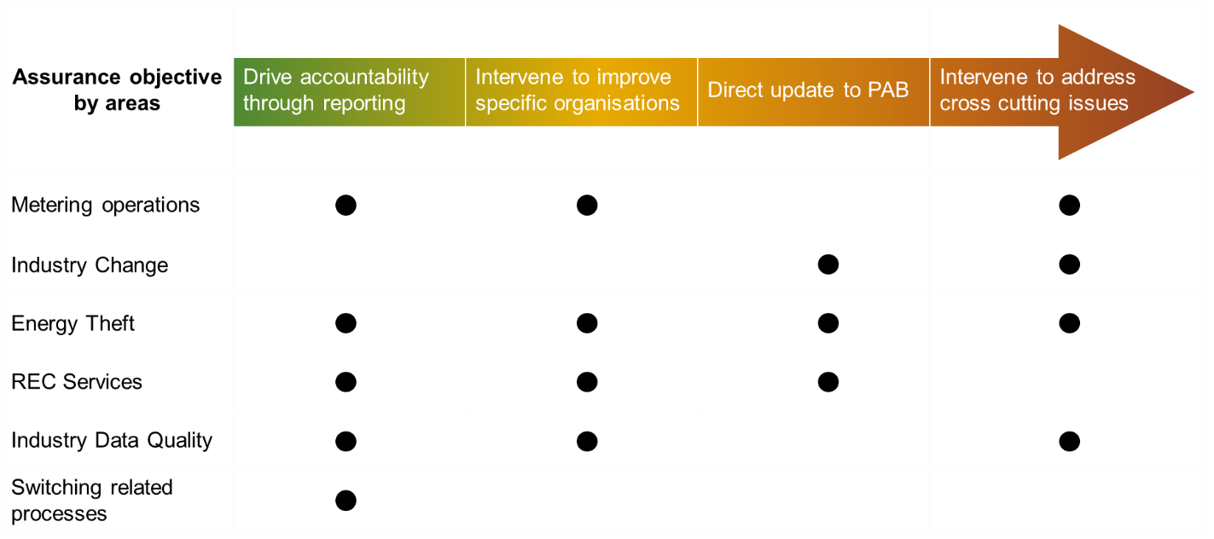
Strategic Assurance Priorities for 2024-25
We have set out below how we intend on apply different assurance strategies to cover the key areas of focus:
If the need arises to adjust these during 2024-25 in response to market conditions, we will discuss changes to our approach with the PAB before changing strategy.

Slide 11

RIG Discussion
FOR DISCUSSION | This paper summarises proposed areas of focus and activities planned for the Performance Assurance Operating Plan (PAOP) for the next performance year which starts on 01 September 2024. The Code Manager is seeking feedback from RIG members to gain insights before presenting the PAOP for approval to REC PAB in August. We ask RIG members to read this paper ahead of the meeting to allow discussion on the following: Are there any other focus areas or activities the Code Manager and PAB must consider whilst developing the PAOP? Are there any views from RIG members on the proposed priority levels and frequency for the activities listed, which REC PAB may consider when approving the PAOP? The list within this document contains activities we have proposed for inclusion as well as activities we have considered but decided to not include within the PAOP to ensure activities remain proportionate to the risk being managed. Are there any views from RIG members on the scope of activities defined within this paper?

Slide 12
5. pre-payment incorrect mode change upon switching
Rec professional services team

Slide 13
Pre-payment incorrect mode change upon switching
We are experiencing a significant number of issues when we acquire customers from other suppliers. These customers are often left in prepay mode, preventing them from topping up and frequently resulting in a loss of supply. We believe the previous supplier should switch the customer to credit mode before the transfer of supply occurs as set out in REC Schedule 11 - Section 3 Smart PAYGE process, however this is not happening in a lot of cases.
We have conducted some analysis to identify which suppliers are responsible for this issue. The findings are detailed below.
From:
Supplier (1) 22.4 %
Supplier (2) 20.8%
Supplier (3) 11.7%
Supplier (4) 11%
Supplier (5) 10.4%
It would be great if we could get a view from other suppliers and see if anyone else is experiencing the same issue.

Slide 14
6. Multiple Switch Requests impacting Consumer experience and Party performance
REC Professional services team

Slide 15
Background
REC Parties have told the Code Manager that they are seeing multiple registrations attempts (10 plus attempts on consecutive days in some instances) on individual MPxNs. They are concerned about Consumer detriment and Party Performance impacts.
This was initially presented as a non-domestic issue, but initial Code Manager investigations have also highlighted potential concern around proposed domestic transfers as well.
Consumers trying to switch are not getting time to review objection related communications from the incumbent Supplier to allow them to act.
This also appears to have impacted Party performance against associated Risk Drivers, 8.9, 8.10 & 8.11
The Code Manager invites discussion and welcomes engagement on this matter, both here at RIG and directly via your OAM.
If this issue is well supported, it may be suitable for progression to the Change Issues Group for further discussion and development.

Slide 16
7. import & export indicators for map’s
REC Professional services team

Slide 17
Import & export indicators for map’s (d0303 Dataflow)
Context
  Meter Asset Providers (MAP) are notified of changes to their portfolio via a D0303 flow
  The D0303 flow carries the notification of an install, removal, appointment and de-appointment event
  The D0303 flow does not have a concept of whether an MPAN is Export or Import
  Only the Import MPAN carries the primacy for meter rental and asset management activities by the MAP, the Export MPAN is largely superfluous to a MAP
  An Import and Export MPAN will typically share the same MSN
  A MAP will receive D0303 notifications for both the Import & Export MPAN
Problem Statement:
  On receipt of a D0303 flow, a MAP cannot readily distinguish whether a flow relates to the import or export MPAN
  As the D0303 flows carry the same MSN for both Import and Export MPANs, a MAP would interpret one of the flows as a duplicate
  Given the Import MPAN has primacy, there is no straightforward way to identify which flow relates to the import MPAN without triage and interrogation

Slide 18
Import & export indicators for map’s (d0303 Dataflow)
Recommendation:
  The D0303 notification to MAPs should be updated to carry both an Import and Export indicator
  This would allow MAPs to interpret flows received for Import / Export sites appropriately
  With the proliferation of SEG tariffs, this is a growing problem facing the MAP community
What would this mean for industry?:
  What changes would be required at a Supplier level to facilitate this change?
  What changes would be required at a MEM level to facilitate this change?
    Recognising this change would not be implemented until post MHHS, this would be changes to the MSS / MSA

Slide 19
8. aob
all

Slide 20
Next meeting:
13 September 2024
Thanks for attending

