Slide 1
REC Issues group
13 December 2024

Slide 2
1. Introduction and agreement of agenda
Shelley rouse

Slide 3
Agenda For today
 | TITLE | TIME | LEAD
1 | Introductions and Agreement of Agenda | 10:00 | Chair
2 | Actions Log | 10:05 | Chair
3 | Data Cleanse Update | 10:20 | REC Performance Assurance Team
4 | TDIS Updates | 10:35 | REC Performance Assurance Team
5 | Latest Insights on Performance in Last Quarter | 10:50 | REC Performance Assurance Team
6 | Suppliers to Deappoint Unqualified Meter Operator Agents (MOA) | 11:05 | REC Performance Assurance Team
7 | REC Process Maps | 11.20 | REC Technical Services Team
8 | AOB | 11:35 | All
9 | Close | 12.00 | Chair

Slide 4
2. Actions log
Chair

Slide 5
Actions log
ACTION REF. | ACTION | OWNER(S) | UPDATE | STATUS
RECRIG_24_1108_03_01 | The Code Manager to investigate whether the process of a meter operative updating an unknown meter location is stated in the REC or any other code guidance. | REC Code Manager | An update will be provided at the RIG meeting on 13 December 2024. | Open
RECRIG_24_1108_04_01 | The Code Manager to investigate if there is any guidance published on the process of updating LLFC’s. | REC Code Manager | This was raised as a wider discussion following the previous meeting. | Closed

Slide 6
3. data cleanse update
Rec performance assurance team

Slide 7
Update on Data Cleanse – new MTD Reports
New MTD Reports (ESME ID, Meter Location, Number of Register Digits) provided as part of December files.
Updated Guidance document available through Category 3 Change – due to be implemented 13 December.
As a reminder data cleanse reports focus on meters with an install date following the cut-off date meeting the following rules:
  Meter Type is a Smart Meter
  ESME ID is not populated or populated with all zeros
  Meter location is not populated or populated with ‘F’ (unknown)
  Number of register digits does not match rules based on type
Target for end of Sprint 3 approved by PAB in November as:
  No more than 10% of installations less than 1 month old appear on the data cleanse report
  No more than 5% of installations over 1 month old appear on the data cleanse report
Number of installations will be measured based on same EES data as used to produce the Data Cleanse reporting.

Slide 8
Invalid TopLine Report – Items for Discussion
Based on direct Party engagement some items for discussion have been identified in relation to the DNO Invalid Topline Report:
  Interaction between supplier and DNO reports
  DNO feedback / experience – items requiring supplier action
  TCR LLFs – potential exemption needed?
  Export MPANs

Slide 9
4. TDIS Updates
REC Performance Assurance team

Slide 10
THEFT TARGET METHODOLOGY
TTM is required to be updated each year, following closure of the prior year.
Call for Evidence was issued in early October, with November response date.
Code Manager currently finalising analysis of responses and other information and drafting updated TTM for Category 3 Consultation.
Consultation expected to be issued following PAB (16 December), with response deadline of 24 January 2025.
Changes expected to be relatively limited, and to include:
  Some adjustments to TDV – based on information from call for evidence and consideration of inflation
  Adjustment to Smart/Non-Smart target split based on current market data.
As per call for evidence no intent to change segments, overall target or allocation method (given prior year changes and impacts of R0173).

Slide 11
DPI Derogation
Portfolio share data is calculated based on market share data obtained from CSS
Previously identified data quality issues with DPI data have not yet been resolved – impacts on the domestic/non-domestic market share split and hence can impact target calculations if incorrect
Given market share data is based on December position, the Code Manager has requested a similar derogation apply for the 2025/26 Theft Target calculation as was applied for the current year:
  The Code Manager will share market share data as per CSS once available (Target 8 January 2026).
  Parties who believe this is not an accurate reflection of their supply portfolio will have an opportunity to submit an adjustment that will be applied for target calculations (and subsequent debit/credit calculations).
  Responses will be required by 7 February 2025 and will be required to be accompanied by a declaration regarding the accuracy of the data provided.
  Responses should ideally be provided by MPID and must be provided at a Party level if MPID splits are not possible.
  The submission can only adjust the number of meters split between domestic / non-domestic. NO change in the overall number of registered meters can be made.
Suppliers with a non-domestic only licence do not need to take any action as their portfolio is already assumed to be entirely non-domestic.

Slide 12
5. latest insights on performance in last quarter
REC Performance assurance team

Slide 13
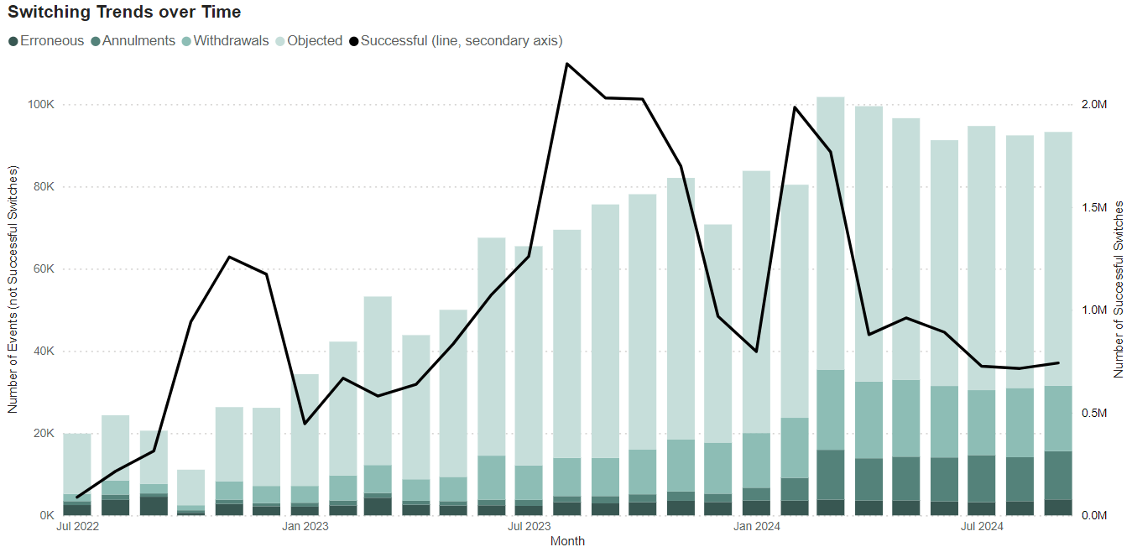
Latest insights on Party Performance
Domestic Supply
Figure 1 – Switching trends amongst domestic customers.

Slide 14
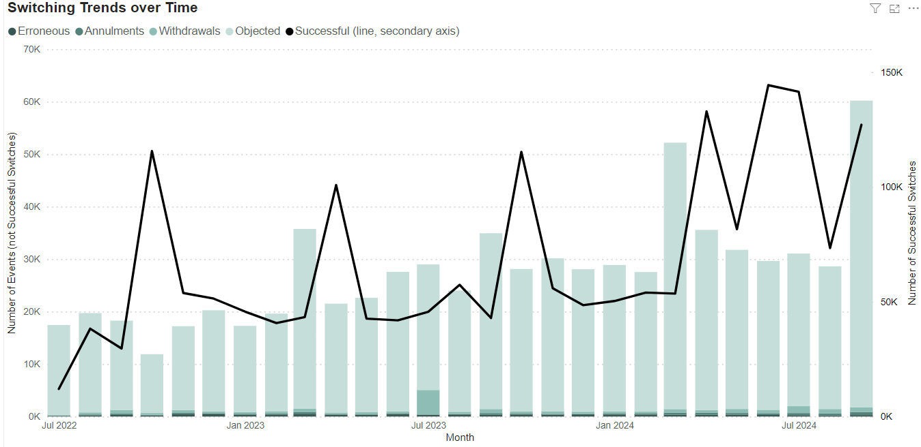
Latest insights on Party Performance
Non-Domestic Supply
Figure 1 – Switching trends amongst non-domestic customers.

Slide 15
Latest insights on Party Performance
We have issued PATs to Parties who have performance risks identified by specific Risk Drivers. These insights are based on the latest industry data available (September 2024).
On average, 1.66% of risk driver measurements were over the PAB threshold in September, a decrease from 2.75% in the previous month. We note that the majority of this movement can be attributed to a lower number of Parties being over threshold for Risk Driver 6.1 (Failure of DNO to process Meter Point Location updates for Registered Meter Point Records).
We have noticed an increase in the number of Parties above threshold for Risk Driver 8.11 (High Objection Rate), Non-Domestic which is expected given this trend appeared last year too and coincides with the contract renewal period for Parties.
Risk Score 8.10 has been at consistent levels across the quarter due to numerous Parties having a very low volume of switches but a higher proportion of objections which may be due to having domestic sites as part of larger I&C portfolio under a single customer contract.
Retail Risk 8 – An enquiry PAT has been issued to one Supplier over the threshold for Domestic Objections, with eleven notifications being sent to the other Suppliers over the threshold for Change of Occupier Objections, Non-Domestic Objections and Domestic Objections for the first time.
Retail Risk 10 – Four enquiry PATs have been issued to the Suppliers who continue to be over the threshold for Risk Driver 10.3 (Data quality issues preventing switching).
Retail Risk 6 – One enquiry PAT has been issued to a Supplier over the threshold for Risk Driver 6.1 (DNO unable to update MPL promptly).

Slide 16
A simpler checklist: Upcoming activities
Party Role | Submit monthly data | Review performance dashboards each month | Review / action quarterly PATs | Data Cleanse 3 in progress | Theft Target Methodology consultation and publication, including targets for next theft year | Party Annual Rating Methodology Consultations | Reporting into PAB on performance
Suppliers
MEMs
DNOs
GTs
Service Providers
Each REC Party has a specific Maintenance of Qualification deadline, and may have specific PATs that they need to complete / adhere to.
Notes:
Discussion around how last quarter went….

Slide 17
6. Suppliers to deappoint unqualified meter operator agents (MOA)
Rec performance assurance team

Slide 18
Unqualified Meter Operator Agents
The Code Manager has reconciled the MOA Meter Participant Identifier (MPID) live in Elexon’s Market Domain Data (MDD) which has identified some MPIDs are live but not qualified under the REC. Therefore, the Code Manager is proposing the following activity to update appointments and end date these within MDD:
In addition to the unqualified MOAs listed above, the Code Manager has been contacted by a Party (OVO Energy Ltd) attempting to exit the market for two of its MOA MPIDs (HYDE, SOUT). The Code Manager will work with the Party to include their portfolio within the activity proposed above to support the market exit process.
DECEMBER 2024:
Notify Suppliers to deappoint unqualified MOAs
JANUARY 2025:
Confirm MOA portfolio is zero
FEBRUARY 2025:
Request Elexon to end-date the relevant MPIDs in MDD w.e.f. February release.
MOA Company Name | MOA MPID | MPAN count
Central Homes & Facilities Management | CHFM | 7
Magnum Utilities Limited | EMSL | 27
Fulcrum Metering Services Limited | MMSL | 96
Syndicate City Limited | MSSL | 42
Amey Metering Limited | NORW | 13
ACTION: All Suppliers must ensure they do not have the above listed MPIDs appointed as the MOA for any MPANs within their portfolio by 31 December 2024.

Slide 19
7. REC Process Maps
REC Technical services Team

Slide 20

overview
Map created for each interface table in REC Schedules, providing supporting information on REC processes
Currently 112 diagrams for live REC
46 for MHHS with some enhancements – due for publication January 2025
Produced in IBM Jazz, extracted in png and saved on a page in the Portal, presented by Schedule
Some improvements made; now seeking other ideas for refreshed set and publication

Slide 21
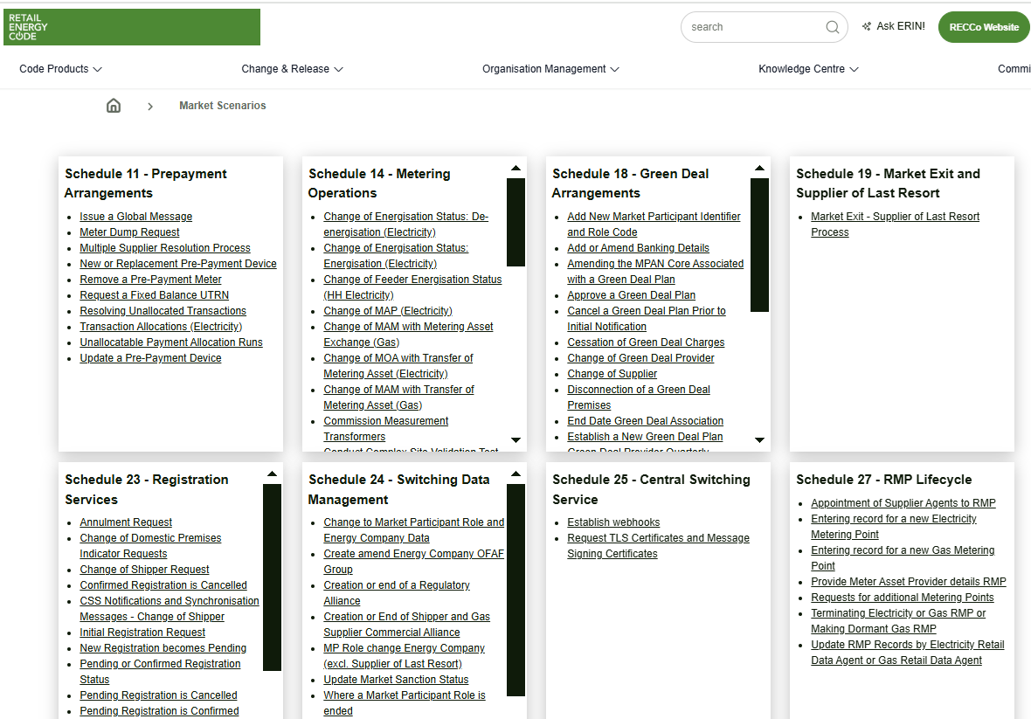
Current portal view

Slide 22
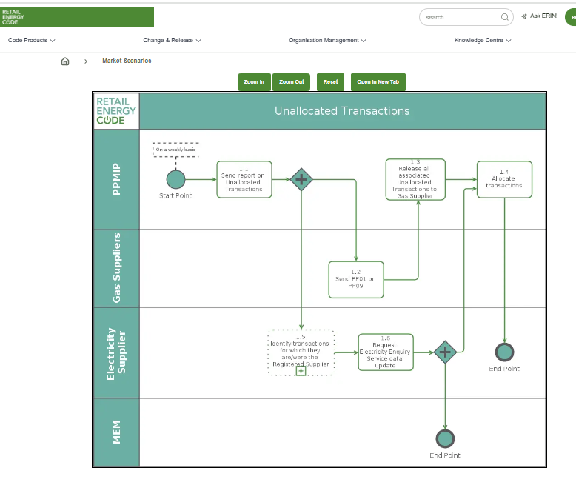
Recent enhancement to view

Slide 23
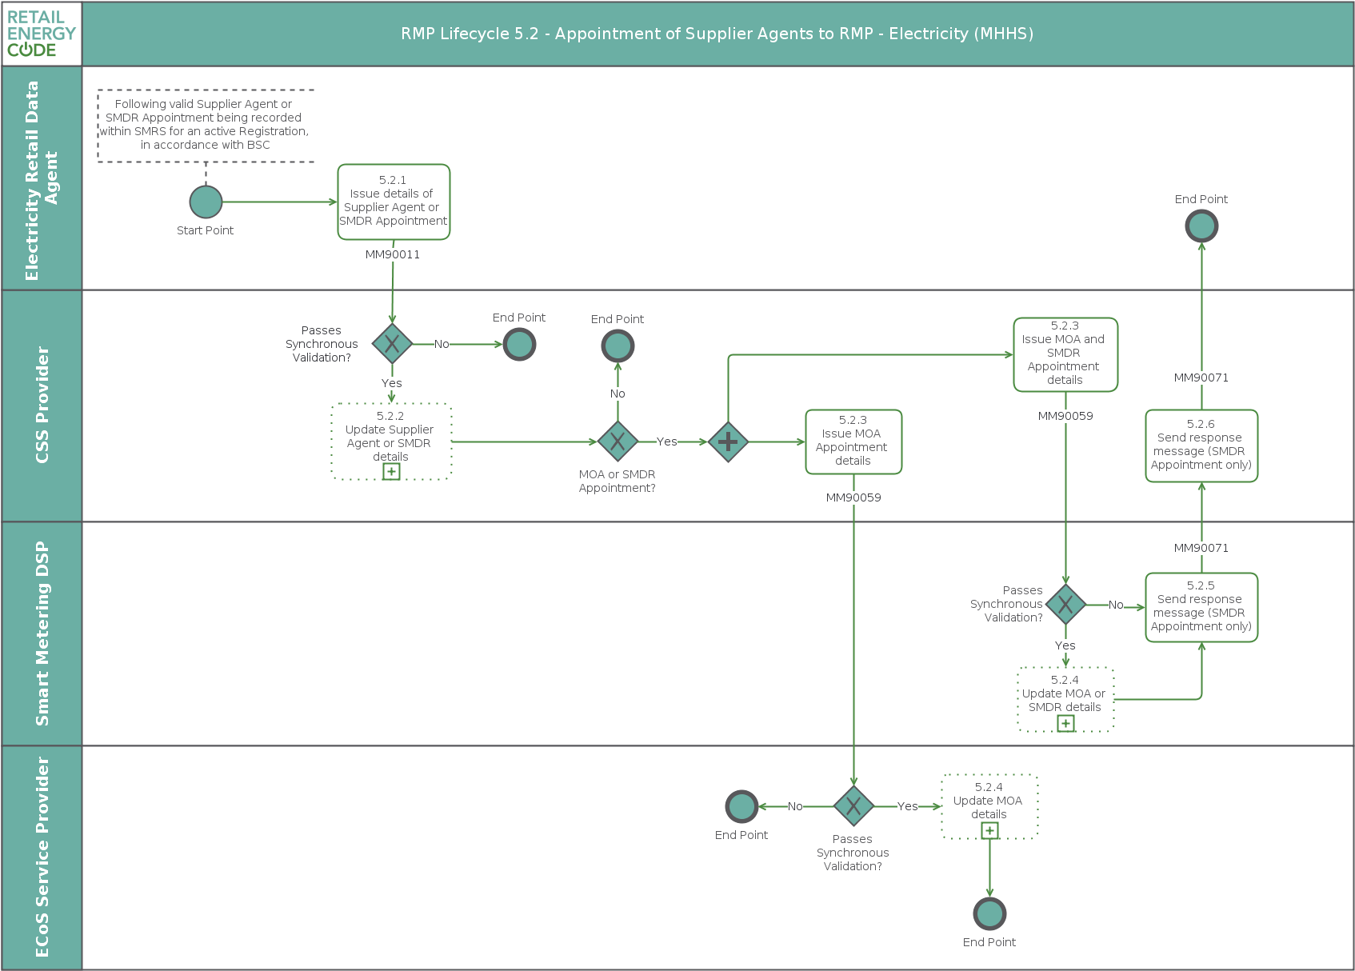
Further enhancements to MHHS versions
- Due for publication in January

Slide 24
Usage and feedback
Updated for releases
Some functional constraints using current tool e.g. can’t add links to documents / Market Messages etc
Customer feedback and Code Manager response:
Manual to search for them – exploring ways to link from Schedule
Too much text on landing page – include legal text section ref in title (as MHHS), potential search function on page, filter by applicable party roles
Legal text and steps in diagram not clearly linked – change to using legal text refs (as MHHS)
Confusion between Market Scenarios / Market Messages – changed to Process Maps
Want more information included – put in MM ref (as MHHS); information / key box; other information e.g. SLAs possible. Want to avoid very busy diagram, and over-complex scenarios; purpose is not to entirely replicate Schedule information.
Useful to know what comes next at the end points – sometimes will be very clear, other times not specified in Schedule or complex to represent in diagram. Useful to go beyond interface table?

Slide 25
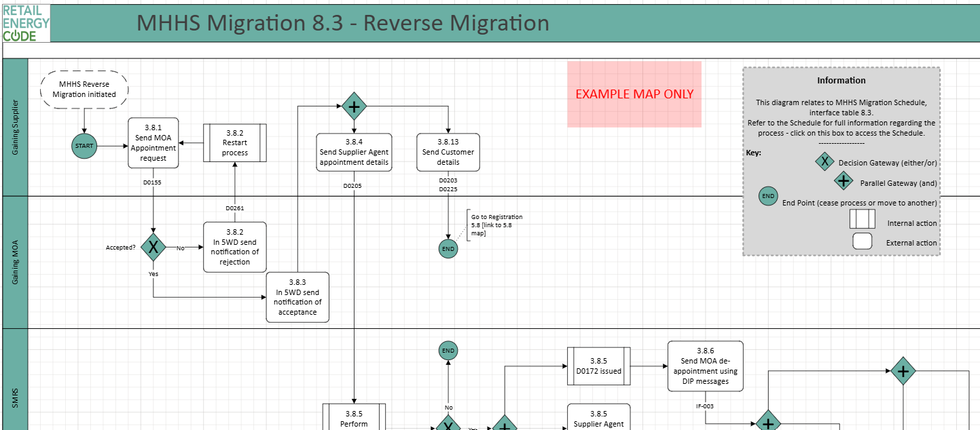
Example map

Slide 26
Rig feedback
Aware of them – yes/no?
Use them – yes/no? What for?
How do you access them?
Any ideas for change?
technicalenquiries@recmanager.co.uk

Slide 27
7. AOB
ALL

Slide 28
Next meeting:
10 January 2025
Thanks for attending

