Slide 1
REC Issues group
14 February 2025

Slide 2
1. Introduction and agreement of agenda
Shelley rouse

Slide 3
Agenda For today
 | TITLE | TIME | LEAD
1 | Introductions and Agreement of Agenda | 10:00 | Chair
2 | Performance Assurance Update | 10:05 | REC Performance Assurance Team
3 | Confidential vs Anonymous Response Education Piece | 10:45 | REC Professional Services Team
4 | Issues Update | 11:00 | REC Professional Services Team
5 | AOB | 11:15 | All
6 | Close | 11:30 | Chair

Slide 4
2. performance assurance update
Rec performance assurance team

Slide 5
For Information: TDIS Updates
Rec performance assurance team

Slide 6
THEFT TARGET Calculations
Theft Target Methodology Change Consultation has closed and the updated Theft Target Methodology (TTM) was published on 7 February.
Domestic Premises Indicator adjustments due date has also passed (7 February).
Code Manager is in the process of applying and verifying theft target calculations for 2025/26 Reporting Year.
Targets will be published before 1 March via the REC Portal (specifically the Theft Dashboard).
Communication will be sent to all Contract Managers/Alternates when targets are available and will also be shared via the REC Bulletin.

Slide 7
For ACTION: Mid-Sprint review and PATs approved by PAB
Rec performance assurance team

Slide 8
Data Cleanse Mid Sprint RevieW
In Sprint 3, we had extended Sprint 2 reports for three months to provide Parties with the opportunity to achieve their Sprint 2 target and introduced new reports that have now been active for three months. As the new Meter Technical Detail reports were released in December 2024, these have not been included in the mid sprint review.
The Code Manager is applying the Performance Assurance Techniques (PATs) approved by PAB at the January meeting in respect of the Sprint 2 extensions. This includes:
  Action Plan PATs for those Parties who have made limited progress and who are responsible for the most significant remaining populations of meter points.
  Management Assertions for Parties who made progress on during the extension for the Energised no MSN report but had cleansed less than 75% of the outstanding population – seeking confirmation this will be addressed prior to the end of Sprint 3.
  Enquiry PATs for the current sprint where parties had made better progress but still had remaining items to resolve (above a de minimus threshold).
In addition, we have contacted Parties in respect of their progress on Sprint 3 Reports.

Slide 9
Data Cleanse Mid Sprint Review
For the Sprint 3 Reports engagement is occurring via OAMs to gain further feedback on the Invalid Topline Report for those Parties where little progress had been made by mid-Sprint (acknowledging that this may in part reflect a ramp up of activity).
We are also keen to hear feedback from MEMs and Suppliers regarding CDSP reports given limited progress:
  Again noting that this may in part reflect a ramp-up of activity particularly given this was the first set of gas reports included in data cleanse.
  The annual nature of this data also hampers cleansing by Parties and impedes Code Manager tracking.
  Feedback during RIG welcome, and also feedback on whether a separate session specifically on this is helpful.

Slide 10
For Information: Data Cleanse
Rec performance assurance team

Slide 11
Report Updates
As discussed at the December and January RIG we have made some changes to the Data Cleanse Reports, these went live this month.
The changes made were:
  Amendments to the cut-off date for new Meter Technical Details (MTD) reports following correction from the MHHS programme of the cut-off for final data extracts for bulk population (new cut-off date is 16/08/24 for ESME ID and 13/09/24 for Location and Number of Register Digits).
  Creation of two versions of the new MTD reports – one for installing supplier and one for current supplier (NB: currently there is very high overlap in these reports).
  Inclusion of a new field (“load date”) showing the first month an item appeared on the data cleanse reports for an initial tranche of reports. Note this is supplier specific (i.e. ‘resets’ on switch). Reports covered:
    (New) MTD Reports
    No Meter MTC Reports
    Plot Address Reports
    Invalid Topline Reports
    MTR Type Mismatch Report
    Energised No Meter Reports

Slide 12
For Information: Potential new Switching Risk Measures
Rec performance assurance team

Slide 13
Potential new Switching Risk Measures
The volume of (competitive) switches continues to increase.
We performed an assessment of the current measurement of switching related risk drivers and the potential to introduce additional measures leveraging the same underlying data.
Our analysis was informed from the results of application of switching related PATs over the past two years.
We identified a number of potential new measures that could be introduced, and presented these to the PAB in December.
We are keen to gain further feedback from parties, including:
  Insight to inform prioritisation – e.g. if you believe the monitored behaviour has impacted your organisation.
  Feedback on potential challenges with the monitoring – e.g. if you believe there may be valid reasons for the proposed measures.

Slide 14
Potential new Switching Risk Measures
Area / Activity | Risk | Measurement Approach | Notes
Change of Occupier (COO) Flag | Gaining party sets the COO Flag when no COO has occurred to avoid objections | Outcome measure based on proportion of completed switches where COO flag set. | Existing measurement focusses on objections to switches by the losing supplier. Measure to be split domestic/non-domestic to align with R0155.
Erroneous Switches | ES occur and impact consumers and other Parties. | Outcome measure comparing relative share of ES and all switches. | The overall level of ES remains low, however previous PA activity has identified issues that did not breach current risk driver thresholds.

Slide 15
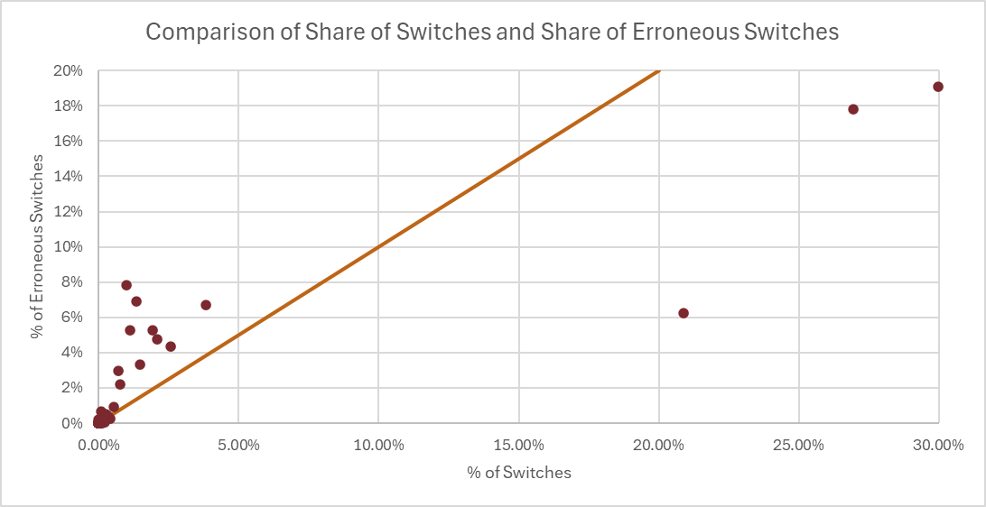
Potential new Switching Risk Measures

Slide 16
Potential new Switching Risk Measures
Area / Activity | Risk | Measurement Approach | Notes
Erroneous Switches | The ES Resolution flag is incorrectly set – potentially in an attempt to avoid objections for a non-ES related switch | Outcome measure based on abnormally long ES resolution timescales. OR Compliance measure based on ES resolution switches and prior registration data. | c. 4% of switches with the ES flag in 2024 had a reported resolution time (based on last recorded registration) of over 2 years.
Objections | Repeated Objections are made by a losing supplier to block a switch. OR Repeated switch requests are submitted by a gaining supplier despite a valid objection. | Outcome measure based on percentage of switches with multiple objections. Separate measures for gaining and losing scenarios. | Of MPxNs with objections, 39% received multiple objections in 2024. Over 14,000 MPxN had more than 5 objections.

Slide 17
For Information: R0155
Rec performance assurance team

Slide 18
R0155 – Change of Occupier: Evidentiary Standards and Timescales
The Authority has approved R0155 on 04 February 2025.
This will be implemented as part of the REC Release planned for 27 June 2025.
The change solution, on steer from PAB, includes assurance before implementation to gain confidence that Parties will be ready to operate in line with the changes to the REC.
  This assurance will be gained via an information request acting as a requalification style review. This will apply to Suppliers with a licence to supply Non-Domestic sites.
  The details of this information request, including the timelines, will be confirmed soon but Parties will be expected to respond by the end of April.
  The information request will ask Parties to demonstrate how they are preparing for the implementation of R0155 and cover the following areas:
    Updates to Internal Operating Procedures and Training
    Internal monitoring and management reporting
  We will provide more detailed communications to help Parties through this process over the coming weeks.

Slide 19
3.confidential vs anonymous response education piece
Rec professional services team

Slide 20
Confidential vs anonymous responses
Current wording:
All responses will be treated as non-confidential unless indicated otherwise. Responses marked as confidential will be shared with RECCo, The Code Manager, Responsible Committee and the Authority (where relevant) but will not be published to REC Parties, Service Providers or wider stakeholders.
Anonymous responses will omit the detail of the submitting Organisation but the content of the response will be published on the REC Portal and provided to the Responsible Committee as part of a Preliminary and/or Final Change Report.

Slide 21
Confidential vs anonymous responses
Proposed new wording:
Responses can be submitted as:
Non-confidential – the full response plus the submitting organisations name and category will be published; or
Confidential – responses will only be shared with RECCo, the Code Manager, the Responsible Committee and the Authority (where relevant) but will not be published to REC Parties, Service Providers or wider stakeholders. Details of the response will not be referenced in any Change Report; or
Anonymous – the full response will be published, but will omit the name of the submitting organisation (organisation category will be published). Details of the response will be referenced in the Change Report, and the organisation name will be shared with RECCo, the Code Manager, the Responsible Committee and the Authority (where relevant).
Organisations can submit the whole response as non-confidential, confidential or anonymous, or flag each question separately as they wish.
All responses will be treated as non-confidential unless indicated otherwise.
The Code Manager recommends that only financials or other commercially sensitive information is submitted confidentially, and that anonymous is used for all other cases where the submitting organisation does not wish to be identified, as this allows the details of the response to be seen in the Change Report and for the Code Manager’s comments to the response to be published.

Slide 22
4.issues update
Rec professional services team

Slide 23
Quarterly update on Issues
46 Issues raised since improvements following Code Manager review was implemented in June
15 at initial assessment
22 at solution development
3 out for Party impact assessment
2 progressed to CP’s
4 withdrawn

Slide 24
Solution Development
These Issues are currently in solution development activities such as information requests, facilitating working groups, progressing Issues through Theft Issues Group, defining and developing through Change Issues Group & Technical assessment.
Issue | Title
I0172 | End-to-End New Connections Process Review to Eliminate Issues Related to New Builds and Similar Situations
I0180 | Clarity on use of on hold for switching issues, including the obligations of CSS Users
I0186 | Non Dual-Fuel Gas PSR Consumer
I0187 | Schedule 8 Review and Best Practice Guidance Development
I0189 | Voice of the Consumer
I0196 | Requiring the Supplier/Shipper to validate and enrich the data from the MEM prior to updating this in CDSP
I0197 | Introducing a process to provide updates during fault resolutions
I0198 | GAS MEMs move towards a single interface for key market messages
I0200 | Improving address management targets
I0212 | Protecting Crimestoppers and their Contacts
I0213 | Creation of a mechanism to allow third parties to report objection activity
I0214 | Multiple Switch Requests Increasing Objection Rate
I0215 | Schedule 30 Switch Meter Reading Problems - Rejections and Timings

Slide 25
Solution Development
Issue | Title
I0218 | Proposal to Enable Broader Use of Retail Energy Location (REL) Data for Non-Switching Applications
I0219 | Stranded RMPs in Defunct Suppliers
I0222 | ESME ID Update Rejections
I0223 | Reconciliation of Unallocatable Transactions Review
I0225 | Clarification on TDIS portfolio transfers on sale
I0232 | Non-Domestic Change of Occupier SDEP Screens (R0155 Solution)
I0233 | Introduction of an Energy Theft Unit (ETU) under the REC
I0234 | Introduction of an energy theft Referral Assessment Service under the REC
I0236 | REC Party Auto de-accession proposal

Slide 26
Impact Assessment
These Issues are currently in Service Provider or Party impact assessment.
Issue | Title
I0179 | Proposal for Limiting Queries in EES API Calls (Single API Call With Multiple Queries)
I0194 | CSS Change to Allow Prevent of Registration by Market Segment
I0224 | Agile Reporting within CSS
Progressed to CP’s
CP | Title
R0168 | Clarify & strengthen CRS Providers requirements
R0193 | Add Enumeration Values to the DI51035 - Communications Provider Data Item

Slide 27
New/ Initial assessment
These Issues have recently been raised and will be assigned to an analyst, or have been assigned to an analyst
and going through an initial assessment. This includes activities to validate/ confirm the Issue such as meeting
with the proposer & Service Providers, consolidated Code Manager assessments and preparation of Change Reports and Change Plans.
Issue | Title
I0174 | Mandating ETTOS Follow up
I0175 | Introducing a Reasonable Endeavours Scheme within the REC
I0176 | Creation of an Energy Theft Detection and Resolution Body
I0190 | Related Meter Point RMP status rules
I0191 | De-energisation of disconnected meters
I0205 | Provision of HH consumption data for Advanced Meter ETs
I0216 | REC Changes to tie in with DCP419
I0227 | Domestic Elective HH Switching
I0228 | ECOES API for Export MPAN Creation at Scale
I0230 | Meter Asset Providers may not receive effective from settlement date (J0049) in the D0303 flow following MHHS design changes
I0231 | Shared Sites in Electricity Enquiry Service (EES)
I0235 | Missing Scenario Variant (DNO to MOA) in D0179
I0237 | Erroneous Switch Review
I0240 | Data alignment of meter information through MHHS Migration
I0241 | MHHS Incremental Changes for Go Live

Slide 28
Withdrawn
Issue | Title
I0184 | Gas Meter Type Code - Thermal Mass Measurement
I0195 | Addition of MEMs to the Gas Enquiry Service (GES) API.
I0199 | A process for resolution of Gas unregistered sites
I0204 | Provision of HH consumption data for Advanced Meter ETs

Slide 29
5. AOB
ALL

Slide 30
Next meeting:
14 march 2025
Thanks for attending

