Slide 1

REC Issues group
12 December 2025

Slide 2
1. Introduction and agreement of agenda
Kev Duddy

Slide 3
Agenda For today
 | TITLE | TIME | LEAD
1 | Introductions and Agreement of Agenda | 10:00 | Chair
2 | Meter Install EFD Prior to MPAN Creation EFD | 10:05 | RECCo
3 | Performance Assurance Update | 10:25 | Code Manager
4 | Hard to Find Meter Locations | 10:55 | Code Manager
5 | AOB | 11:15 | All
6 | Close | 11:30 | Chair

Slide 4
Housekeeping
Competition Act compliance
Meeting is recorded
Free discussion of ideas
Any other AOB?

Slide 5
2. Meter Install EFD prior to MPAN creation EFD
recco

Slide 6
Meter Install Date Prior to MPAN Creation date LEADING TO Meter update ISSUES 1/2
Background
An issue has been identified through MHHS Early Life Support that where the Meter Installation Date / Time (DI-057) is earlier than the MSID Creation Date some meter update requests via the IF-005 ‘MTD Updates to SMRS’ are being rejected.
This issue impacts Metering Points with legacy meters installed with install dates earlier than 1997, when the existing arrangements were implemented.
The Event Types impacted are Meter Update and Meter History Update
The root cause of the issue is the validation rule REG1011 ‘Meter Install Date Cannot be Prior to MPAN Creation Date’ being applied to existing meters as well as Meter Install events.
This issue does not impact meter exchanges or removals as the removed meter information in the IF-005 does not include the Meter Installation Date.
The issue may impact in excess of 1.2 million Meter Points.
Resolution
The MHHS Programme have provided a suggested workaround where the meter should be removed using the ‘MeterRemoval’ scenario variant and replaced with the updated details using the ‘MeterInstall’ scenario variant. The effective from date would need to be within the MOA appointment period, with the suggestion to use the first date of the MOA appointment period.
St Clements have suggested an SMRS update which would relax the validation on the meter effective from date to only apply it when a
new meter is installed.

Slide 7
Meter Install Date Prior to MPAN Creation date LEADING TO Meter update ISSUES 2/2
RIG Discussion
RIG are asked to confirm if they recommend that ST Clement’s proposed fix to ‘not apply REG1011 where the supplied installation date matches the value already stored in MPRS’ and if so whether this should be prioritised.
RIG are further asked to confirm if they would support RECCo raising a clarification BSC CP to amend the wording around the SMRS validation rules in BSCP 706 to say: ‘Where a new meter is installed the Date of Meter Installation must be greater or equal to the MSID creation date’
Finally, are RIG happy with the proposed workaround of removing and replacing the meter with an EFD of the MOAs appointment date, which is likely to be the MHHS Migration effective from date. This will leave a situation of no meter history existing for legacy.
  Should the workaround be limited to certain material updates? (e.g. removing check meters)
  Are there any other possible workarounds RIG would like considered?
Next Steps
RIG recommendation and level of prioritisation to be provided to St Clements.
Any recommended BSC CP to be raised by RECCo.
Formal REC guidance on the work around to be considered.

Slide 8
3. For Information: Performance Assurance Update
Andrew waghorn

Slide 9
4. Hard to find meter locations
Code manager

Slide 10
hard to find meter locations (1 of 2)
Common issues with finding the meter location are:
  Identifying the correct meter in a large bank of meters.
  Accessing the meter at Commercial buildings where the meter is after a Security check point.
  Finding the meter at Retail/industrial parks or other blocks of flats where the meter location is not obvious or hidden.
Failed Metering Appointments cause…
Increased time and effort
Negative customer experience
Additional cost

Slide 11
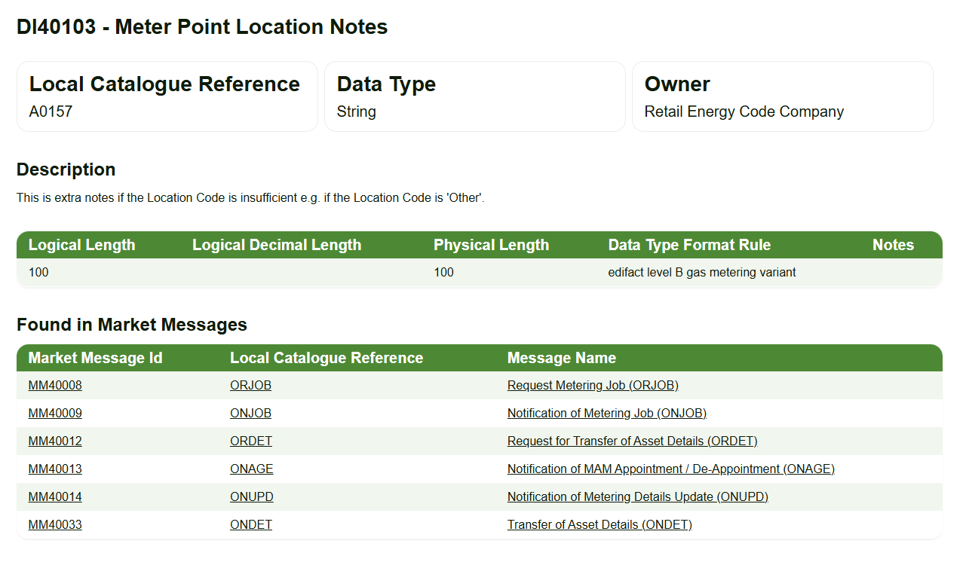
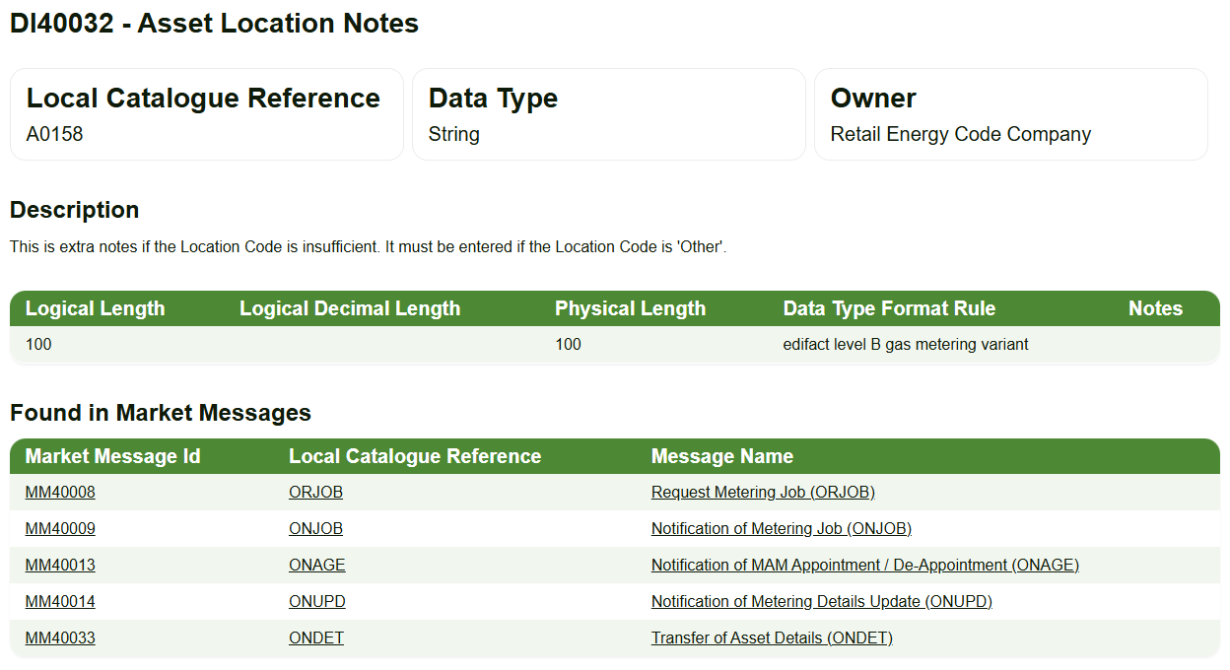
hard to find meter locations (2 of 2)
Gas Flows do have free text fields to pass additional information to share access or location information, but it is not widely used.
Electricity flows – No free text field to provide more information
How do RIG Members currently mitigate against failed appointments in this context?

Slide 12
5. AOB
ALL

Slide 13
thanks for attending
Next meeting:
09 January 2026

