Slide 1
REC Issues group
13 February 2026

Slide 2
1. Introduction and agreement of agenda
Kev Duddy

Slide 3
Housekeeping
Competition Act compliance
Meeting is recorded
Free discussion of ideas
Any other AOB?

Slide 4
Agenda For today
 | TITLE | TIME | LEAD
1 | Introductions and Agreement of Agenda | 10:00 | Chair
2 | Performance Assurance Update | 10:05 | Code Manager
3 | Inconsistent Use of ‘Metering Point Address Line 1’ | 10:35 | Code Manager
3 | Inconsistent Use of ‘Metering Point Address Line 1’ | 10:35 | Code Manager
4 | RIG Terms of Reference (ToR) and Improvements | 10:45 | Code Manager
5 | Data Error Management – Newly Established Process | 10:55 | Code Manager
6 | AOB | 11:05 | All
7 | Close | 11:15 | Chair

Slide 5
Outstanding actions
Action Ref | Details | Owner | Date Raised | Target Completion Date | Updates provided to RIG Members | Status
RECRIG_26_0109_05_01 | The Code Manager to draft changes to the Terms of Reference and circulate before the next RIG meeting for comments. | Code Manager (KD) | 09/01/2026 | 13/02/2026 | Draft RIG Terms of References circulated with the pre meeting papers for Feb meeting | Propose to Close

Slide 6
2. For Information: Performance Assurance Update
Code manager

Slide 7
Sprint 5 Updates
Report Changes
ESME ID Report modified to only include enrolled SMETS1 meters
Guidance updated to reflect this change, and to assign primary responsibility for cleansing based on meter type (S2 = Installing, S1 = Current). Both suppliers will continue to receive the report.
MHHS Indicator will be added to all electricity reports from March onwards.
Mid-Sprint Review
Mid-sprint review taking place based on this month’s files / position
We will compare progress to sprint target to assess if progress is broadly on track
Communications will be issued to contract managers

Slide 8
860 / 861 Data Submission
Reminder 860 / 861 files mandatory monthly submission for MEMs
Reminder – file encoding must be UTF-8 (not UTF-8 BOM) and field names must match specification. Sample file available on portal (Organisation Management -> Useful Documents).
Validation has been amended to set the following fields to mandatory only where an MSN is provided:
  Meter Type
  Meter Asset Provider ID
  Number of Register Digits
  Date of Meter Installation
PARC update will be made to reflect this – timing tbc
Some reports of validation only returning first error – under investigation by the Portal team.

Slide 9
3. Inconsistent use of “Metering Point Address Line 1”
Code manager

Slide 10
Inconsistent use of “Metering Point Address Line 1”
Use of Address Line 1 to record and share Building Network Operator (BNO) information.
Building Network Owner (BNO)
Metering Point Address Line 1 shall be a Free Text field, subject to the following:
LANDLORD, PLOT or FLAT being utilised
where the presence of an organisation name would assist in positive identification of the Metering Point Address, and is not present elsewhere in that address, it may be entered in Metering Point Address Line 1 (e.g. “PLOT 1 Barratt Homes”);
V1.0 2.2 states that:
The Energy Market Data Specification Address Population Rules
An organisation that owns and/or operates the electricity distribution network within a multi occupancy building between the intake positions and the customers installations.
Because the DNO does not manage these assets, it is a useful piece of information for relevant Parties (MOA, Supplier, DNO) to be aware of to support the consumer.

Slide 11
Inconsistent use of “Metering Point Address Line 1”
Would parties find it helpful in day-to-day operations if the BNO information is provided?
Is there a preference as to where this information is provided?
Do parties feel that a change to the guidance surrounding address line 1 is required for more explicit use?
Is there an issue with using Address Line 1 in this way?

Slide 12
4. Rig terms of reference (toR) and improvements
Code manager

Slide 13
Terms of Reference
Comments requested before the meeting
Subject to no comments/discussion, these will be updated on the Portal following the meeting
Based on feedback at the January meeting via Slido, changes were drafted
Draft ToRs circulated with the pre meeting papers.

Slide 14
5. Data error management – newly established process
Code manager

Slide 15
Data error management – newly formed process
The Performance Assurance Board (PAB) identified a lack of clear process for logging, resolving, and tracking industry data issues under the REC. The Data Error Management process has been designed to address this gap.
The Central Data Error Resolution Log introduces a clear and consistent approach for recording, managing, and monitoring industry data issues. It acts as a single source of truth, improving transparency and visibility across all data‑related concerns.
A wide range of industry data is managed through REC processes, directly affecting the operations of stakeholders and consumers. Establishing a robust mechanism for tracking data issues supports effective resolution management and enhances confidence in data quality.
The Central Data Issue Log will consolidate all submissions made via the portal, including newly raised issues and existing issues shared for visibility.

Slide 16
Data error management – newly formed process
Existing Issues
Newly identified data errors that are not suitable to be managed or resolved in established resolution processes
New Issues
Already being managed through established resolution processes.
To be submitted for inclusion into the log to ensure wider visibility and comprehensive tracking.
New submission acceptance criteria does not apply to these entries.
Need investigation to determine the root cause and appropriate resolution pathways.
The new submission acceptance criteria does apply to these entries.
  Data Error Management wiki page
  REC Webinar: Data Error Resolution Management Process (25 February 2026) - 2026-02 (February) - REC Portal

Slide 17
6. AOB
ALL

Slide 18
6.1. The central switching service reprocurement/extension options feedback
dcc

Slide 19



DCC Procurement Feedback
Procurement
Slido
#8566998

Slide 20
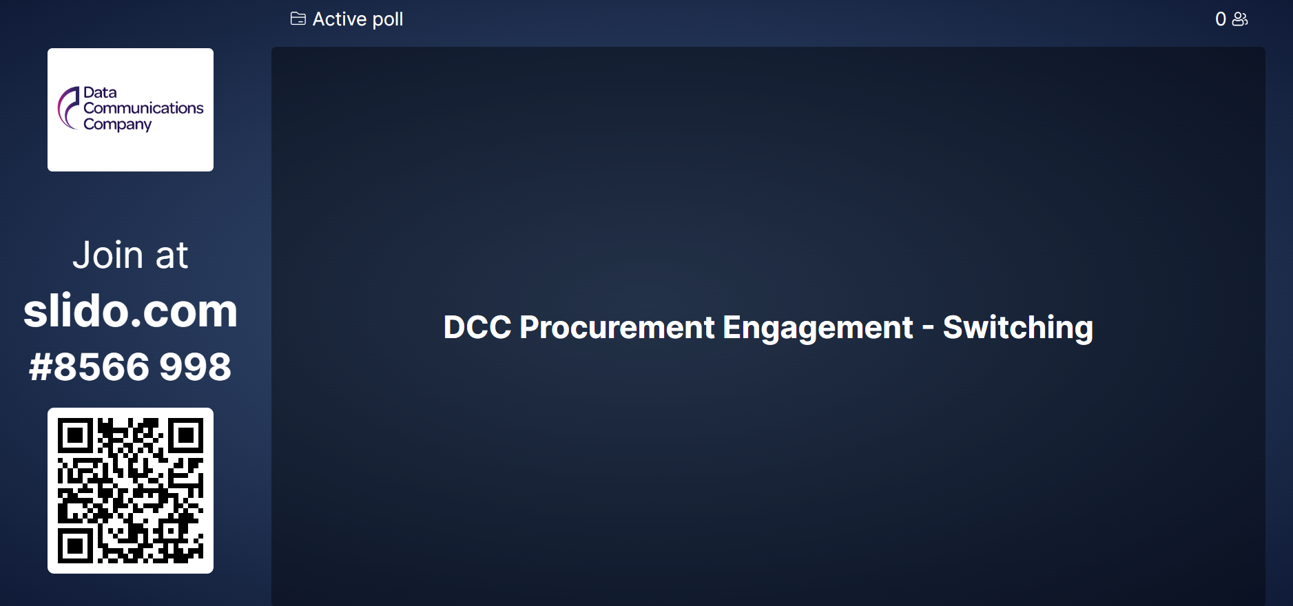
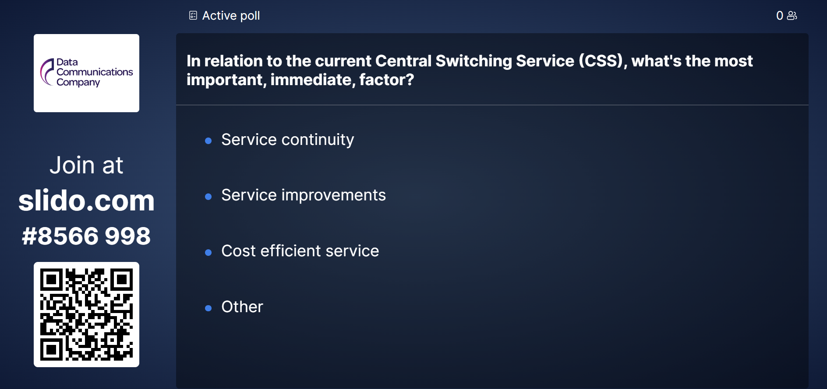
DCC Procurement Feedback
Summary
As we prepare next steps in re-procuring/extending the Central Switching Service's, we want to ensure future arrangements are shaped by what matters most to our stakeholders and users. This short survey is an opportunity for you to share your experience, priorities, and any improvements you would like us to consider.
Your feedback will directly inform our approach and help us reflect any short term or strategic improvements we should consider, whilst continuing to provide the strong, consistent service we provide to industry today.
Slido
#8566998
Slido
#8566998

Slide 21
thanks for attending
Next meeting:
13 March 2026

