Slide 1
REC Issues group
12 June 2026

Slide 2
1. Introduction and agreement of agenda
Kev Duddy

Slide 3
Housekeeping
Competition Act compliance
Meeting is recorded
Free discussion of ideas
Any other AOB?

Slide 4
Agenda For today
 | TITLE | TIME | LEAD
1 | Introductions and Agreement of Agenda | 10:00 | Chair
2 | Address Prioritisation Matrix Invalid Postcode | 10:05 | Code Manager
3 | Performance Assurance Update | 10:25 | Code Manager
4 | Last Inspection Date | 10:40 | Code Manager
5 | Energy Digitalisation Framework | 10:50 | NESO RECCO
6 | Key Callouts | 11:10 | Code Manager
7 | AOB | 11:20 | All
8 | Close | 11:30 | Chair

Slide 5
Outstanding actions
Action Ref | Details | Owner | Date Raised | Target Completion Date | Updates provided to RIG Members | Status
RECRIG_26_0213_03_01 | The Code Manager agreed to review previous work on Address Line 1 population and industry guidance, to assess whether the guidance should explicitly allow or prohibit BNO entries. | Code Manager | 13/02/2026 | 12/06/26 | A Working Group for I0200 'Review of the REC's Address Management Service' has been scheduled for 11 June, agenda and meeting slides are available on the REC portal. | Open
RECRIG_26_0213_03_02 | The Code Manager also agreed to investigate historical change proposals relating to BNO identification and republish the link to the address guidance in the next meeting papers. | Code Manager | 13/02/2026 | 12/06/26 |  | Open
RECRIG_26_0213_05_01 | The Code Manager and RECCo to provide guidance on the new Data Error Management Issue Log process and how/where REC Parties can interact with it. | Code Manager/RECCo | 13/02/2026 | 12/06/26 | An update will be provided at the meeting on 12 June 2026. | Open

Slide 6
Outstanding actions continued
Action Ref | Details | Owner | Date Raised | Target Completion Date | Updates provided to RIG Members | Status
RECRIG_26_0213_05_02 | The Code Manager and RECCo to provide clarification on the objective and requirement underlying the introduction of a Data Error Issue Log separate to the existing Change Process - Issue Log | Code Manager | 13/02/2026 | 12/06/26 | An update will be provided at the meeting on 12 June 2026. | Open

Slide 7
2. Address Prioritisation Matrix Invalid Postcode
Code manager

Slide 8
Address Prioritisation Matrix Invalid Postcode
Problem
R0283 Annual Address Management Plan Updates introduced the concept of the Address Prioritisation Matrix (APM).
Electricity invalid postcodes to be populated in the matrix first.
Timetable
Overview
DCC had been making progress resolving address data issues, but they recognised the REC had no mechanism to clearly establish Code-level targets for address improvement, or overall market performance.
Trial has been taking place to enhance the DCC data to allow targeted improvements.
DCC AQP set out invalid postcodes and plot addresses as key areas for improvement.
Pending discussions at CHIG and RIG.
Electricity data was enhanced using EES data.
Current plan is 3-week consultation June-July with decision expected July 26 PAB and go live either Aug or Sept 2026.

Slide 9
Address Prioritisation Matrix Invalid Postcode – questions to consider today
Questions
Feedback on the data items used to enhance the data;
Feedback on the suggested reporting categories;
Feedback on the prioritisations;
Any recommendations for SLAs; and
Feedback on expected implementation date.

Slide 10
APM –Electricity Invalid Postcode – data enhancement
Data item | Reason for exclusion | Reason for inclusion | Lower priority
Trading Status | Exclude any new or terminated MPANs as will not trigger a match | Include Traded MPANs as these do trigger a REL match
Trading Status EFD |  | Included to establish how long MPAN has been Trading
Connection Type | Unmetered on unlikely to have an OS address | Whole Current as less likely to know their own MPAN | HV, LV EHV as more likely to know their own MPAN
Meter type | n/a | Split out by smart meter, dumb meter, AMR meters | No meter – assume more work required in general before meter can be installed
Meter Installation date |  | Establish how recent the New Connection is and if someone has been able to find the property recently
Energisation Status | n/a | Split by Energised and De-energised | De-energised
Domestic Premise Indicator (DPI) |  | Split by Domestic and Non-Domestic
Profile Class |  | Group into PC1&2, 3&4 | PC5-8 as more likely to know their own MPAN
Energisation Direction |  | Split by Import and Export
Current Energy Supplier MPID |  | Split by Energy Supplier
Current Energy Supplier EFD |  | To establish if MPAN has Switched recently (looking at the other EFDs)
DNO MPID

Slide 11
APM –Electricity Invalid Postcode – trial
Initial reporting split
Feedback and Findings
Data split | What is it
Older non-SMETS | Trading, Whole Current, Energised only - PC1-4, non-SMETS meters. At least 3 years since MPAN started trading
Older SMETS | Trading, whole current, Energised only - PC1-4 and export, SMETS meters At least 3 years since MPAN started trading
Newer all | New Connections, Energised, meter fitted only and includes export MPAN trading for less than 3 years
2nd file – newer all | New Connections not in original file
2nd file – Not New Connection | Older PC1-4 not in the original file
2nd file – PC1-4 | AMR or Half Hourly meters
PC5-8 and HH | Should be AMR but includes some SMETS meters
Finding | Reason | How can it be taken forward
Energy Supplier input is key | As the volumes are so high, both Parties recommended including Energy Suppliers in the trial | Recommendation for round 1 of the APM
Different updates | Each Party provided their updates in different formats | APM round 1 and subsequent consultations will include a template with set outcomes and updates to allow simpler reporting.
New Connections takes care of itself | There is a timing issue with the PAF that can mean some of the postcodes do become valid. Also, BAU new connections processes mean the address is updated relatively quickly | Look at deprioritising new connections up to 1 or 2 years following the meter installation. I0200 will investigate the BAU process for new connections addresses to make sure it is as effective as possible.
Continue to separate by SMETS meter installation | MPANs with a SMETS meter installed were easier to update and less likely to require Energy Supplier input | Enhanced data to provide separate reports based on SMETS and non-SMETS.

Slide 12
APM –Electricity Invalid Postcode – stage one – top priorities
Priority Category | Name | What is it? | Reason for recommendation
1 | SMETS | MPAN Trading more than X years Whole Current connection SMETS Meter installed | Consumers have more tariff options available (Export, time of use etc) Feedback from trial showed these were “easier” to resolve
2 | Non-SMETS | MPAN Trading more than X years Whole Current connection, Non-SMETS Meter installed (K, N, T, S, NSS) | Improved MPL available when Smart Meter installation is booked Consumer Switch process smoother
3 | New Connections SMETS | MPAN Trading less than X years Whole Current connection SMETS Meters only | Change of Occupier from developer to Consumer more likely to have occurred so Switch more likely Consumers have more tariff options available (Export, time of use etc) Date of Meter installation can be used to filter out newer instances as BAU activity likely to resolve these
4 | AMR | MPAN Trading more than 2 years Whole Current connection AMR meters only (includes H Meter Types which may be Domestic / Microbusiness) | Consumers have more tariff options available (Export, time of use etc) Can include Domestic / Microbusiness usage
5 | New Connections AMR | MPAN Trading less than X years Whole Current connection AMR Meters only | Consumers have more tariff options available (Export, time of use etc) Can include Domestic / Microbusiness usage

Slide 13
APM –Electricity Invalid Postcode – stage one – lower priorities
Priority Category | Name | What is it? | Reason for recommendation
6 | Older not Whole Current | MPAN Trading more than X years Not Whole Current Connection Type All Meter Types | Consumers have more tariff options available (Export, time of use etc) Can include Domestic / Microbusiness usage
7 | Older Whole Current no Meter | MPAN trading more than X years Whole Current connection No Meters installed | Potentially pending Disconnection If the MPAN is not pending Disconnection, updating the MPL will help when Consumer requests a Meter
8 | New Connections not Whole Current | MPAN Trading less than X years Not Whole Current Connection Type No Meter installed | Potentially BAU processes will resolve Consumers have more tariff options available (Export, time of use etc)
9 | Older not Whole Current no Meter | MPAN Trading more than X years Not Whole Current Connection Type No Meter installed | Potentially pending disconnection If the MPAN is not pending Disconnection, updating the MPL will help when Consumer requests a Meter
n/a | New Connections x years no Meter | MPAN Trading less than X years Whole Current Connection Type No Meter installed | Potentially BAU processes will resolve
n/a | Has UPRN | EES data has a UPRN that does not start 999. | Not worked as expected timing issue. MPANs to be passed back to DCC for investigation
n/a | Not Trading | MPAN is Disconnected, New or Registered | REL obligations do not apply. Disconnected expected to be de-activated so timing issue

Slide 14
APM –Electricity Invalid Postcode – suggested outcomes
Outcome Status | What is it?
Postcode only updated | Postcode updated but the rest of the address remains unchanged
Postcode and address updated | Postcode and address updated
Address only updated | Postcode unchanged and rest of the address updated
Postcode valid - on PAF | Timing issue - postcode is now on Royal Mail database
Postcode valid - non PAF | Non postal address so will never be on Royal Mail database. Does not need Energy Supplier input
Require Energy Supplier support | Recognise address is not correct but do not have enough data to correct it. Require Energy Supplier to provide their view of the address to carry out additional analysis Note that this is not expected to be used in stage one as the Energy Supplier data is provided up front
Disconnected | Timing issue - MPAN now disconnected so no address update required
DNO UPRN available | You hold a valid UPRN. Please provide it to help DCC match to Ordnance Survey

Slide 15
APM –Electricity Invalid Postcode – suggested slas
Party Type | Minimum SLA | Reason for the minimum
Energy Suppliers – round 1 | 10 Working Days | Energy Suppliers are not being asked to analyse the data, just provide what billing address data they have. Expectations are this could be via a script / automated request. Note this was in place via MRA MAP09 ahead of CSS go live.
DNOs / IDNOs | 20 Working Days | MPAN level analysis will be required. This could be set based on number of MPANs or set at a company level. Could also set a longer SLA for round one as this will have the higher volume and include the Energy Supplier data. DNO that took part in the trial was able to check over 7000 MPANs within this time period.
Energy Suppliers – round 2 | 10 Working Days | MPAN level analysis will be required but expectations are volumes will be low as most of the data has been provided in round 1.

Slide 16
3. For Information: Performance Assurance Update
Code manager

Slide 17
Updates to Reports
The field GSP has be added to the below reports:
  Invalid MAPID Current
  Invalid MAPID Installing
  Plot Addresses
  Plot Addresses D
A new report “Disconnected Active MPANs” has been created, containing Terminated MPANs with a Supplier. It has the below criteria:
  RMP Status = T
  Current Supplier is Populated

Slide 18
Sprint Updates
Sprint 6 Scope
June is the first month of Sprint 6, which will run until November. Sprint 6 includes the below reports:
  Energised no meter – Target: Reduction of pot value to zero, excluding MPANs that have been energised within one month of the close of sprint
  Invalid Topline – Target: No more than 20% of the report items over one month old. No items over 2 months old
  Missing Meter Location & Missing ESME ID - Target: no more then 5% of meter points with a date of meter installation under 1 month old and no more then 2.5% of meter points of with a date of meter installation between 1 and 6 months with the meter location or ESME ID not populated.
  Disconnected Active MPANs – Target: No meter points over 30 working days old included in the report.
In parallel we will be continuing to produce the following reports and believe action is taken but is best managed outside the sprint through other PATs:
  MEM-EES Reconciliation Differences
  Gas CDSP Reconciliation

Slide 19
4. Last Inspection Date
Code manager

Slide 20
Optional Inspection date fields in RGMA Data Flows
Optional inspection date fields in RGMA flows mean the central dataset cannot be relied upon to determine last inspection dates or schedule next inspections.
Background:
CoMCoP requires MAMs to maintain and monitor metering equipment in a way that necessitates inspection, with the detail driven by risk, safety legislation and asset management processes.
Risk:
Potential inability to evidence that inspections were completed within required periodicities, despite CoMCoP placing responsibility on the MAM for maintenance and monitoring processes.
Potential mitigation:
Establish an internal inspection evidence register with mandatory last inspection fields; schedule from validated RGMA event dates (install/exchange) where inspection data is missing; reconcile and backfill from work management records; introduce code change to improve population of inspection related fields.

Slide 21
5. Energy Digitalisation Framework
Neso
recco

Slide 22
Problem Statement
The sector needs clearer coordination, transparency, and governance around digital and data‑related change.
There is a need to define, oversee, and align architectural standards, roadmaps, and design decisions to ensure interoperability, reduce duplication, and support efficient whole‑system outcomes.

Slide 23
High level scope
The ask
Purpose
Objectives
Ofgem has requested that NESO undertake an architecture exercise to support the development of a coherent GB digital energy ecosystem.
NESO is working closely with RECCo and Elexon to deliver this work
Diagnose the current fragmentation across digital public infrastructure programmes
Produce a reference architecture that clarifies how these infrastructures interoperate,
Provide immediate, evidence-based recommendations that inform Ofgem & DESNZ’s consultation in 2026
Ensure this work is non‑prejudicial to future governance decisions
Establish a Whole System Digital Architecture Baseline
Define the ‘To-be’ reference architecture
Produce Prioritised Architectural Interventions
Support the case for an enduring function

Slide 24
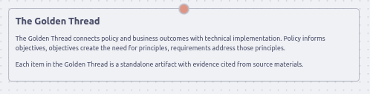
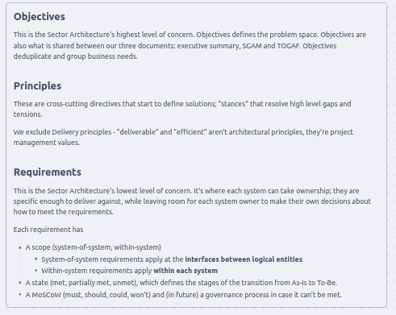
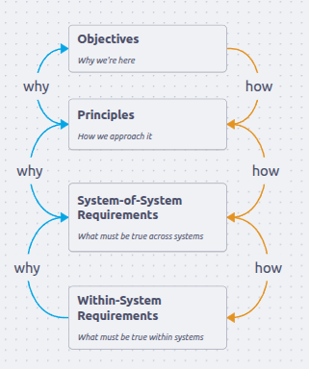
Objectives, Principles, Requirements

Slide 25
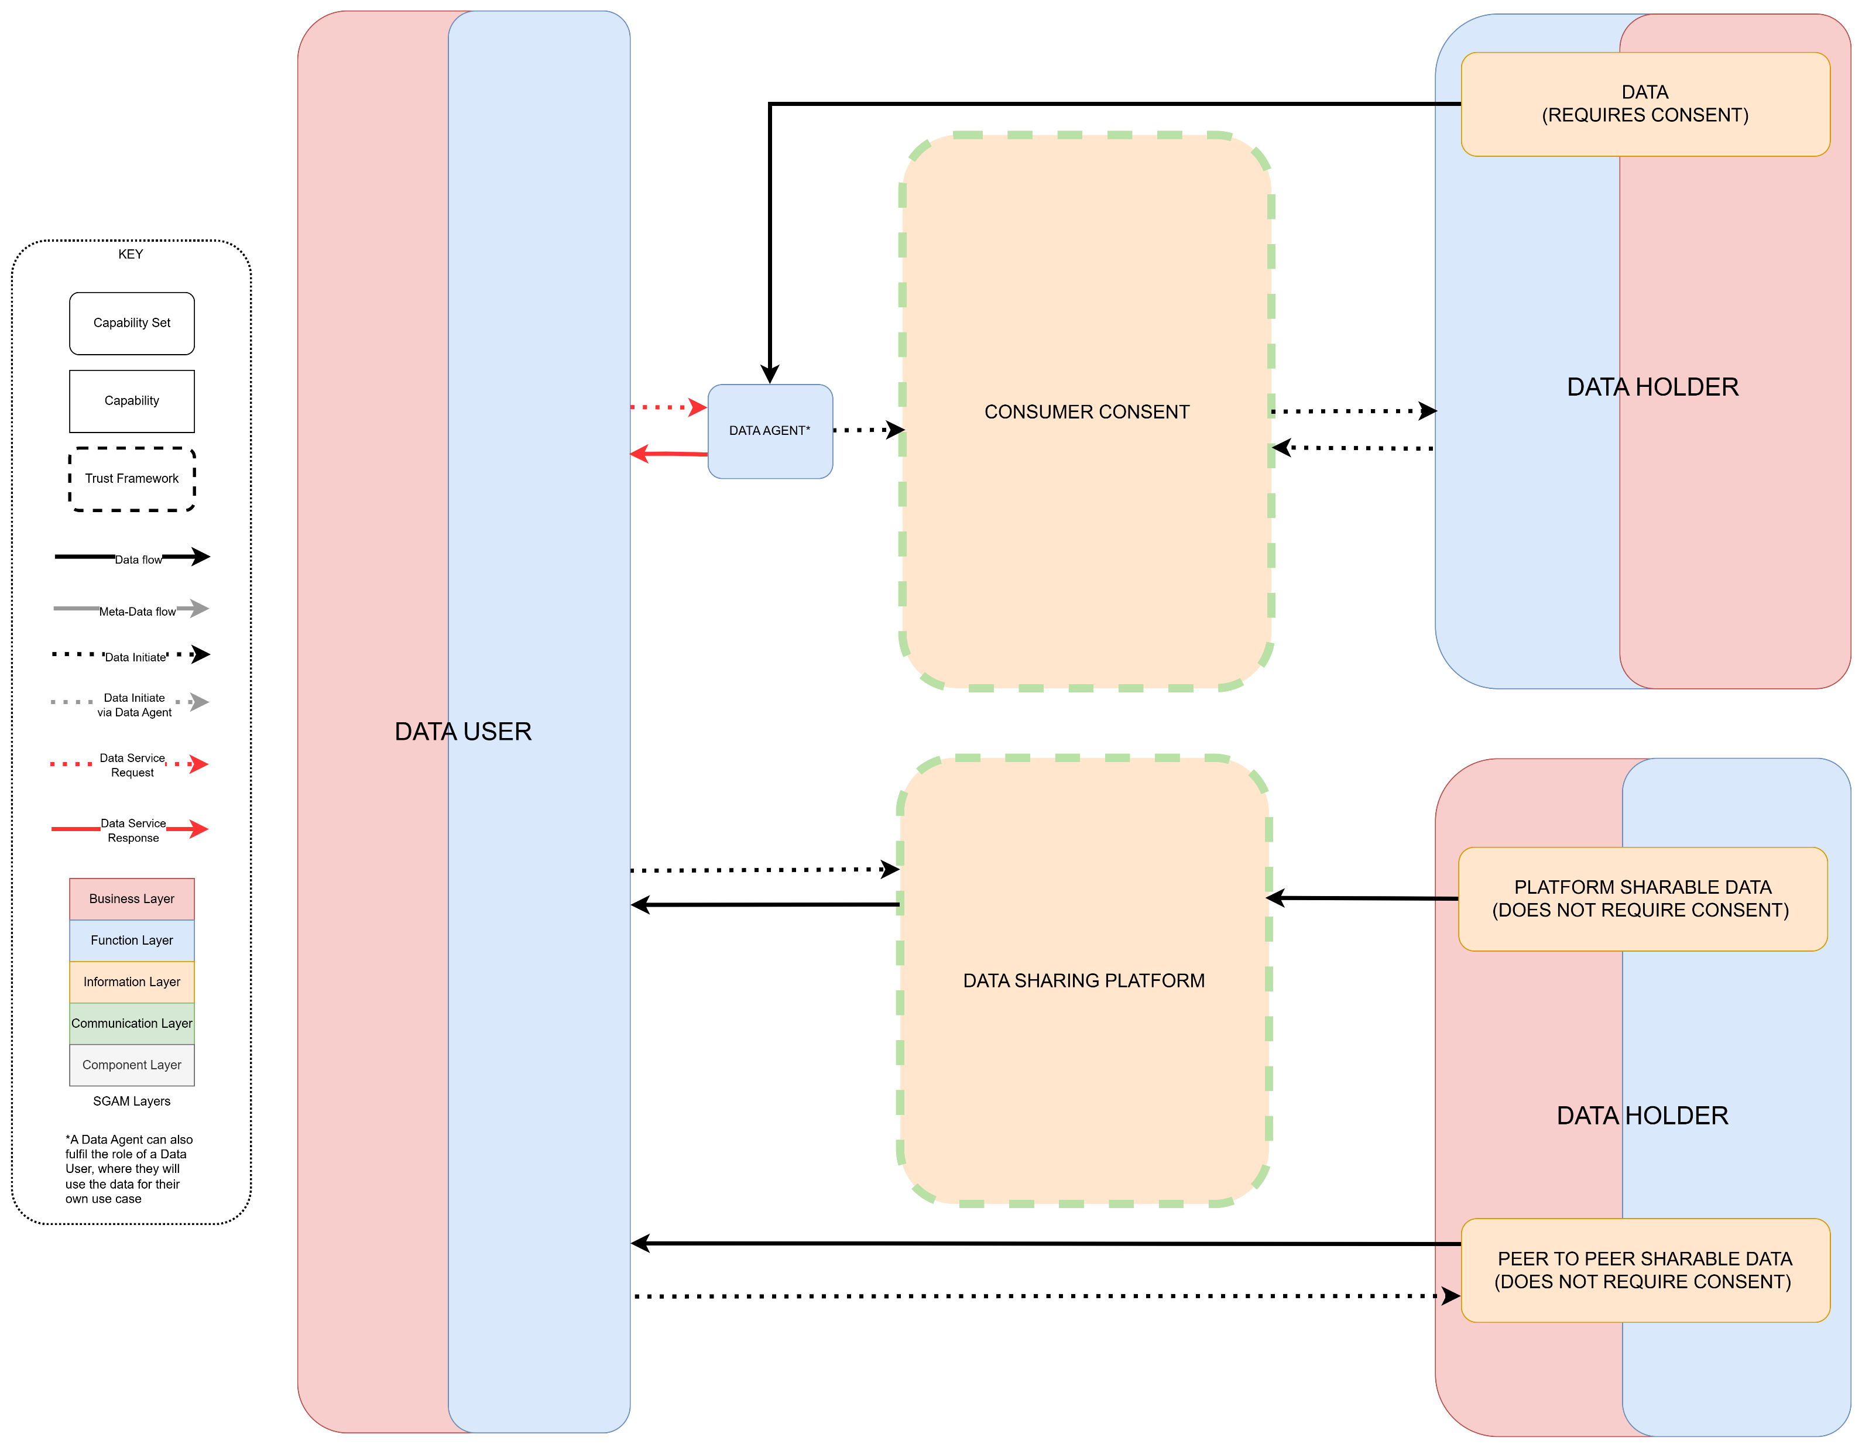
Logical ‘as is’ diagram

Slide 26
6. Key Callouts
Code manager

Slide 27
Key callouts - June
REC Release 26 June 2026 (4.3.0)
13 changes targeted for implementation
Electricity MEM/DNO Contacts refresh
Refresh activity now underway to verify contacts held within the Metering Hub
New and updated MHHS related REC Guidance
Energisation Status Effective from Date discrepancy in EES and SMRS (Supply Meter Registration Service).
The Code Manager hosted a webinar on 03/06/26 to provide an overview of the changes included in the June Release. The recording and slides are available on the REC Portal.
D0150 Guidance for MHHS Reverse Migrations
MTDs for NHH Metering Points, Reverse Migrated from Advanced

Slide 28
REC Working Groups
I0278 – Establishing the Safe Isolation Provider (SIP) as a Standalone REC Metering Party – Meeting 2 | REC Parties / Market Participants | Time and Date
This REC Issue will look to establish a strong governance framework for standalone SIPs, including defining their scope, high safety standards, a streamlined Accreditation, strong qualification and audit processes and building the end-to-end process of this new REC Party. | Limited to max 2 representatives per organisation. Please see the REC Change Bulletin for details on the organisations. | 29 June, 14:00-15:30
I0312 – Review of Export meter work arrangements – Meeting 3 | REC Parties / Market Participants | Time and Date
This REC Issue will look to review the metering arrangements and obligations of Import/Export Suppliers in REC Schedule 14 - Metering Operations, which currently has limited distinction between the activities for Import and Export Metering where there is a shared Metering Asset. The lack of consistent approach across industry in managing meter works and investigations/faults where Import/Export Metering is present can lead to delays in accepting and completing of meter works, and updating of Supplier/industry records. | Energy Suppliers, MOAs, SIPs | TBC

Slide 29
REC Working Groups
I0200 – Review of the REC’s Address Management Service – Meeting 2 | REC Parties / Market Participants | Time and Date
This REC Issue has been re-scoped following the completion of RECCo’s CRS Improvement Plan and the Address Data Quality workstream to address a broader range of address management challenges across the REC, and the wider industry Code requirements. The working group will support the solution development, providing a collaborative forum for stakeholders to contribute expertise and insights on address related issues, help shape practical and enduring improvements to current processes and The first working group meeting took place on 11 June 2026. | All REC Parties | TBC

Slide 30
7. AOB
ALL

Slide 31
thanks for attending
Next meeting:
10 July 2026

