Slide 1
REC Issues group
14 August 2026

Slide 2
1. Introduction and agreement of agenda
Kev Duddy

Slide 3
Housekeeping
Competition Act compliance
Meeting is recorded
Free discussion of ideas
Any other AOB?

Slide 4
Agenda For today
 | TITLE | TIME | LEAD
1 | Introductions and Agreement of Agenda | 10:00 | Chair
2 | Performance Assurance Update | 10:05 | Code Manager
3 | SDEP – Contract Manager Escalations | 10:10 | Code Manager
4 | Switch Meter Readings in MHHS | 10:25 | Chris Sercombe - EDF
5 | Changes to Settlement Timetable – Impacts on Downstream Processes | 10:40 | Code Manager
6 | The Enquiry Service Evolution | 10:55 | RECCo
7 | Key Callouts | 11:10 | Code Manager
8 | AOB | 11:15 | All
9 | Close | 11:30 | Chair

Slide 5
Outstanding actions
Action Ref | Details | Owner | Date Raised | Target Completion Date | Updates provided to RIG Members | Status
RECRIG_26_0612_07_01 | The Code Manager to develop guidance to standardise the missing meter exchanges process. | Code Manager | 12/06/2026 | 14/08/2026 | Guidance document has been published on the Useful Documents page on the REC portal. Direct link can be found here. | Open

Slide 6
2. For Information: Performance Assurance Update
Code manager

Slide 7
3. Sdep – contract manager escalations
Code manager

Slide 8
SDEP - Contract manager Escalations
Issue raised: An inconsistent Contract Manager Escalation process.
Background and Context:
A party has raised frustration that Contract Manager (CM) Escalations are not following a consistent process.
They experience multiple approaches:
    CM will ask that the relevant team action the linked SDEP case without responding,
    CM do not respond or action at all,
    Parties escalating to the Code Manager after the 5WD prescribed in Schedule 30
    Parties will continue to chase escalations multiple times without escalating to the Code Manager.
    Parties will not escalate to the correct CM within the Organisation
The party flagged that the frustration is partly due to delay in resolution to the escalation, but the main frustration was the non-communication translating to no information being passed on to the end consumer.
Subject for discussion:
The party would like to understand if there is appetite in the industry for the following:
    Should there be an obligation for receipt of an escalation?
    Should the guidance be prescriptive to how many times an escalation should be raised to a Contract Manager before it’s escalated to the Code Manager?
    Is there a need to review the escalation guidance in Schedule 30?

Slide 9
4. Switch meter readings in MHHS
Rig member

Slide 10
Issues with Cumulative and Time of Use Register Readings
SUmmary
MHHS has changed how Switch Meter Readings are obtained and agreed, including processes within Section C (Switch Meter Reading Problems) of REC Schedule 30: Resolution of Consumer Facing Switching and Billing Issues.
As a result, MHHS Settlements Processes for switching use Cumulative Readings.
However, as we understand it, the majority of Electricity Suppliers still bill using time-of-use register readings. A such there is a need to agree Disputed and Missing Switch Meter Readings at a register level.
REC Schedule 30 only requires Electricity Suppliers to agree on the Cumulative reading, with agreeing register-level readings optional within the process
DISCUSSION POINTS
Industry Process
Market Messages
SDEP Updates
Aligned Supplier Approach
Current industry process requirements do not specify that Suppliers must give both types of read, however for billing accuracy it is vital.
In the event of a dispute or missing read flow it is important to have a view of both cumulative and time of use reads when agreeing to a reading to be used for customer billing by both suppliers.
It would also support the missing and disputed reads process to have the same information provided in SDEP messages as well as the date and time of the reads taken, as MHHS uses time specific reads.
Aligning the approach to missing and disputed reads across suppliers will support quicker and more effective resolution processes between suppliers as well as more efficient resolution for customers.
01
02
03
04

Slide 11
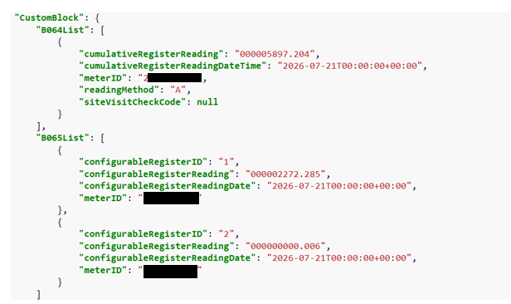
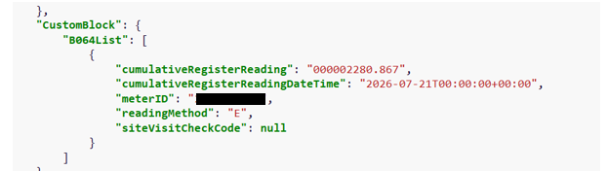
Example Scenario 1:
COS Gain where the supplier has “TO” in dispute but proposing Register read as COS read due to not providing the Registers and TOU in PUB-041 and D300.
Outgoing DSP: PUB-041 Cumulative Read Only
Incoming DSP: PUB-041 Cumulative & Register Read

Slide 12
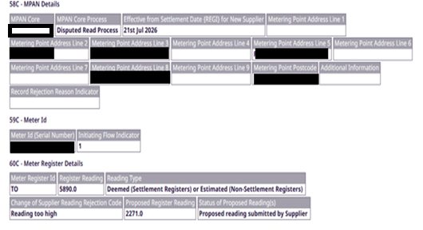

Example Scenario 1:
D0300 using register “TO” to change Switch Reading from Cumulative to Register Reading
Smart Reads

Slide 13

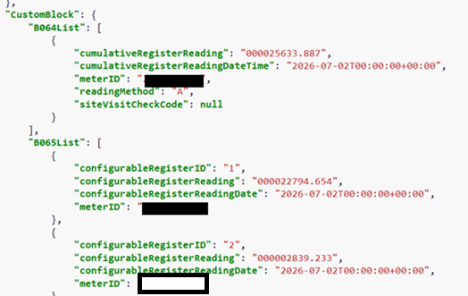
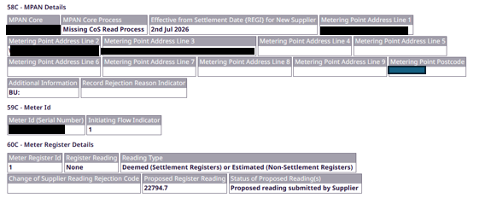
Example Scenario 2:
Incoming DSP providing both cumulative and register level readings.
Smart Readings for Switch
D0300 Missing Switch Reading proposing register reading, but nothing for cumulative reads

Slide 14
5. Changes to Settlement timetable – impacts on downstream processes
Code manager

Slide 15
Changes to settlement timetable
Electricity Settlement Timetable is scheduled to reduce to 7 months.
Background
As part of the wider MHHS programme, the Electricity Settlement Timetable is expected to reduce from 12 months, down to 4 months.
The first phase, scheduled in October 2026 with an expected implementation of April 2027, will see the timetable reduce from 12 months down to 7 months initially.
Currently, the D0086 'Notification of Change of Supplier Readings’ data flow is used by Data Collectors to provide Change of Supplier readings.
Data Collectors will still be able to issue the D0086 flow but they will not affect Settlement if after 7 months.
Discussion Points
Should there be a concerted effort to clear anything between 7-14 months before October.
Do Suppliers need to make manual adjustments to systems to sort out billing?
Will Suppliers still need the D0086 to be able to bill?
Do Suppliers stop raising disputes after a shorter period (six months for example)?
Is there a need for Suppliers to chase each other for reads?
Do we still raise disputes for up to 12 months ? Knowing any changes we make will not impact settlements for example?

Slide 16
6. The enquiry service evolution
REcco

Slide 17

Friday 14 August 2026
The Enquiry Services Evolution
Working with industry to evolve the Enquiry Services
Gas goes first but electricity is planned alongside it.
RECCo ES Evolution Programme

Slide 18
WHAT
The Enquiry Services Evolution project brings together improvements to both the Gas Enquiry Service (GES) and the Electricity Enquiry Service (EES). The aim is to provide one consistent experience for users across both gas and electricity through a coordinated, cross-fuel approach.
1
2
3
4
Discovery
RECCo Gateway Opens
GES go-live
EES Development
June 2026 – December 2026
Engagement via workshops
Delivery approach for EES confirmed.
Late 2026
A period of parallel running between existing and future arrangements.
To be confirmed
The new Gas Enquiry Service is expected to go-live.
Further details to be confirmed as the plan progresses.
RECCo ES Evolution Programme
2 / 7

Slide 19

WHY
The market has moved further than the service.
The current services have supported the market well, but they are becoming harder to update and improve. By modernising them, we can maintain the reliable service users expect while making it easier to introduce future improvements as industry needs change.
Up to date digital technologies.
Reliability remains.
Better value for money as it is easier to expand and maintain.
Fewer planned outages, ability to scale based on demand.
Room for data access and flexibility.
Better alignment across gas and electricity records.
Space to widen access, aligned to current and new use cases.
Dual-fuel experience.
RECCo ES Evolution Programme
3 / 7

Slide 20
HOW
Gas goes first.
Conscious decision based on market risk.
GES API Gateway transition
Evolution happens
This work doesn’t change who uses the service, and it doesn’t change the data you get. We will maintain the same data interfaces. You’ll keep getting the same data, the same way, as you do now. Xoserve continues to power the APIs through transition.
Lift-and-shift first, by design. Then changes can be made to how the data is made available and stored behind the scenes.
GES Online will be re-platformed
Electricity is planned
New GES front end with an improved user experience.
The Electricity Enquiry Service is also within the scope of this project. Decisions on how it will be delivered are expected by first half of 2027.
RECCo ES Evolution Programme
4 / 7

Slide 21
GETTING READY
Getting ready, and the network that gets us there.
RECCo is testing the API internally, working with Service Providers and speaking with users of the service.
API testing is underway now
Discovery
RECCo is running the API endpoint switch internally first, so the new gateway is proven before any party has to move.
Service Providers working with RECCo to determine actions needed to deliver the new service.
The Exchange Sessions
API Consumers, we would love you in it
The Exchange is a rolling programme. You will see more of these as project gathers pace. Current focus is GES API users.
Enquiry.services@retailenergycode.co.uk
Not just API testing. Getting in early gives you a voice. Put your hand up: Enquiry.Services@retailenergycode.co.uk
RECCo ES Evolution Programme
5 / 7

Slide 22
REFERENCE
The dates that matter
Every date here is publicly stated and approved for use. These are current planning dates and are subject to change as the programme develops.
PHASE | WHEN | WHAT HAPPENS
Discovery | June 2026 | Discovery. Workshop outputs feed in directly.
 | August 2026 | API User Community launches as a dedicated technical channel.
 | Jul to Oct 2026 | API gateway testing window. Three months to validate.
Transition | Nov 2026 | API gateway opens with parallel running.
 | First half 2027 | API endpoint transition target. The single biggest operational ask.
 | Jul 2027 | Gas portal go-live.
Beyond | Mid-2028 | Programme completes for the current scope.
Three months' advance notice before every operational milestone that affects users. No hard cutover at any milestone.
RECCo ES Evolution Programme
6 / 7

Slide 23
Thank you.
To keep up to date, visit our new webpage https://retailenergycode.co.uk/our-programmes/enquiry-services-evolution/
PRIMARY POINT OF CONTACT
ALSO AVAILABLE
Elise Handy
Keith Little
RECCo Service Delivery Manager
Stakeholder Engagement Lead
RECCo · Enquiry Services Evolution Programme
CCG Consulting · Supporting RECCo on the ES Evolution Programme
elise.handy@retailenergycode.co.uk
enquiry.services@retailenergycode.co.uk
keith.little@ccgconsulting.co.uk
RECCo ES Evolution Programme | Internal & Partners | August 2026
7 / 7

Slide 24
7. Key Callouts
Code manager

Slide 25
Key callouts - august
Consumer Consent Digest – August 2026
REC Portal Relaunch
Check the REC Portal Relaunch web page to see what’s new, join workshops, try out prototypes, and help shape the new Portal which is being created to provide a better digital experience for the retail energy market.
Operational Contacts Reminder
All REC Supplier Parties are required to provide Operational Contacts prescribed for issue resolution and escalations, including telephone numbers where appropriate.
If you have any questions or require a copy of the template, please contact enquiries@recmanager.co.uk.
Sign up to receive future editions of the newsletter. You can access this edition of the Consumer Consent Digest on the Consumer Consent Hub.
Consultation on the proposed REC drafting required to implement the Consumer Consent Solution (CCS) Minimum Marketable Product expected early September.

Slide 26
Impact Assessments
Change Proposal | Lead | REC Parties / Market Participants | Data Specification Impacts |  | Response Deadline
 |  |  | Impacted areas | Impacted Parties
I0297 – Meter Manufacturers Make and Type not Populated in SMRS | Flo Monea | Energy Suppliers, Data Services, Distribution Network Operators (DNO), Meter Operator Agents (MOA) | J0410 / DI048 | Energy Suppliers, Data Services, DNOs, MOAs | 22 August
I0285 – Organisations with multiple role types EES and SDEP access | Caroline Freimuller | All REC Parties, SDEP Users | N/A | N/A | 28 August

Slide 27
Information Requests
Change Proposal | REC Parties / Market Participants | Data Specification Impacts |  | Response Deadline
 |  | Impacted areas | Impacted Parties
Cross Code Steering Group Information Request - Energy Market Data Specification feedback | All Parties for all codes | N/A | N/A | 28 August

Slide 28
Consultations
Change Proposal | REC Parties / Market Participants | Data Specification Impacts |  | Response Deadline
 |  | Impacted areas | Impacted Parties
SDEP Review Improvements (2) – Usability | Energy Suppliers, DNOs | SDEP | SDEP Users | 21 August
R0333 - Smart Meter Communication Licence Code Changes | Smart Meter Communication Licence Holders: Smart DCC Ltd, DCC2 Ltd | N/A | N/A | 28 August

Slide 29
REC Working Groups
I0200 – Review of the REC’s Address Management Service – Meeting 3 | REC Parties / Market Participants | Time and Date
The third working group will take place on 03 September 2026. Pre-meeting papers will be provided by 26 August 2026. The third session will focus on review of the draft Address Management Guidance document and the DCC’s list of stop words. | All REC Parties | 03 September, 14:00 - 16:00
I0278 – Establishing the Safe Isolation Provider (SIP) as a Standalone REC Party – Meeting 4 | REC Parties / Market Participants | Time and Date
This REC Issue will look to establish a strong governance framework for standalone SIPs, including defining their scope, high safety standards, a streamlined Accreditation, strong qualification and audit processes and building the end-to-end process of this new REC Party. | Open to invited attendees only | 18 August, 10:00 - 11:30

Slide 30
REC Working Groups
Prepayment Working Group – Expression of interest | REC Parties / Market Participants | Time and Date
This working group would provide a forum for Parties and stakeholders to discuss current challenges, emerging issues, and potential areas for REC change in relation to PPM Consumers, processes, and obligations. It is expected that R0037 Prepayment Credit Balance & Debt Transfer Processes and I0329 A review of the Misdirected Payments and Debt Assignment will be discussed here | Energy Suppliers | TBD

Slide 31
Ad hoc requests
I0314 Crossed Meters Process: Clarifications and Support | REC Parties / Market Participants
Following discussion at the July Change Issues Group meeting as well as feedback provided via the Information Request, the Code Manager will be drafting a guidance document. Parties are invited to provide worked examples where the Crossed Meters process has been successful. Examples will be anonymised for publication in the guidance document. Please contact us at change.management@recmanager.co.uk by the end of August. | Energy Suppliers, MEMs, Network Parties, TPIs

Slide 32
8. AOB
ALL

Slide 33
thanks for attending
Next meeting:
11 September 2026

