Slide 1
REC Issues group
11 September 2026

Slide 2
1. Introduction and agreement of agenda
Kev Duddy

Slide 3
Housekeeping
Competition Act compliance
Meeting is recorded
Free discussion of ideas
Any other AOB?

Slide 4
Agenda For today
 | TITLE | TIME | LEAD
1 | Introductions and Agreement of Agenda | 10:00 | Chair
2 | Performance Assurance Update | 10:05 | Code Manager
3 | DCC Business Continuity Disaster Recovery | 10:20 | DCC
4 | Tariff Interoperability Engagement | 10:30 | Code Manager
5 | Data Error Resolution Management | 10:50 | Code Manager
6 | RECCo Annual Stakeholder Survey | 11:10 | RECCo
7 | Key Callouts | 11:20 | Code Manager
8 | AOB | 11:35 | All
9 | Close | 11:50 | Chair

Slide 5
Outstanding actions
Action Ref | Details | Owner | Date Raised | Target Completion Date | Updates provided to RIG Members | Status
RECRIG_26_0814_04_01 | The Code Manager to facilitate a working discussion between affected Suppliers and REC Change Management relating to switch meter readings under Market-wide Half Hourly Settlement | Code Manager | 14/08/2026 | 11/09/2026 | An update will be provided at the meeting on 11 September. | Open
RECRIG_26_0814_07_01 | The Code Manager to investigate the filtering issue on the Operational Contacts list on the REC Portal. | Code Manager | 14/08/2026 | 11/09/2026 | It was confirmed that if users ‘enable editing’, when downloading the Operational Contacts list, they can use the filter. | Propose to Close

Slide 6
2. For Information: Performance Assurance Update
Code manager

Slide 7
3. Dcc business continuity disaster recovery
dcc

Slide 8
CSS BCDR Testing 2026: Proposed Approach & Timing
DCC proposes that CSS BCDR testing in 2026 is conducted in the live Production environment
DCC recommends that CSS is taken offline during the live failover and failback events
  To mitigate any risk to data from geo-replication synchronisation lag
  With further mitigation measures including use of a backup vault service and pre-test validation of recovery scripts
The test runbook was executed successfully in the pre-production environment under load (July 2025)
Two change windows of 4 hours will be requested for 09:00 – 13:00; actual downtime is estimated at <1.5hr
Proposed dates:
  Sunday 25th October 2026 (failover and run from DR infrastructure)
  Sunday 15th November 2026 (failback to Active/Active)
DCC are running an industry engagement session on 15th September to share more information about the testing process and provide an opportunity to ask questions or raise concerns
To register your interest in attending this session, please email: bcdrteam@smartdcc.co.uk

Slide 9

CSS BCDR Test Approach: Failover
Key
Active/Primary
Secondary
Cold Standby
START:
Market Participants
END:
Run for 3 weeks before failback
Market Participants
Switching Portal
Switching Portal
Market Participants
Market Participants
Market Participants
Market Participants
Internet
Internet
Global Server Load Balancer
Global Server Load Balancer
UK West
UK West
UK South
UK South
CSS Applications
CSS Applications
CSS Applications
CSS Applications
CSS Applications
CSS Applications
CSS Applications
CSS Applications
Database
Database
Database
Database
Database
Database
Database
Database
Geo- replication
Geo- replication
Storage
Storage
Storage
Storage
Storage
Storage
Storage
Storage

Slide 10
Questions

Slide 11
4. Tariff interoperability engagement
Code manager

Slide 12

What is Tariff Interoperability?
A standard way to share tariff data
Tariff Interoperability creates a consistent pattern for publishing, discovering and retrieving tariff pricing information, so services can use it reliably and suppliers can implement against one agreed approach.
1
Consistent data
Standard tariff information, shared in a predictable format.
Phase 1a briefing
2
Common routes
Market participants know how to discover and request tariff data.
3
Clear implementation
Suppliers can build, test and evidence readiness against clear expectations.

Slide 13
What is Phase 1a?
Phase 1a = public tariff data
Phase 1a introduces the public route for Tariff Interoperability.
It allows authorised market participants to discover Supplier tariff endpoints and request public tariff information through a standard API pattern.
It covers public tariff pricing data only. Consumer-specific data is not part of Phase 1a.
A simple, consistent route for publishing and retrieving public tariff information.
1
2
3
4
Supplier publishes Endpoint
Central Register lists endpoint
TI User finds endpoint
Supplier API returns public tariff data
Public tariff
data only
No consumer-specific
route in Phase 1a
Supplier build +
industry testing
Public route overview

Slide 14
High-level
timeline
From confirmed obligations to go-live
Phase 1a now moves through implementation activity: consultation closure, supplier readiness activity, attestation and go-live.
Dates are presented as planning markers for supplier engagement and readiness conversations.
Build and test activity should not wait for go-live: raise blockers early so they can be resolved before attestations are due.
The key supplier window is now: confirm scope, build, test and evidence readiness.
May 2026
17 Sep 2026
Jan 2026
Feb 2027
Schedule + SLC live
API consultation
closes
Supplier attestations
due
Phase 1a go-live
Regulatory basis established
Feedback window closes
Readiness evidence expected
Implementation + hypercare
Implementation route

Slide 15
Build and test
Build
Test
Phase 1a success depends on Suppliers completing both sides of implementation.
Build without testing creates go-live risk. Testing without early build compresses defect resolution.
Implement the required Phase 1a API and supporting operational processes.
Use the test window to evidence readiness and resolve defects before implementation.
Host tariff endpoint(s)
Engage with test approach and workbook
Return tariff IDs and tariff details
Exercise key API journeys
Register endpoint and contact information
Resolve defects and blockers quickly
Confirm logging, error handling and support route
Submit supplier attestation or evidence
Build early
Raise Blockers

Slide 16

What we need from Suppliers
RECCo will reach out through Operational Account Managers (OAMs)
The immediate engagement will be practical: confirm scope, awareness and confidence to meet the implementation date.
1
Are you in scope?
2
Are you aware?
3
Are you confident?
Confirm whether the supplier is expected to implement Phase 1a obligations.
Confirm the right people have seen the implementation materials and know what is required.
Confirm whether you can meet the February 2027 implementation date or raise blockers early.

Slide 17
5. Data error resolution management
RECCo

Slide 18
Establishment of the Data Error Resolution Process
Reasoning behind Data Error Resolution (DER) Process establishment
After 4 years of operation the PAB, RECCo, and REC Code Manager saw the need for a coordinated and centralised place for Data issues to be logged, investigated, and resolved.
PAB Commissioned the DER Process in response to this need.
The DER Process is now in operation and data errors have been processed to resolution. The centralised log has provided the ability to identify and track error route causes and propose solutions to long term issues.
Notes:
Emphasise that the process is in operation and items are being process through.

Slide 19
What is the DER Process?
DER Process Objectives
Improve data quality
Provide a single route for issue resolution
Ensure clear ownership and accountability
Enable cross-party collaboration
Identify recurring and systemic issues
The Data Error Resolution (DER) Process provides a structured mechanism for identifying, investigating and resolving REC data errors impacting Market Participants, REC Services, and associated stakeholders.

Slide 20
Who’s involved
DER RACI
Activity | REC Parties | RECCo Service Delivery Managers (SDMs) | Code Manager | OAMs | Service Providers (CRS, EES, GES) | RECCo Performance Assurance | Chair
Submit data error (via form) | R | R | A | R | R | R | I
Initial triage & logging | I | R | C | C | C | C | R
Maintain Data Error Log | I | C | I | I | I | C | R
Agenda preparation | I | C | I | I | I | C | R
Review existing issues | C | R | R | R | R | R | C
Prioritisation of issues | C | R | C | C | C | R | C
Investigation & resolution | C | R | C | R | R | C | I
Provide progress updates | I | R | R | R | R | R | C
Identify systemic trends | I | C | C | I | I | R | C
Escalation of blockers/issues | C | R | C | C | C | R | C
Escalation to PAB / governance | C | C | R | I | I | R | C
Meeting facilitation | I | C | I | I | I | C | C
Stakeholder communication | I | R | R | C | C | R | C
Key Participants
REC Parties
RECCo Service Delivery Managers (SDMs)
REC Code Manager
Operational Account Managers (OAMs) / REC Technical Service (RTS), REC Professional Services (RPS)
REC Service Providers E.g.:
Central Registration Service (CRS)
Electricity Enquiry Service (EES)
Gas Enquiry Service (GES)
Performance Assurance
  R = Responsible (delivers the work)
  A = Accountable (owns the outcome / final decision)
  C = Consulted (provides input)
  I = Informed (kept updated)
Notes:
Primary responsibility of Parties is the submission of errors as they arise

Slide 21


Comparing to existing forums
Issue Group | DER Process | CHIG | RIG
REC Changes
Non-Data Operational Issues
Data issues caused by REC changes
Data Cleanse
Data issues with unknown sources
Data issues with known source (within REC)
Data issues with known source (outside of REC)
The new DER Process has been established to centralise and coordinate activity to investigate and resolve issues with REC data.
It will sit alongside existing committees, like the Change Issues Group (CHIG), the REC Issues Group (RIG), the Technical Change Workshop, and the Performance Assurance Board.
It will not duplicate their work, but may at times engage and ensure alignment with these committees, take issues from them, and/or inputting into their processes, i.e., with new REC Issues and Change Proposals, or inform assurance data cleanse activities.
*
* To be tracked through DER Log and passed onto relevant Code Manager
Notes:
Emphasize the note at the bottom specifying that items that sit outside of the REC’s remit will still be tracked through the Log but this is to pass them onto the relevant code manager for tracking and resolution.

Slide 22
When to Use the DER Process
Use DER when:
✅ A data error within REC governed systems has been identified
✅ Multiple parties may be impacted
✅ Investigation and coordination are required
✅ Ownership and resolution need to be tracked
The DER Process has been designed to reduce overlap with existing processes and forums to minimise double working.
The DER process is used to track issues, ensuring clear resolution accountability, understand the resolution pathway, and facilitating progress rather than being responsible to undertake the specific resolution actions
Do Not Use DER when:
❌ Raising a change proposal
❌ Requesting system enhancements
❌ Seeking operational guidance
❌ Reporting trends or insights only
Notes:
The DER Moderation team is not the team that will be directly resolving issues, but is responsible for assigning resolution pathways.

Slide 23
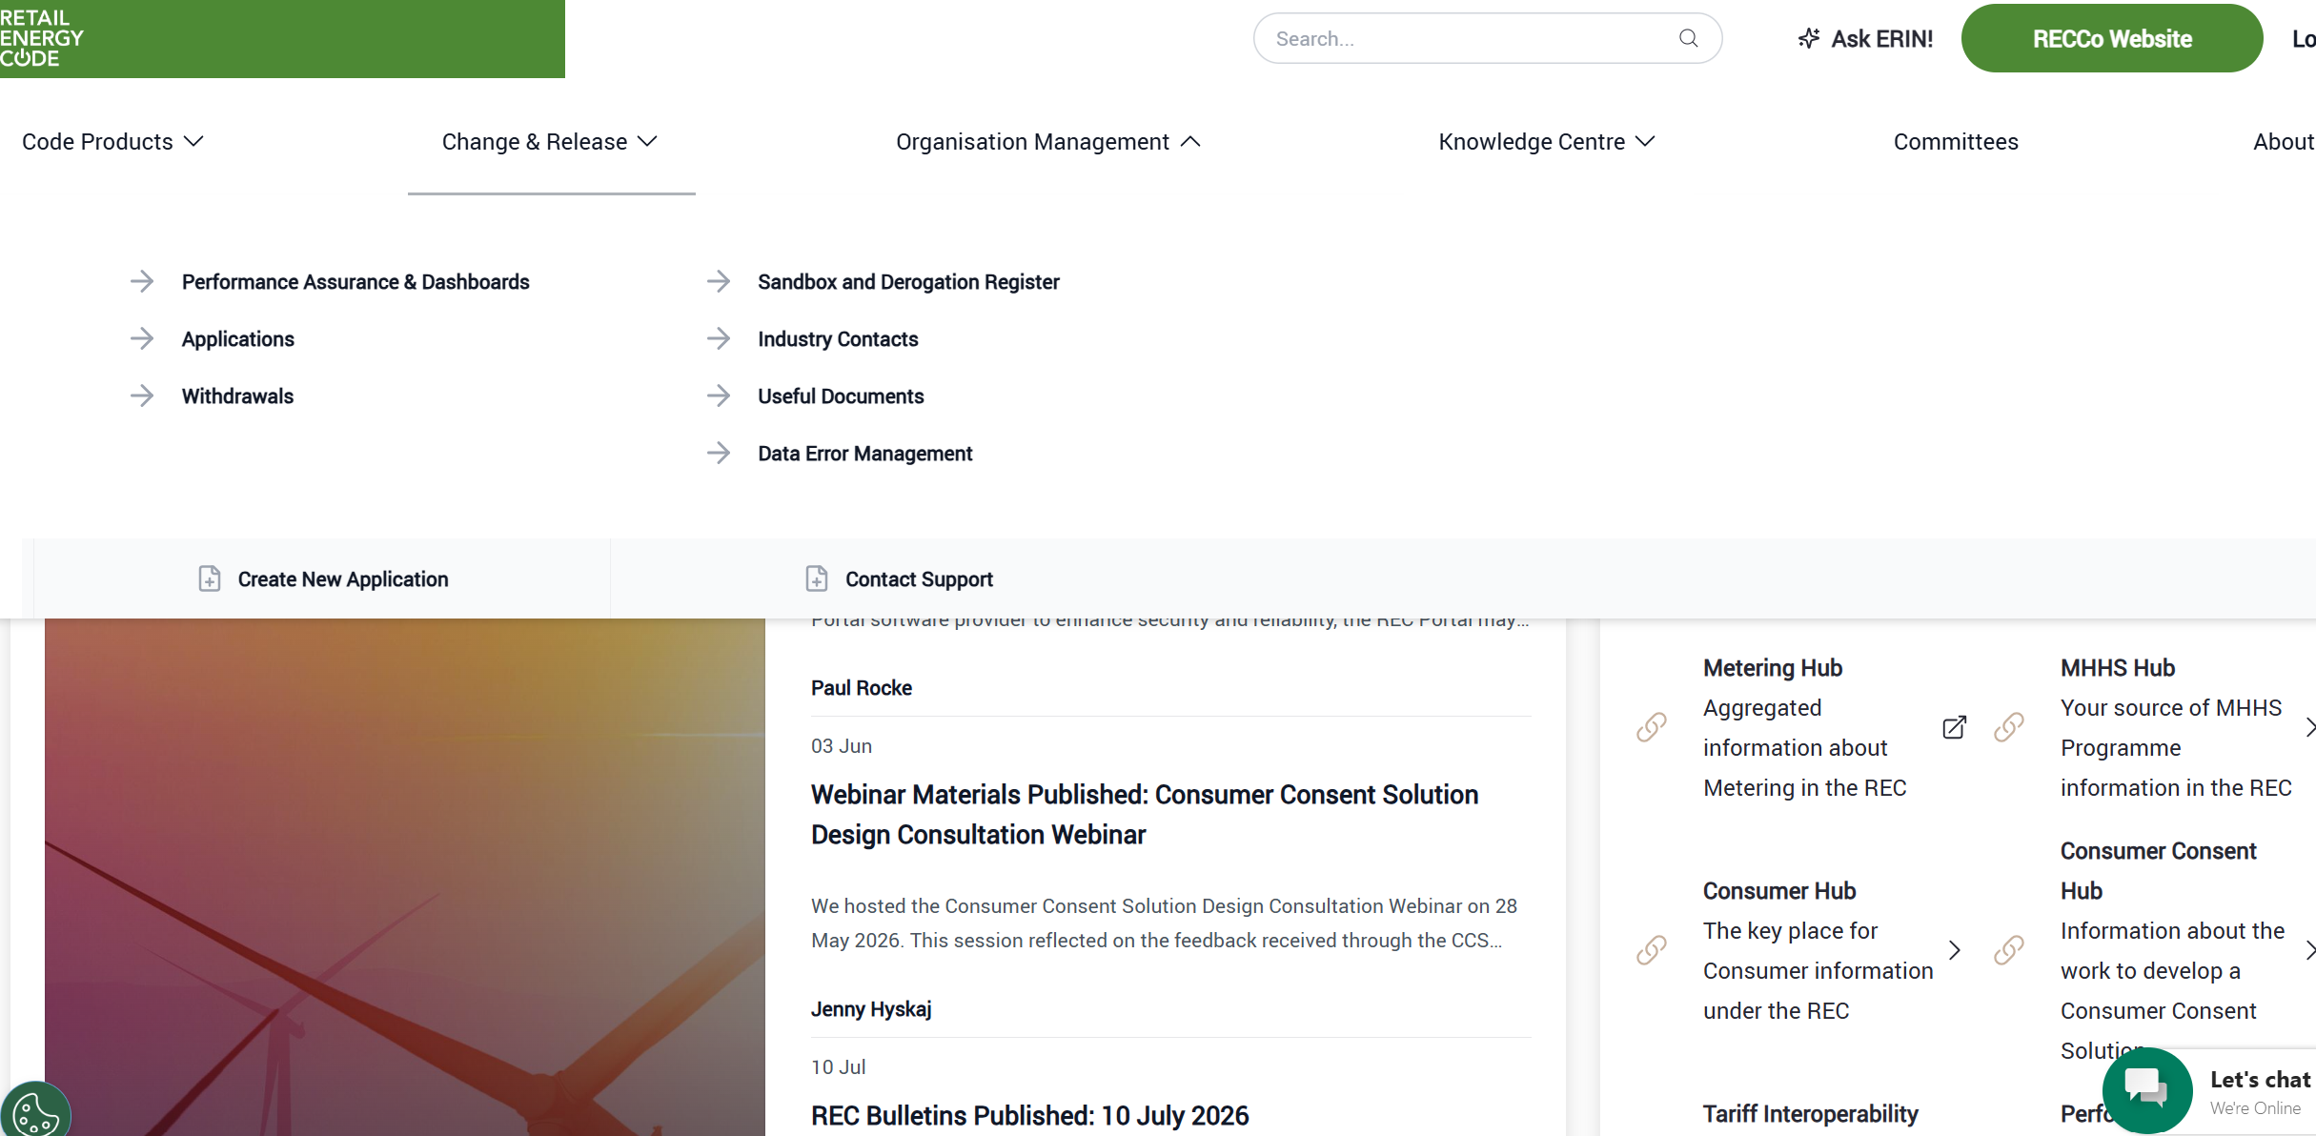
How to submit a DER Process form
The DER Process begins with a form submission found on the REC Portal.
Please note that once DSP is active the process will change to fit the new platform. Information will be sent out updating when this happens
1. Navigate to the Data Error Management page under “Organisation Management” on the Portal

Slide 24
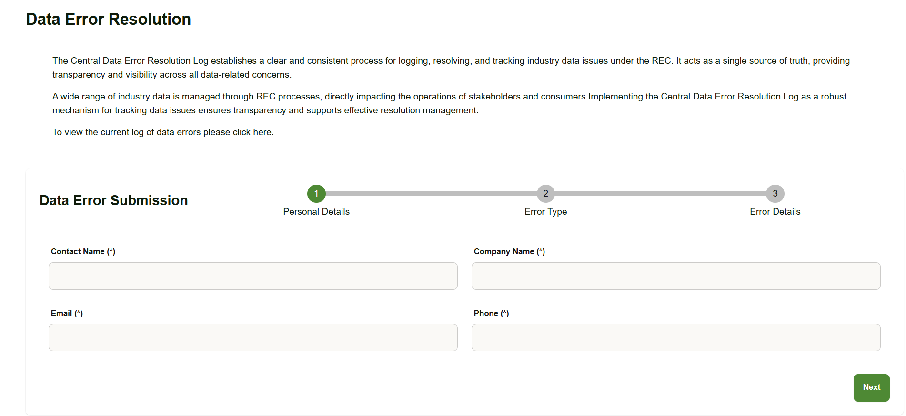
How to submit a DER Process form
The DER Process begins with a form submission found on the REC Portal.
Please note that once DSP is active the process will change to fit the new platform. Information will be sent out updating when this happens
2. Fill in contact details. It is key these details point to someone willing to be kept informed of the Data Error Progression and can answer clarifying questions as needed
Note you can also find the link to the DER Log here
Notes:
Contact information is essential for resolution and contact

Slide 25
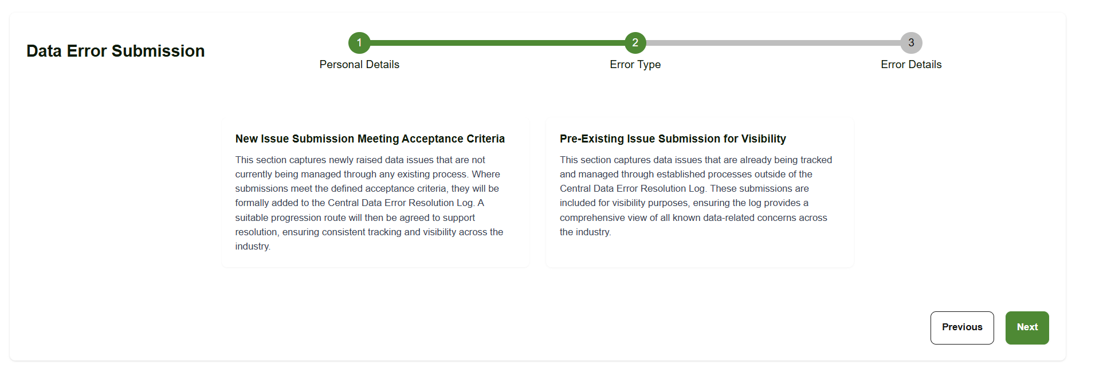
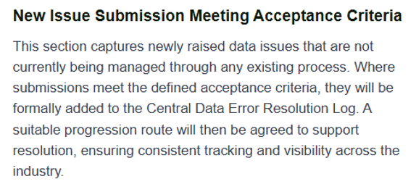
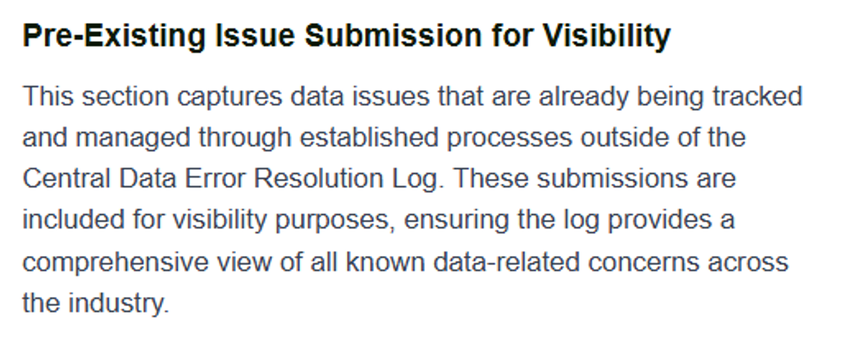
How to submit a DER Process form
The DER Process begins with a form submission found on the REC Portal.
Please note that once DSP is active the process will change to fit the new platform. Information will be sent out updating when this happens
3. Select whether the issue is New or Pre-Existing.
New Issue
Newly identified Issues
Not tracked outside of DER
No pre-agreed resolution pathway
Example
A new error is discovered in the CSS Database
Pre-Existing
Known issue
Tracked in processes outside of DER
Agree resolution pathway already underway
Example
An old error where a series of meters are mislabeled with a known pathway to resolution

Slide 26
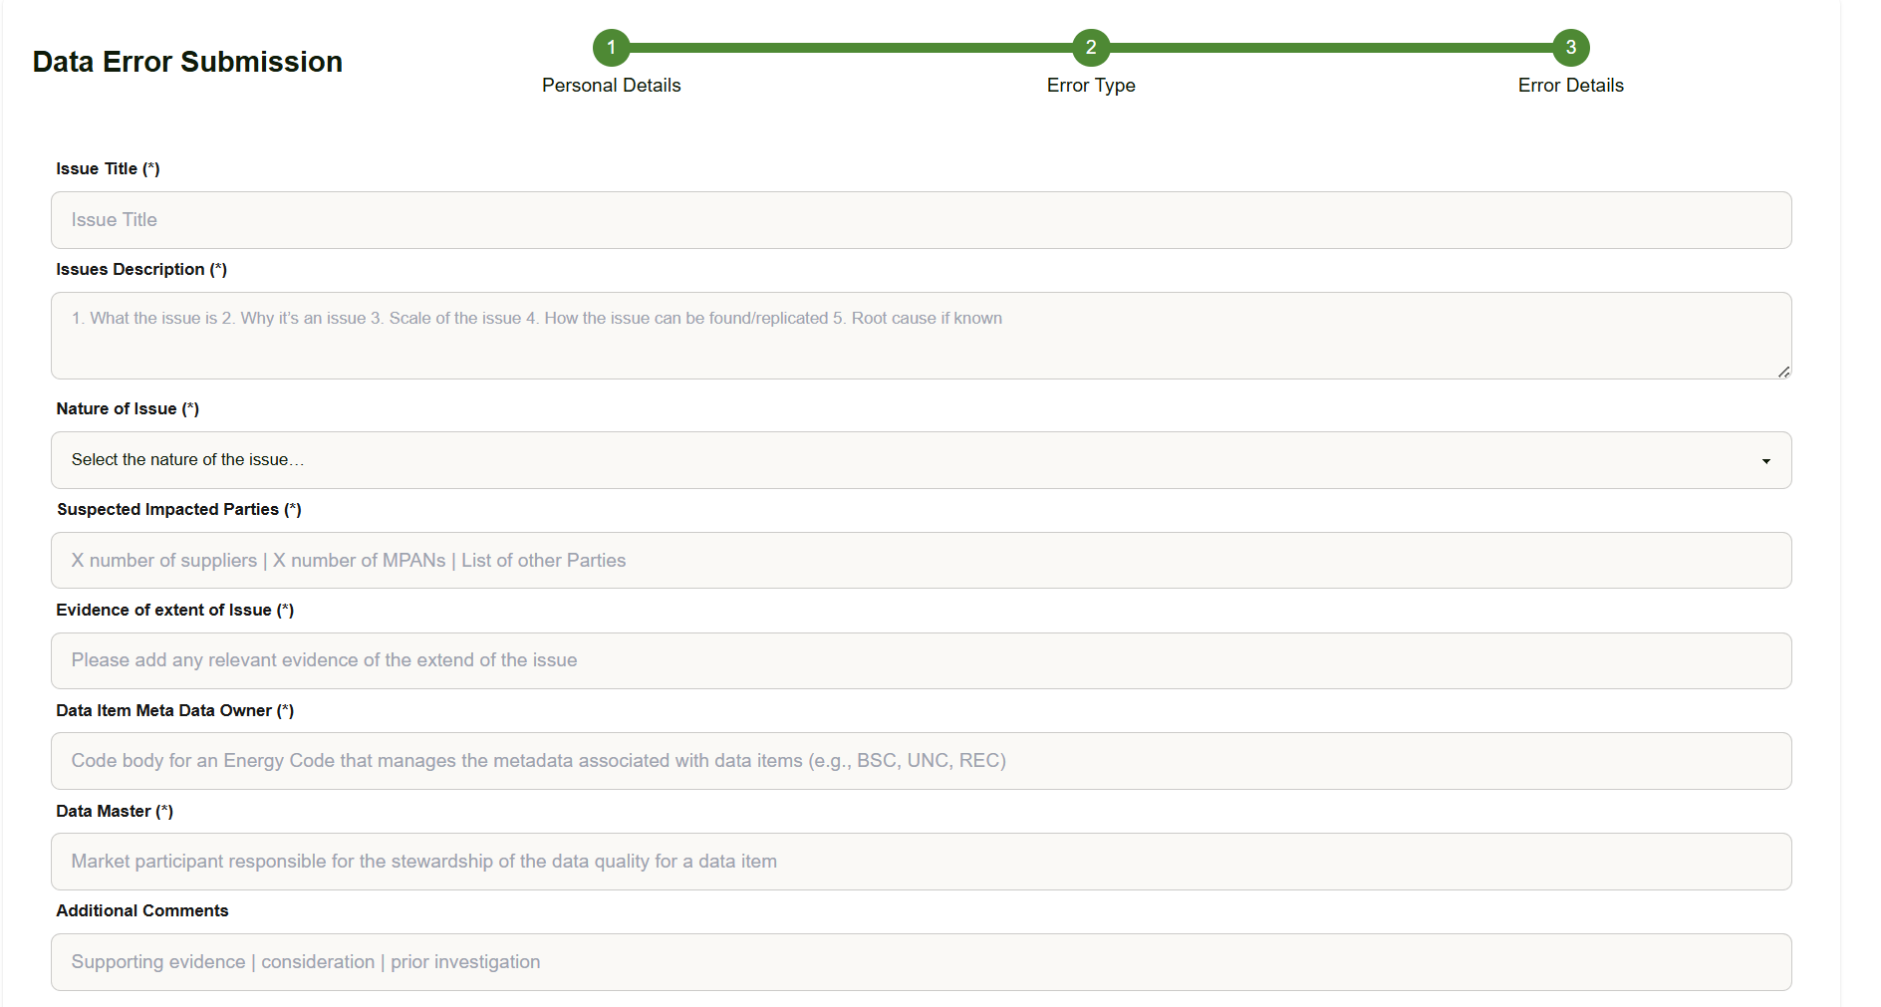
How to submit a DER Process form
The DER Process begins with a form submission found on the REC Portal.
Please note that once DSP is active the process will change to fit the new platform. Information will be sent out updating when this happens
4. Fill in Data Error details. This should be as detailed as possible to reduce the likelihood we will need to revert to you for more details.
A good DER Submission contains all the detail needed to properly assess the scale and severity of the error. Precise figures and breadth of issue aid considerably. Factors such as affected data item, parties impacted, scale/extent evidence, suspected consumer impact, known root cause, current management route, urgency rationale
Issues with better submissions are more likely to be assessed accurately and improve resolution speed.

Slide 27
The DER Process in action
1. Issue Identified
↓
2. DER Form Submitted
↓
3. Initial Review within 2 working days
↓
4. Added to DER Log
↓
5. Fortnightly DER Meeting Discussion
↓
6. Action Owner Assigned
↓
7. Investigation
↓
8. Resolution Agreed
↓
9. Issue Closed
↓
10.Lessons Learned / Trend Analysis
The DER Process proceeds through several steps to resolve a data issue issue.
Error submitters will be informed at specific stages of progression and will be able to track your item through the log (updated on the Portal fortnightly).
You will be informed of the outcome of the initial review and that it has or has not been placed. If the submission is rejected you will informed why.
DER communication will be conducted through email and logs will be maintained of communication to aid in error resolution.
Where resolution requires further support

Slide 28
Resolution Process
The Process of resolution is based on 3 steps
Review
Data errors are reviewed upon submission by the secretary. If accepted they are then taken to the moderation group for a wider analysis of resolution pathways.
Initial review is completed within 2 days of submission. If the matter is urgent the relevant members of the moderation group meet to discuss within a further worker day. If the matter is non urgent it is added to the fortnightly moderation call agenda.
Pathway
After the initial review is completed the moderation team will determine an initial resolution pathway. This is documented in the log and actions are assigned to resolve the issue based on the agreed path.
What this pathway will look like will vary from submission to submission due to the wide forms the errors could take.
Actions aim to be resolved within the 2 week period between Core team meetings.
Confirming Resolution
Once all actions in the resolution pathway are completed the outcome is communicated to the submitting party. If further actions are required, the new pathway is recorded and actions continue.
When the error is deemed resolved, the final outcome is taken to the relevant parties to confirm it is satisfactorily resolved. It is then added to the closed item log.

Slide 29
Questions
Question Form
FAQ
Please submit any DER Process Questions to this link:
DER Process Questions – Fill out form
Any questions regarding the DER Process, including trouble shooting, should be submitted via the form.
As questions get submitted we will develop an FAQ. This will be published alongside the form on the REC Portal when it is completed.

Slide 30
6. Recco annual stakeholder survey
REcco

Slide 31



Share your feedback with us. Your insights help us continuously improve and deliver the high-quality services you expect.
2026 Annual Committee Survey
REC Issues Group (RIG)
https://online1.snapsurveys.com/hjh0ut?_cat=giibdea
Scan the QR code and have your say.
on behalf of
This survey is run independently by Researchcraft. Your responses are confidential and anonymous unless you choose otherwise.

Slide 32
7. Key Callouts
Code manager

Slide 33
Key callouts - September
Stakeholder Advisory Forum Nominations
RECCo expects to establish the REC SAF on 30 November 2026
Tariff Interoperability Phase 1a Consultation
Visit the RECCO webpage for details
Responses due by close of play 17 September 2026
Nominations must be sent by an organisation’s named Contract Manager (or Alternate) before 5pm on 23 September 2026 to committees@recmanager.co.uk.

Slide 34
Impact Assessments
Change Proposal | Lead | REC Parties / Market Participants | Data Specification Impacts |  | Response Deadline
 |  |  | Impacted areas | Impacted Parties
I0331 Regulatory Alliance Creation Rejections | Caroline Freimuller | Energy Suppliers, DNOs, GTs, ERDAs, GRDAs | n/a | n/a | 25 September

Slide 35
Consultations
Change Proposal | Lead | REC Parties / Market Participants | Data Specification Impacts |  | Response Deadline
 |  |  | Impacted areas | Impacted Parties
R0292 Obligate Energy Suppliers to provide photo evidence of Theft in Conveyance to Network Parties | Caroline Freimuller | Energy Suppliers, DNOs, GTs | n/a | n/a | 14 September
R0321 DNOs Create Export MPANs after approving G98/99 commissioning documents | Caroline Freimuller | Energy Suppliers, DNOs | n/a | n/a | 14 September
R0336 Legal text to support REC Change R0180 | Caroline Freimuller | Energy Suppliers, CSS Users | n/a | n/a | 14 September – please advise the Change Team in advance if you require an extension

Slide 36
REC Working Groups
I0200 – Review of the REC’s Address Management Service – Meeting 4 | REC Parties / Market Participants | Time and Date
The fourth working group will take place on 05 October 2026. Pre-meeting papers will be provided by 28 September 2026. | All REC Parties | 05 October, 14:00 - 16:00
I0278 – Establishing the Safe Isolation Provider (SIP) as a Standalone REC Party – Meeting 5 | REC Parties / Market Participants | Time and Date
This REC Issue will look to establish a strong governance framework for standalone SIPs, including defining their scope, high safety standards, a streamlined Accreditation, strong qualification and audit processes and building the end-to-end process of this new REC Party. | Open to invited attendees only | 10 September, 15:00 - 17:00

Slide 37
8. AOB
ALL

Slide 38
thanks for attending
Next meeting:
09 October 2026

