Slide 1
REC Issues group
09 October 2026

Slide 2
1. Introduction and agreement of agenda
Carl dennis

Slide 3
Housekeeping
Competition Act compliance
Meeting is recorded
Free discussion of ideas
Any other AOB?

Slide 4
Agenda For today
 | TITLE | TIME | LEAD
1 | Introductions and Agreement of Agenda | 10:00 | Chair
2 | Performance Assurance Update | 10:05 | Code Manager
3 | Consumer Journey when Managing Looped Services | 10:10 | Code Manager
4 | Key Callouts | 10:40 | Code Manager
5 | AOB | 10:55 | All
6 | Close | 11:15 | Chair

Slide 5
Outstanding actions
Action Ref | Details | Owner | Date Raised | Target Completion Date | Updates provided to RIG Members | Status
RECRIG_26_0814_04_01 | The Code Manager to facilitate a working discussion between affected Suppliers and REC Change Management relating to switch meter readings under Market-wide Half Hourly Settlement | Code Manager | 14/08/2026 | 09/10/2026 | An update will be provided at the meeting on 09 October. | Open

Slide 6
2. For Information: Performance Assurance Update
Code manager

Slide 7
3. Consumer journey when managing Looped Services
Code manager

Slide 8
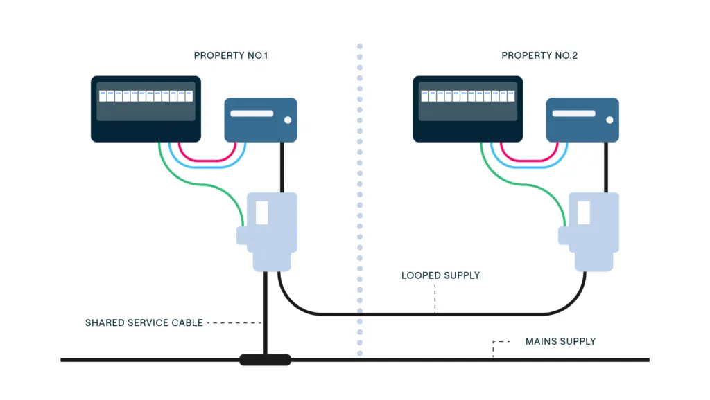
What is a Looped Service?
A looped service is where two (or more) neighbouring properties share a single electricity service cable.
While this type of connection is no longer installed today, many older properties, particularly terraced and semi‑detached houses still have looped services.
The electricity cable first enters one property. From there, a second cable runs from the first property’s meter position to the second home’s meter position. If your service cable is underground, it can be difficult to tell if you are on a looped service.
The shared service cable is DNO-owned equipment, the scenarios that have been raised to the Code Manager are related to metering works that a consumer has requested and the operational coordination surrounding them.
The party would like to understand if there is any improvements that could be made when learning that there is a Looped Service to better improve the current consumer journey.

Slide 9
Consumer journey when managing Looped Services - Background
Issue raised: Lack of clear guidance surrounding the Consumer Journey when there is a Looped Service preventing an installation
Background
A party has requested industry input with the increase in installations of Electric Vehicles and Heat Pumps. They feel it is becoming more evident that a looped service could negatively impact a consumer’s journey if not operationally planned in advance of an appointment.
Three scenarios and discussion points have been set out on the next slide, with some questions relating to CoMCoP also being raised.
Points to note
Any change to the REC, would likely result in a DCUSA impact.
A previous DCUSA issue concluded that Suppliers did not have permission to disrupt the supply to other Suppliers’ customers even if the express permission of those customers is received. This issue was raised in 2014.

Slide 10
Three Scenarios
Supplier A
Supplier A
Supplier A
Supplier B
Supplier A
Supplier A/B
Consent þ
Consent þ
Consent þ
Consent þ
Consent þ
Consent ý
Scenario 1: both consumers are happy for works to take place
Scenario 2: both consumers are happy for works to take place, but Supplier A does not Supply both consumers
Scenario 3: one consumer refuses
Do Parties feel that Looped Services are adequately covered by a Code? (DCUSA/REC or other)
Do Parties feel that the there is sufficient information for metering parties' awareness of Looped Services?
Are there any other considerations Parties feel should be considered?

Slide 11
4. Key Callouts
Code manager

Slide 12
Key callouts - October
REC Engagement Day
RECCo are hosting a REC Engagement Day in central London on 12 November 2026
The CoMCoP Mark
Consumer Consent consultation
Consultation closes at 9am on 19 October 2026
Webinar was hosted on 29 September 2026.
Launched and available to eligible CoMCoP accredited organisations.
Bringing together REC Party stakeholders from across the retail energy market for a day of insight, discussion and collaboration.
It provides a clear and consistent way for organisations to communicate their accredited status.
Access the launch materials on the REC Portal.
Stakeholder Advisory Forum (SAF) Elections
REC Contract Managers and Alternates have received an email containing all the details
Voting is open for six representatives on the new SAF until 21 October 2026.
Votes for candidates to committees@recmanager.co.uk before 5pm on 21 October 2026.

Slide 13
Key callouts - October
Theft Detection Incentive Scheme (TDIS) Update
RECCo is undertaking an extended verification of the TDIS 2025/26 Scheme Year submissions to ensure the scheme is concluded accurately.
DTC Pre-Release
Share feedback on REC Services
RECCo's 2026 Annual Stakeholder Satisfaction Survey is now open. If you use or engage with REC Services, please share what is working well and where improvements could be made.
On 23 September 2026 the Data Transfer Catalogue (DTC) was updated to version v15.6, ahead of the November 2026 REC Release (v4.4.0).
The credit and debit processes will be progressed as soon as the verification is complete.
The updated DTC catalogue is now available to download on the REC Portal.
It should take around 10 minutes to complete and closes on 16 October 2026.
As a result, the associated credit and debit processes may take place slightly later than in previous years.

Slide 14
Information Requests
Change Proposal | Lead | REC Parties / Market Participants | Data Specification Impacts |  | Response Deadline
 |  |  | Impacted areas | Impacted Parties
I0335 - Introduction of Defined Electricity Metering Work Categories for Metering Accreditation | Poppy Mullins | Electricity Meter Operator Agent (MOA), Electricity Metering Operative (EMO) | n/a | n/a | 23 October

Slide 15
Consultations
Change Proposal | Lead | REC Parties / Market Participants | Data Specification Impacts |  | Response Deadline
 |  |  | Impacted areas | Impacted Parties
R0322 Erroneous Switch Review: I0237 Clarifications | Flo Monea | Consumers, Energy Suppliers | MM00234 MM40007 (Data Items) SV00234, DI50174, DI50994, DI50995, DI50996, DI50997, DI50998, DI90017 | Energy Suppliers | 09 October
R0324 – Use of REL data to Support Key Regulations | Poppy Mullins | RECCo, Government departments in Great Britain | N/A | N/A | 09 October

Slide 16
Category 3 Change Proposals Consultations
Change Proposal | REC Parties / Market Participants | Data Specification Impacts |  | Response Deadline
 |  | Impacted areas | Impacted Parties
C3-0173 - Adding Metering Inventory Services as a new user category within the Electricity Data Access Matrix | MAPs, MEMs, Suppliers | N/A | N/A | 16 October
C3-0172 - Address Prioritisation Matrix new outcomes status | DNOs | N/A | N/A | 16 October

Slide 17
REC Working Groups
I0278 – Establishing the Safe Isolation Provider (SIP) as a Standalone REC Party – Meeting 5 | REC Parties / Market Participants | Time and Date
This REC Issue seeks to establish a strong governance framework for standalone SIPs, including defining their scope, high safety standards, a streamlined Accreditation, strong qualification and audit processes and building the end-to-end process of this new REC Party. | Open to invited attendees only | 06 October, 09:30 - 13:00

Slide 18
5. AOB
ALL

Slide 19
thanks for attending
Next meeting:
13 November 2026

