Slide 1
Proposed TDIS Change – Adding Payment for Investigations
JuLY 2024

Slide 2
Change overview
Incentive payment available for all investigations completed.
  Confirmed thefts continue to be valued based on existing scheme mechanism.
  Investigations concluded as not confirmed theft receive payment, with differential levels for desktop and site-visit investigations.
Propose payment for non-confirmed theft investigations are based on a fixed percentage of TDV, with cost socialised based on market share. This is the simplest calculation and hence more understandable and predictable for parties.
Identified the following specific changes required:
  Definition of what constitutes a Desktop Investigation and Site-Visit. To be progressed as part of separate but parallel change.
  Data Submission including PARC change
  Calculations for debit/credit determination
  Requirements for Theft Target Methodology

Slide 3
Changes – Data Submission
Suppliers are already required to report all investigations at the point this commences under existing drafting, specifically paragraph 6.2 of Annex 3 of the Energy Theft Reduction Schedule:
6.2 Each Energy Supplier shall record all Energy Theft investigations at the point the theft investigation commences and shall submit such records to the Code Manager via the REC Portal. Once the investigation is concluded, details of the Energy Theft investigation must be re-submitted together with the outcome. Submissions must be compliant with the data specification set out in the Performance Assurance Reporting Catalogue.
Change arguably not required, however propose small change in wording for clarification:
6.2 Each Energy Supplier shall record all Energy Theft investigations at the point the theft investigation commences and shall submit such records to the Code Manager via the REC Portal. Once the investigation is concluded, details of the Energy Theft investigation must be re-submitted together with the outcome (including specifying whether the investigation concluded as a Desktop Investigation or Site-Visit). Submissions must be compliant with the data specification set out in the Performance Assurance Reporting Catalogue.

Slide 4
Changes – Data Submission (PARC)
PARC definition for the Residential and Commercial Outcome files to be amended :to include a new field in the Investigation Outcome Block:
Investigations will then be categorised for calculation purposes as follows:
  Confirmed Theft – as-is definition, Investigation Type would need to be populated as “Site Visit” (consistent with existing REC Interpretation Schedule definition)
  Site Visit, no confirmed theft – Investigation Type = “Site Visit”, Date Investigation Closed populated (indicating investigation complete), Current investigation code not A, B or C.
  Desktop Investigation, no confirmed theft - Investigation Type = “Desktop Investigation”, Date Investigation Closed populated (indicating investigation complete), Current investigation code not A, B or C.
Field Name | Mandatory / Conditional / Preferred | Type | Length | Column Number in File Validation | Description / Permitted values
Investigation Type | M | Char | 40 | 58 (Commerical) 40 (Domestic) | Latest / final investigation type at point of data submission. Permitted values: Desktop Investigation Site Visit

Slide 5
Changes – Calculations
Completed but Unconfrimed Theft Investigation should be added to the Interpretations and Definitions Schedule, i.e.
Completed but Unconfirmed Theft Investigation means the Holder of an Energy Licence (or person acting on their behalf) has completed an investigation into potential Energy Theft but has determined it does not meet the definition of a Confirmed Energy Theft
Numerous updates required to paragraphs in Annex 3 of the Energy Theft Reduction Schedule (14):
7.3 The Code Manager shall produce and provide to each Energy Supplier and the REC PAB, an overall Indicative TDIS Summary Report. The Code Manager shall provide each Energy Supplier with a copy of the Indicative TDIS Summary Report with the Confirmed Energy Thefts and Completed but Unconfirmed Theft Investigation for all other Energy Suppliers anonymised. The Code Manager shall provide the REC PAB with a non-anonymised copy of the Indicative TDIS Summary Report.
7.4 The content of the Indicative TDIS Summary Report will detail the aggregate number of Confirmed Energy Thefts and Completed but Unconfirmed Theft Investigation recorded for the relevant scheme month for each Energy Supplier against each of their relevant Theft Targets. The specific format of the Indicative TDIS Summary Report may be revised from time to time subject to the approval of the REC Performance Assurance Board.
8.2 All debits and credits associated with the TDIS Reporting Year will be calculated by the Code Manager based on the total number of Confirmed Energy Thefts and Completed but Unconfirmed Theft Investigation shown within the final TDIS Reporting Year Summary Report, covering the full TDIS Reporting Year and utilising Energy Supplier market share figures based on the figures utilised at the commencement of that TDIS Reporting Year.

Slide 6
Changes – Calculations (continued)
Updates required as follows, all paragraphs are from Annex 3 of the Energy Theft Reduction Schedule (14):
8.2 All debits and credits associated with the TDIS Reporting Year will be calculated by the Code Manager based on the total number of Confirmed Energy Thefts and Completed but Unconfirmed Theft Investigation shown within the final TDIS Reporting Year Summary Report, covering the full TDIS Reporting Year and utilising Energy Supplier market share figures based on the figures utilised at the commencement of that TDIS Reporting Year

Slide 7
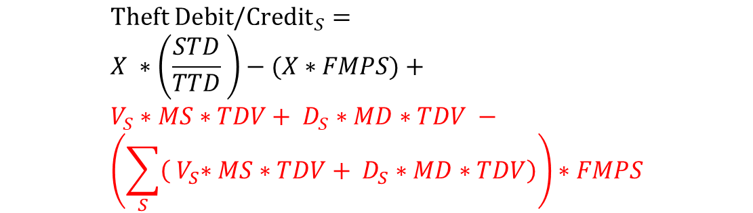

Changes – Calculations (continued)
8.3 Debits and credits resulting from the TDIS will be calculated for each consumer segment within the scheme using the following formula:
Where:
[existing definitions retained]
V_{s} = Number of Completed but Unconfirmed Theft Investigation that were concluded as a Site Visit for supplier S
D_{s} = Number of Completed but Unconfirmed Theft Investigation that were concluded as a Desktop Investigation for supplier S
MS = Site Visit Multiplier (i.e. the proportion of TDV payable for a Site Visit Completed but Unconfirmed Theft Investigation)
MD = Desktop Investigation Multiplier
= Sum over all suppliers
$${Theft Debit/Credit}_{S}= \\ X ∗\left(\frac{STD}{TTD} \right)−(X∗FMPS)+ \\ V_{S}∗MS∗TDV+ D_{S}∗MD∗TDV − \\ \left(\sum_{S}{\left({ V}_{S}∗MS∗TDV+ D_{S}∗MD∗TDV\right)}\right)∗FMPS$$
$$\sum_{S}{}$$
Reminder: FMPS already defined as final Metering/Supply Meter Point Market Share

Slide 8
Changes – Theft Target Methodology
Updates required to allow the determination of new parameters as part of the TTM process to section 4 of the Energy Theft Reduction Schedule (14):
4.2 Each Completed but Unconfirmed Theft Investigation will qualify for an incentive payment, the value of which will be calculated as a percentage of the Theft Detection Value. This percentage will be set such that the value of the payment is no more than the estimated likely net cost to an Energy Supplier of having undertaken the associated investigation activity, as compared with having taken no action.
4.3 The Code Manager, shall, at the same time as it determines and publishes the Theft Targets for a TDIS Reporting Year, establish and publish a Theft Detection Value for each consumer segment to be used in that TDIS Reporting Year and the associated percentage multipliers for calculation of payments for Completed but Unconfirmed Theft Investigation as outlined in paragraph 4.2.

Slide 9
Example Scenarios
Example scenarios created to help understand potential outcomes of changes
Data created for these scenarios and is not based on actual suppliers, although attempts to reflect some of the varying results seen in current TDIS reporting
Scenarios based on assigning assumptions regarding performance of confirmed thefts compared to target and conversion rate of investigations (i.e. how many investigations needed to identify confirmed theft):
Theft Performance
Outperforming
Significantly above average
Above Average
Average
Below Average
None
Investigation efficiency
Abnormally high
High
Median
Low
Abnormally low
None

Slide 10
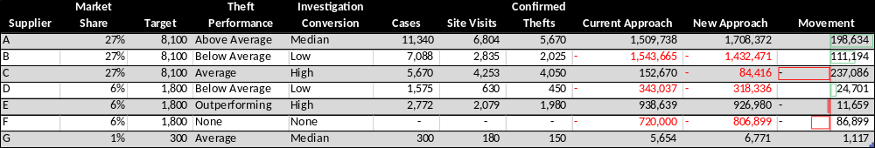
Example Scenario – Domestic
Values driven by assumptions regarding performance against target and investigation conversation, including proportion of investigations leading to site visits.
Key Assumptions:
£12m total pot
Overall pot performance c. 45%
Site visit multiplier 50% (does not also receive desktop payment)
Desktop investigation multiplier 20%

Slide 11
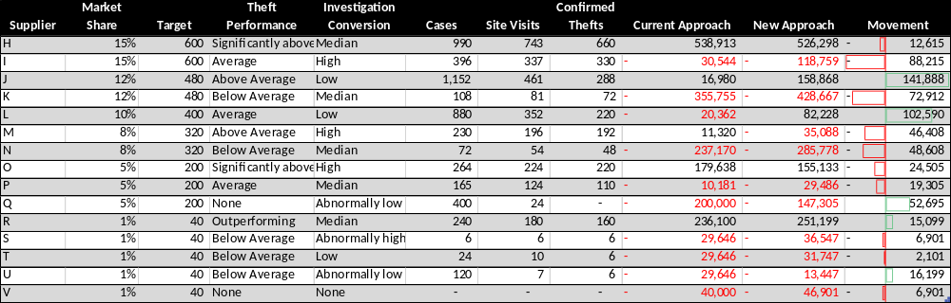
Example Scenario – Non-Domestic
Key Assumptions:
£4m total pot
Overall pot performance c. 55%
Site visit multiplier 50%
Desktop investigation multiplier 20%

Slide 12
Open Questions / Input Required
Should a different multiplier be determined for each pot, or is a single multiplier for all pots feasible? TDV varies by pot so the payment would differ by pot with a single multiplier.
The change will need to define the initial values for the multipliers – input from TIG members would be appreciated. For information:
  Based on 2023/24 data¹ there are approximately three times as many site visits for each confirmed theft reported (i.e. two site visits that would be eligible for payment under the change). Individual performance (by party and pot) varies significantly from 8-100%.
  It would appear many parties have only reported site visits. Excluding those parties there were approximately seven times as many investigations as confirmed theft (i.e. a further four desktop investigations).
Is there a need to explicitly call out that the parameters will be set in the first year as part of the change?
Are there other changes needed not captured here? Is there a need for any changes to the general description of the scheme? Are there changes needed to the Unbilled Energy Code of Practice?
1 – Based on 2023/24 Theft Data submitted prior to 18 July 2024, note although parties are required to submit investigations once they commence the current level of reporting suggests that not all suppliers are doing so.

Slide 13
Thank YOU
Contact us: PERFORMANCEASSURANCE@recmanager.co.uk

