Slide 1
REC Tariff interoperability Solution working group (TISWG)
12 June 2025

Slide 2
Introduction and recap

Slide 3
Agenda
Agenda Item | Presenter
Welcome and Introduction | Chair
Confirmation of Agenda | Chair
Approval of Previous Minutes | Theo Burnard
Review of Actions Log | Theo Burnard
Recap of Previous TISWGs and Clarification of Phase One Scope and Terms | Chair / DESNZ
Solution Development: Route Two User Governance | Sarah Jones
Solution Development: Route Two Notifications to Users | Sarah Jones
Solution Development: Route Two Consent Management | Sarah Jones
Q&A | Chair
AOB

Slide 4
Approval of Previous meeting’s Minutes

Slide 5
Review of actions log

Slide 6
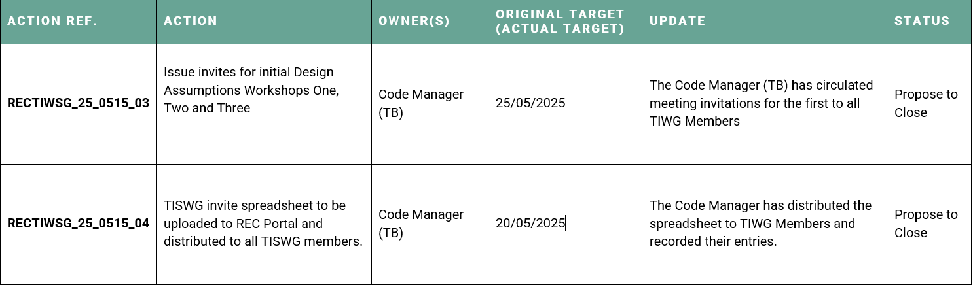
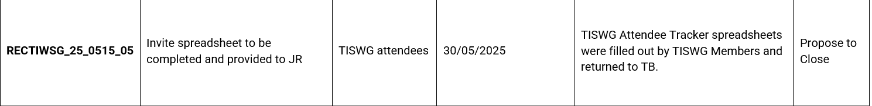
Actions log

Slide 7
Clarification of scope and definitions

Slide 8
TISWG RECAP
High-level business process developed for the four Use Cases showing the two routes for accessing data.
  Route One - Public route for sharing generic tariff pricing data in a standardised format;
  Route Two - Private route for sharing customer specific tariff pricing data and information regarding the Supplier registration.
TISWG meeting on 4 June 2025 focused on Route One with Strawperson proposals shared for comments by 13 June.
TISWG meeting on 12 June 2025 (this meeting) will focus on Route Two design elements.
Any additional feedback on the topics covered in today's session are requested from TISWG by Friday 20 June 2025.
Feedback to be provided by email to committees@recmanager.co.uk .

Slide 9
Clarification on Phase one scope and terms
Both in TISWG meetings and via other feedback channels, attendees have noted that a clarification of scope and some terms would be appreciated.
From a scope perspective, we will outline in this meeting the scope of the MVP (Phase One) and future Phase Two.
Stakeholders have queried the current definition of ‘Bespoke’ as it relates to contracts between Suppliers and non-domestic consumers.
Having consulted with our colleagues at Ofgem, and in further discussions with industry stakeholders, we have defined a ‘bespoke contract’ as:
We consider a “Bespoke non-domestic contract” to be one that is tailored to the individual needs of the customer being supplied by the licensee and is not widely available to the open market
Accordingly, Suppliers will not be obligated to provide tariff pricing data relating to contracts which fall under this definition. However, they will not be precluded from doing if they wish to make this data accessible.

Slide 10
Route Two
API User Governance

Slide 11
RECAP on Previous TISWG meetings
Summary of previous discussions on user governance to help inform this meeting
Route One (Public) - As discussed in TISWG on 4 June.
  Sharing of publicly available tariff data for domestic and designated premises, if applicable, (excluding bespoke contract data).
  Therefore, no limitation on who can access the data.
  There will be a defined set of rules where Suppliers will not be required to fulfil requests e.g. security, volumetrics.
Route Two (Private)
  Sharing of customer-specific tariff data (excluding bespoke pricing data, unless the Supplier chooses to provide it.).
  Previously suggested that Users would not require accreditation with reliance placed on individual supplier terms and conditions.
  Concerns raised by participants to be further considered.

Slide 12
User Governance
Problem Statement:
A simple and efficient mechanism is required to require Users to register to use the Tariff Interoperability solution for Route Two (Private) and comply with a minimum set of standards for use of that service.
Context:
Multiple Suppliers have expressed reservations that, without a validated register of Route Two (Private) users, they would not have confidence on who was calling their tariff endpoints and requesting customer specific data, and this would impact their ability to take action for misuse of the data and the Tariff API service.
Without a central mechanism to require Users to agree a set of minimum terms for use of the service, Suppliers would need to individually determine and administer T&Cs with Users. Users would also be required to review multiple sets of T&Cs and sign multiple agreements that they have no control over. This is likely to be inefficient for both Suppliers and Users leading to higher costs and/or reduced take up.
Without a central register of Users, each Supplier would need to maintain its own register of User webhooks to enable notifications and each User would be required to register webhooks with each Supplier.
The REC provides a mechanism to develop and deliver a simple registration service for Users and for Users to agree a minimum set standards that they must comply with, that balance the needs of customers, Users and Suppliers. RECCo has a track record in developing and administering such arrangements that take into account the associated risks.
REC governance also requires that any changes to requirements are considered in the context of consumer protection, governance efficiency, promoting innovation and digitalisation, data quality and accuracy. They also provide for controlled implementation. This should provide confidence to Users on the stability of the service and promote its use.

Slide 13
User REGISTRATION Strawperson
We believe that the below User Registration Strawperson provides significant benefits for all involved parties; providing additional assurance for Suppliers without overburdening users or creating barriers to entry.
Optimiser request access to API
Optimiser
RECCo
Supplier
Optimiser
Completes form on REC Portal, providing company information and agreeing to access agreement
Stores the information with user endpoint register.
Shares required Tariff Data with the Optimiser
Under this model, Users complete a registration form on the REC Portal and agree to a set of common T&Cs. RECCo will publish information on each User in a User register, alongside the Supplier endpoint register. RECCo maintains the authority to revoke or suspend a user's registration for non-compliance.
Benefits
Suppliers: Provides the single trust anchor, eliminating one-off contracts, while accessing all required information from the User register. Assurance that for any user in breach of the API T&Cs there would be a mechanism available to RECCo to take actions, which could include removal of access to the Tariff Data API.
Users: One-time, quick and automated onboarding, removing any need for recurring paperwork, along with providing access to relevant information to support engagement with a Supplier's API.
RECCo & Market: Central oversight and the authority to suspend access.
The terms of the API T&Cs would need to be defined to recognise the specific risks associated with access under this scheme. These will be developed through the TISWG as part of the API Governance.

Slide 14
Route TWO
Notifications to API UseRs

Slide 15
Use Cases for user notification
Phase One sets out three events that require Suppliers to provide User notifications
Considerations
Change in Tariff Value: Real-time notification is required for Users to update pricing logic and adjust load accordingly. This aligns with Use Case C: “the Supplier modifies the unit price of Time of Use Tariffs’
Customer changes tariff: Critical for enabling Users to validate the applicability of a tariff and continue to optimise against correct pricing signals. This aligns with Use Case D: ‘without requiring the customer…to manually inform the organisation if they change their tariff’
Change of Supplier: The receiving Users would require this information to update authentication, request and receive tariff pricing data from the new Supplier, and verify compatibility.
Assumption Reference: A_0016

Slide 16
Assumption: Supplier Notification to Users
Webhooks used for managing notifications to Users
Consideration
Mechanism required to enable information to be pushed to Users.
Proposed solution to utilise webhooks: industry standard approach for managing events between organisations.
Users would register a single webhook (held in the User register) enabling the receipt of information against any of the defined events.
Suppliers would utilise the central User register to route information to the correct User.
Assumption Reference: A_0017

Slide 17
mpxn data
Under Route Two, where specific tariff information is provided, the message will include MPXN data to allow for scenarios where the customer has multiple MPXNs
Considerations
Supports real-world configurations, where customers have more than one MPAN, including for dual-meter setups (EV & Home).
Including MPXN in the API response ensures the user knows exactly which tariff applies to which supply point. This avoid ambiguity and situations where the user risks assigning the wrong tariff to the wrong ESA or incorrectly aggregating charges.
This also allows for per-meter consent and revocation, where a customer may authorise sharing for their EV MPAN but not their household MPAN.
Assumption Reference: A_0018

Slide 18
Route two
Consent Management

Slide 19
consent mechanism
Proposal for granting consent is set out below:
Customer engages via the User App or website.
Customer redirected from the User App/website to the Supplier’s log-in page and provides their details. They see a single 'consent' screen and approve sharing of their details with the User.
User receives an authentication code.
The User uses the authentication code to register themselves against the customer.
Supplier holds a record of the User against the specific Customer, enabling future interactions.
Customer
Supplier
Optimiser
Supplier
Open Optimiser App, chooses to link their tariff and is redirected to Supplier Log-in page
Provides Authentication Code to Optimiser
Uses Authentication Code to register against customer
Supplier shares event driven information

Slide 20
Hold and maintain consent information
Suppliers will be required to hold and maintain information on the relationships between customers and Users for the purposes of enduring consent
Considerations
Suppliers are the authoritative source of truth for customer identify and account status, being the only party with the full, authenticated access to the customer’s account, MPAN, billing status, and contact information
This aligns with regulatory precedent in other sectors. In Open Banking, banks (like Suppliers) are required to maintain a list of third-party providers per customers, validate consent tokens per transaction, revoke or expire access if consent is withdrawn.
Ofgem’s Data Sharing & Consent work (and the upcoming Consumer Consent Framework) is expected to require clear records of who has what access, for how long, and under what lawful basis; auditable consent trails, especially where data is accessed repeatedly over time. By retaining this data, Suppliers can respond to Data Subject Access Requests, demonstrate compliance, and support redress if misuse is alleged.
Assumption Reference: A_0019

Slide 21
consent Duration
Once a consumer has granted consent to their Supplier to share their tariff pricing data with the User, it will be held for a period of [12] months
Considerations
We welcome views to help inform our assessment of the appropriate duration of consent being active.
Given that type of data being shared and intended purpose we do not believe that a period of less than 6 months would be in the interest of the customer experience and 12 months appears to be more proportionate.
Examples for consideration:
  Open Banking 90-day consent reauthentication rule.
  12-month period active in other areas of Open Banking, including for the Variable Recurring Payments (VRP) dashboard.
  A 180 days period is used by the FCA for the re-confirmation for Account Information Services for Open Banking.
If consent elapses, it is the User's responsibility to engage with the customer to renew consent.
Assumption Reference: A_0020

Slide 22
consent Revocation
The customer must be able to revoke consent, through a request to either the Supplier or the User
Considerations
Expect there to be obligations on Suppliers and Users to robustly manage consent revocation.
For the Supplier route:
  Supplier must immediately record the consent as revoked and give effect to the revocation to prevent further notifications to the User in relation to that Customer.
  Mechanism for Supplier to inform User to be discussed e.g. use of webhooks
For the User route:
  User must immediately record the consent as revoked and give effect to the revocation e.g. inform Supplier and remove trust relationship.
  Supplier immediately records the consent as revoked and give effect to the revocation to prevent further notifications to the User in relation to that Customer.
Assumption Reference: A_0021

