Slide 1
REC Tariff Interoperability Working Group
22nd September 2026

Slide 2
Agenda
AGENDA ITEM | PRESENTER
Welcome & Introduction | Chair
Confirmation of Agenda | Chair
Phase 1a Technical Specification Consultation Update | Chair
Phase 1a TI Energy Supply Message Retry Derogation Request | Andrew Wallace
R0323 – Phase 1a Supplier Performance Assurance Update | Andrew Wallace
Phase 1a Testing and Engagement – Next Steps | Alan Davis
Integration with CCS | Eva Von-Schaxmann
AOB | Chair

Slide 3
TI Phase 1a
Technical Specification Consultation Update

Slide 4

Phase 1a consultation – initial themes
INITIAL THEMES
EARLY TRIAGE CATEGORIES
Large tariff volumes / response size
Each comment will be assigned initial treatment routes:
Suppliers exposing large volumes of Tariffs could cause large API responses
Technical / spec fix
Change to API, schema, EMDS or Data Standards
Retry and Schedule alignment
Known issue addressed in later slides.
Schedule / policy fix
Clarification or change to obligation or regulatory wording needed
Tariff lifecycle and availability
Guidance / operational
Guidance, FAQs, testing or comms response.
Identified a need to clarify withdrawn, closed, amended and sellable tariff treatment.
Specification consistency
Future enhancement
Useful improvement, but not necessarily needed for Phase 1a.
A collection of smaller issues to be resolved
NEXT STEPS
The Tariff Interoperability team will complete a detailed review, confirm proposed treatment and resolution, and draft a formal response for October 2026.

Slide 5
TI Phase 1a
TI Energy Supplier Message Retry Derogation Request

Slide 6
TI Phase 1a – TI Energy Supplier Message Retry Derogation Request
Introduction
Schedule 35 para 2.9(c) and 2.16 require TI Energy Suppliers to retry sending MMXXXX5: Get Tariffs Response and MMXXXX7: Get Tariff Details Response messages that are not received by TI Users.
Suppliers must retry delivery three times at 20 second intervals and then every 60 minutes for the buffer period (12 hours).
Issue identified
The RESTful API design does not support the required message retry process. Instead, it is the role of the TI User to make a request and then check that it has received a HTTP 200 message with the required payload, or a HTTP error message e.g. 400, 404, 429 from the TI Energy Supplier.
The TI User will then be able to determine the next steps, including if it needs to retry or update its request. Under the RESTful API design a TI Energy Supplier will not receive a HTTP message to confirm if the MMXXXX5 or MMXXXX7 has been received by the TI User.
For the avoidance of doubt, a TI User is still expected to apply the retry strategy before contacting a TI Energy Supplier to raise a query
Next steps
To ensure that TI Energy Suppliers have clarity on their TI Phase 1a build requirements, we are requesting a derogation on the TI Energy Supplier message retry requirements at the 29 September PAB meeting.
If this is granted by PAB, we will ensure that this is communicated promptly to all suppliers, TIWG and IWG.
We propose to consult on updating the Schedule 35 legal text to address this issue as part of the changes introduced for TI Phase 1b.

Slide 7
TI Phase 1a
R0323 – Supplier Performance Assurance

Slide 8
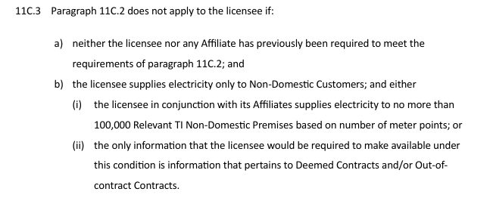
R0323: TI Phase 1a – Supplier Performance Assurance Requirements
Background
R0323 proposes changes to the PARC to:
Require TI Energy Suppliers to provide a monthly performance report (2100) and an ad hoc reporting on API error codes (2110)
Require all Electricity Suppliers to provide an ad hoc reporting on tariffs that cannot be captured within scope of the TI API (2120)
Record the role of the TI Monitoring Tool for transparency
Consultation closed on 07 Sept 2026 and four responses were received.
Update and next steps
We will request an extension to the Change Plan at the Sept PAB so that we can consider the responses and update the legal text where required. We will bring R0323 to the Oct PAB for decision.
Following requests for design clarification, it is now clear that TI Energy Suppliers are not expected to receive and monitor HTTP error codes for the MMXXXX5: Get Tariffs Response and MMXXXX7: Get Tariff Details Response messages. These requirements will be removed from 2110. For the avoidance of doubt, we still propose to require TI Energy Suppliers to report (ad hoc as required by RECCo) on HTTP error codes for the TI User request messages (MMXXXX5a: Get Tariffs Request and MMXXXX6: Get Tariff Details Request).
In response a comment, we will clarify if the 2120 reporting requirements do not apply
where excluded by Elec Supply SLC11C.3.
In response to a comment, we are considering limiting, to two years, the Annual Statement
TI Energy Supplier check on inclusion of all applicable tariffs and query management.
We are continuing to consider other points raised in consultation responses.

Slide 9
TI Phase 1a
Testing

Slide 10
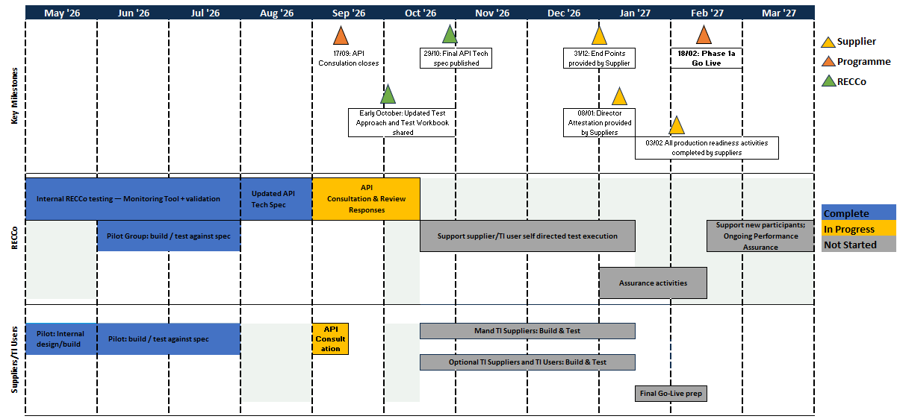
1A Test Update

Slide 11
Integration with CCS

Slide 12
AGENDA
Integration with CCS
1
Permission grant and supplier verification
2
Accessing account specific tariff information
3
JWT access tokens and permission types
4
Shared Signals Framework and ongoing tariff interoperability event notifications
5
Permission revocation routes
6
CCS and TI consultations scope

Slide 13
PERMISSION GRANT
Permission grant and supplier verification
The supplier performs account holder verification inside the CCS permission journey
1
Account holder requests a service from an RTI User
2
RTI User sends a PAR to CCS
3
CCS starts verification
4
Account holder logs in
An account holder interacts with an RTI User to use a service that requires permission for access to account specific tariff information.
The RTI User sends the Pushed Authorization Request (PAR) to CCS which includes the permission authorisation details outlining the request, this can include a request for ongoing event notifications.
The CCS validates the request and directs the account holder to the energy supplier specified within the PAR request.
The account holder logs into their supplier account to authenticate themselves and confirm the supplier can share their MPxNs with CCS.
5
Supplier issues an ID token
6
Account holder chooses whether to give permission
7
CCS records the permission
If authentication is successful, the supplier issues an ID token to CCS including relevant address(es) and the associated MPxNs and redirects the account holder back to CCS
Once back with the CCS, the account holder is presented with the permission screen outlining the permission details including the scope and duration and chooses whether to give permission.
If permission is granted, the CCS records the permission record and redirects the account holder back to the RTI User and provides the RTI User with an authorisation code.
The supplier verifies the person as its Account Holder. CCS remains the authority for the permission record.

Slide 14
ACCOUNT HOLDER SPECIFIC ACCESS
Accessing account holder specific tariff information
The CCS token flow authorises the access to the account holders tariff ID, followed by a public pricing lookup
1
Authorisation code returned
2
Token exchange
3
Supplier request
4
Tariff ID response
5
Public pricing lookup
When CCS redirects the account holder back to the RTI User, it also provides a short-lived, single-use authorisation code.
The RTI User exchanges the code with CCS for a refresh token and access token.
The RTI User presents the supplier-specific access token alongside the Get MPxN Tariff Details request.
The supplier validates the token and returns the Tariff ID for the requested MPxN.
The RTI User uses the Tariff ID to retrieve the associated pricing information using the public endpoints being used for TI Phase 1a.
Refresh token
Held by the RTI User and presented only to CCS to obtain new access tokens while permission remains active.
Access token
Valid only for a specific supplier, it confirms permission is active and allows the authorised data to be shared. It is digitally signed, sender-constrained and short-lived.

Slide 15
TOKEN VS PERMISSION DURATION
JWT access tokens and permission types
The permission defines the scope and duration of access. The JWT authorises an individual request.
A short-lived digital access pass
A JSON Web Token (JWT) is a digitally signed credential. It lets the energy supplier confirm who is requesting data and the permission information supporting the request. Any data sharing must take place within the token's lifetime.
Later access requires a new token which is obtained by the RTI User using the refresh token providing permission is still in place.
Two permission types
ONE-OFF PERMISSION
ENDURING PERMISSION
25 hours
Up to 3 years
Scheduled data may take up to 24 hours to become available, so the permission remains active long enough for collection.
Allows repeated access for the agreed period authorised by the account holder when granting permission unless revoked beforehand.
ONE RETRIEVAL ONLY
REPEATED ACCESS
Once the data is obtained, the requesting RTI User must revoke the permission.
Each new request still requires a valid access token to be presented.

Slide 16
SHARED SIGNALS FRAMEWORK
What the Shared Signals Framework does
SSF is an OpenID Foundation standard for exchanging signed security events between systems
SSF
A standard way for one system to say that something has changed
The signal is signed, verifiable and deliberately light on detail.
1
Set up role or roles
2
Set up the stream
3
Validate the stream
4
Share events
An organisation sets up its receiver, transmitter, or both where required.
The receiver registers a stream with the transmitter for the events it needs.
A verification event confirms that the stream works end to end.
The transmitter shares signed Security Event Tokens (SETs) on the stream when something changes.
The stream is established and tested before it is used to share live events.

Slide 17
SSF IN TARIFF INTEROPERABILITY
Where SSF fits in tariff interoperability
Two stream relationships support the TI journey, and each serves a different purpose
1
Permission lifecycle stream
2
Tariff event notification stream
RTI Users and energy suppliers each set up a stream with CCS to receive permission lifecycle events, including revocation.
RTI Users set up one stream with each energy supplier they need TI event notifications from. The supplier uses the stream to signal when a tariff event occurs.
CCS
transmits to
RTI Users and suppliers
Energy supplier
transmits to
RTI User
The tariff event stream separates notification from access
Notification only
Authorised retrieval
The SSF signal tells the RTI User that something has happened. It does not include the event details.
The RTI User makes a separate authorised request to retrieve the underlying information.
IF PERMISSION IS REVOKED
After receiving a revocation notification from CCS, the supplier stops sending future tariff event notifications to the RTI User.

Slide 18
ONGOING EVENT NOTIFICATIONS
From tariff event signal to event details
The signal starts the journey, the access token is required before event details are shared.
A revocation from CCS requires the supplier to stop event notifications. A valid access token provides the final permission check and authorises access to the details.
1
A tariff event occurs
2
Supplier sends the signal
3
RTI User receives the signal
4
CCS issues the access token
5
RTI User gets the details
The supplier identifies a change against a permission record that includes ongoing notifications.
The SET carries the Grant ID and event timestamp only notifying the RTI User something has happened.
The RTI User receives the notification and asks the CCS for a new access token using their refresh token.
CCS issues the access token providing the permission is still in place.
The RTI User provides the supplier with the access token with the Get TI Event Details request to find out the details of the change.
The SSF signal triggers the process. It does not carry the event details or authorise access.

Slide 19
TI EVENTS
The five TI events
Two events update the tariff information. Three indicate that the underlying relationship has changed or is ending.
*The triggers and timings are aligned to the November consultation except for Change of Occupier which is an additional TI event.
TARIFF DATA CHANGED
RELATIONSHIP CHANGED OR ENDED
1 Change of Tariff ID
3 Change of supplier
The tariff ID associated with an MPxN has changed.
The supplier is no longer or will no longer be the supplier for the MPxN.
4 Change of Occupier
2 Change of pricing information
The account holder is, or will no longer be, associated with the MPxN.
The pricing information under the original tariff ID has changed.
5 Supplier cessation
A supplier who is not mandated to share tariff information is going to, or has opted out.
Events 1 and 2 notify the RTI User of a tariff change. Events 3 to 5 can invalidate the permission. The RTI User must notify CCS where permission revocation is required.

Slide 20
REVOCATION
Permission revocation routes
The CCS is the source of truth for the permission so every revocation must update the CCS record regardless of where the journey begins.
Account holder revokes with the RTI User
Granting account holder revokes in the CCS portal
RTI user identifies an invalid permission
Another account holder raises a query
The account holder tells the RTI User they want to revoke and stop data sharing. The RTI User sends the revocation notification to the CCS.
The account holder who granted the permission logs into the CCS portal and revokes it directly.
A TI event or the RTI Users own records show that the permission no longer has a valid basis.
A validated account holder queries another account holder’s permission for the same property ending data sharing.
CCS records the revocation
CCS updates the permission record so an RTI User can no longer obtain new access tokens. The CCS notifies the relevant CCS users of the revocation.

Slide 21
REVOCATION AND SSF
Revocation stops access and future event signals
The token model and SSF address different parts of the journey
CCS records the revocation once
The authoritative permission status then drives both controls.
DATA ACCESS
SUPPLIER NOTIFICATIONS
1
CCS prevents the RTI User from obtaining new access tokens immediately.
1
CCS sends a revocation SET on the CCS User’s SSF stream.
2
Any access token already issued remains usable only until it expires, up to 30 minutes.
2
The supplier receives the signal and removes the grant from its notification schedule.
3
Without an access token, the RTI User cannot retrieve account specific tariff information.
3
The supplier does not put another Notification of TI Event onto the RTI User's stream.
If a TI signal was already sent, the RTI User still cannot obtain a new access token for the underlying details.

Slide 22
CONSULTATIONS
CCS and TI consultations scope
The boundary between the CCS arrangements and TI arrangements consultations.
OPEN NOW
PLANNED LATER IN 2026
CCS drafting consultation
TI Phase 1b Consultation
Published 7 September 2026
Closes 19 October 2026
Covers the bilateral interactions between RTI Users and energy suppliers
The CCS consultation covers a number of elements that will impact RTI Users and TI Energy Suppliers, in relation to access to account specific tariff information it covers:
Supplier account holder verification
RTI User and supplier interactions with CCS
The PAR including the permission authorisation details
Authorisation codes and CCS token lifecycle
CCS SSF for permission and grant lifecycle notifications
The TI consultation will cover the interactions between RTI Users and suppliers that enable the sharing of account specific tariff information including:
The requests for obtaining the tariff ID and TI event information
Supplier to RTI User SSF stream creation and verification
SSF TI event notifications
Supplier event obligations and operational handling
Stakeholders are advised to read and respond to both consultations

Slide 23
AOB

