Slide 1
TDIS Change Options – SELECTED OPTION STRAWMAN
June 2024

Slide 2
SELECTED OPTION
Title | Description | Advantages | Disadvantages
Payment for all investigations | All investigations (desktop or site visit) receive payout. Payout higher for site visits to reflect additional costs, but remains below TDV in order to reflect highest value/impact is from confirmed theft identification. | Incentivises theft detection activity, which may inherently act as a deterrent Suppliers have greater predictability of some level of payment – helps support resourcing/budgeting Encourages submission of data on all investigations – supporting wider analysis of theft activity / performance. | May encourage investigation of lower quality leads, diluting benefit of efforts. Risk of gaming to increase payments. Higher scheme administration costs – particularly due to additional verification needed due to gaming risks.
Payment for site visits | As above, however payments only made when investigation progressed to site-visit. | As above Risks regarding lower quality leads / gaming and associated administration costs reduced. | As above. May encourage unnecessary site visits.

Slide 3
Key Assumptions
Scheme remains a net-zero scheme each year –i.e. no carry over of debits/credits between periods
Relative performance separately measured for each of desktop investigations, site visits and confirmed thefts
Suppliers continue to report all investigations, with changes in reporting to capture level of investigation performed
Confirmed thefts do not also attract payment for investigation

Slide 4
Required Changes
Potential Change Required | Suggested Change Route | Comments
Define level of activity required to qualify as “Desktop Investigation” and “Site Visit” | Create new definitions in Interpretations Schedule and utilise in revised Theft Schedule | Recommend guidance also drafted to supplement definition
Capture of additional data to categorise investigations | PARC change, linked to above definition | In theory can be inferred from current data, but reliability risk given now driving financial calculation
Changes to calculation of debits/credits | Change to Theft Schedule | See over
Setting value of payment for investigations | Set as part of Theft Target Methodology process
Additional Performance Assurance activity to respond to risks of mis-reporting/gaming | No code change necessary, incorporate in Performance Assurance Operating Plan | May benefit from updating evidentiary requirements in Theft Schedule
Requirement to report all investigations | No change necessary | Already in code, although may be value in clarifying as part of wider change

Slide 5
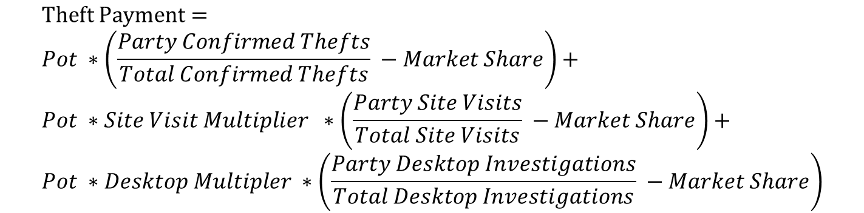
Debits / Credits Calculation
Current calculation set out in Theft Schedule for Debits/Credits, i.e:
This could be applied to payments for investigation, i.e.
This is arguably consistent with the current mechanism whilst ensuring unengaged suppliers make additional contributions, but does not pay out a consistent amount per investigation across suppliers.
$$Theft Payment=Pot ∗\left(\frac{Party Confirmed Thefts}{Total Confirmed Thefts} −Market Share\right)$$
$$Theft Payment= \\ Pot ∗\left(\frac{Party Confirmed Thefts}{Total Confirmed Thefts} −Market Share\right)+ \\ Pot ∗Site Visit Multiplier ∗\left(\frac{Party Site Visits}{Total Site Visits} −Market Share\right)+ \\ Pot ∗Desktop Multipler ∗\left(\frac{Party Desktop Investigations}{Total Desktop Investigations} −Market Share\right)$$

Slide 6
Example Scenarios
Example scenarios created to help understand potential outcomes of changes
Data created for these scenarios and is not based on actual suppliers, although attempts to reflect some of the varying results seen in current TDIS reporting
Scenarios based on assigning assumptions regarding performance of confirmed thefts compared to target and conversion rate of investigations (i.e. how many investigations needed to identify confirmed theft):
Theft Performance
Outperforming
Significantly above average
Above Average
Average
Below Average
None
Investigation efficiency
Abnormally high
High
Median
Low
Abnormally low
None

Slide 7
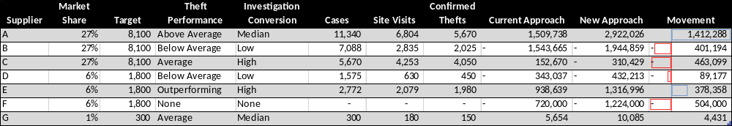
Example Scenario - Domestic
Supplier A has significant increase in payment as the high confirmed theft share is also reflected in a higher share of investigations.
Similar impact for supplier E, but reduced due to high conversion rate.
Example scenario created for illustrative purposes
Values driven by assumptions regarding performance against target and investigation conversation, including proportion of investigations leading to site visits.
Key Assumptions:
£12m total pot
Overall pot performance c. 45%
Site visit multiplier 50% (does not also receive desktop payment)
Desktop investigation multiplier 20%
Supplier C despite having average confirmed thefts moves to debit position due high investigation conversion and hence lower relative number of investigations
Significant increase in debit for supplier F – fully unengaged in scheme

Slide 8
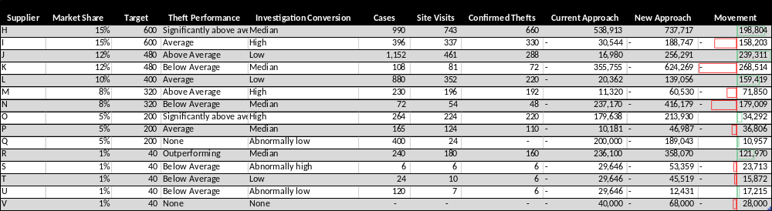
Example Scenario – Non-Domestic
Reporting few or no thefts but a high number of investigations can still result in payment to supplier
Similar to domestic supplier I with a high investigation conversion rate and average performed sees significantly higher payment into scheme (debit)
Key Assumptions:
£4m total pot
Overall pot performance c. 55%
Site visit multiplier 50% does not also receive desktop payment
Desktop investigation multiplier 20%

Slide 9
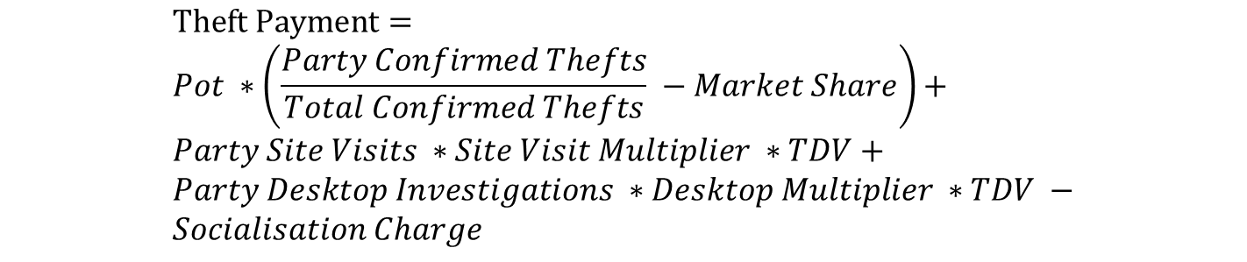
Debits / Credits Calculation – ALTERNATE APPROACH
Alternate option is to make fixed payment for investigations, with cost socialised, i.e.:
Socialisation could be based on:
  Market share – arguably simplest approach
  Share of under performance against target – adding additional incentive to hit target, but risk of funding cliff edge if improvements in performance continue and more suppliers go over target, i.e.
$$Theft Payment= \\ Pot ∗\left(\frac{Party Confirmed Thefts}{Total Confirmed Thefts} −Market Share\right)+ \\ Party Site Visits ∗Site Visit Multiplier ∗TDV+ \\ Party Desktop Investigations ∗Desktop Multiplier ∗TDV − \\ Socialisation Charge$$
Confirmed theft debit/credit (unchanged)
Investigation payment
Socialisation of investigation payment cost
$Socialisation Charge=Total Investigation Payment ∗\frac{Party target underperformance}{Total target underperformance}$

Slide 10
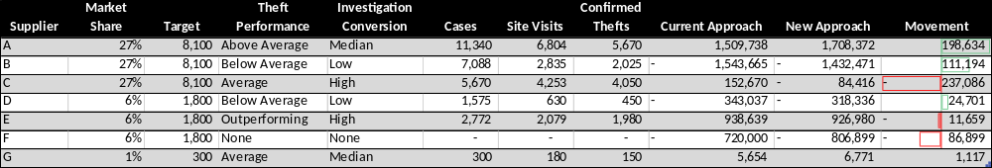
Example Scenario – Domestic Alternate Approach, market share socialisation
Example scenario created for illustrative purposes, using same assumptions as previously but adopting alternate payment rules for investigation payment.
Key Assumptions:
£12m total pot
Overall pot performance c. 45%
Site visit multiplier 50% (does not also receive desktop payment)
Desktop investigation multiplier 20%

Slide 11
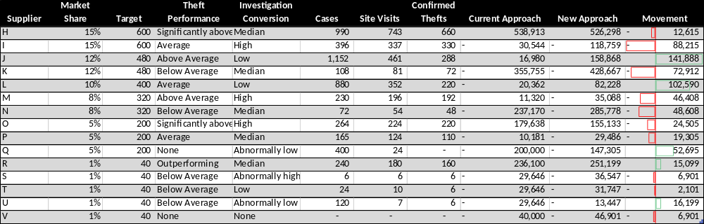
Example Scenario – Non-Dom Alternate Approach, market share socialisation
Key Assumptions:
£4m total pot
Overall pot performance c. 55%
Site visit multiplier 50%
Desktop investigation multiplier 20%

Slide 12
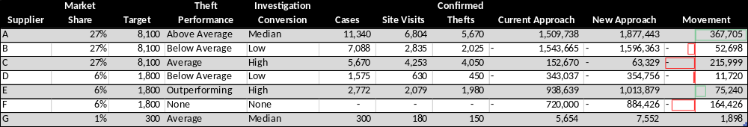
Example Scenario – Domestic Alternate Approach, socialisation based on target underperformance
Example scenario created for illustrative purposes, using same assumptions as previously but adopting alternate payment rules.
Key Assumptions:
£12m total pot
Overall pot performance c. 45%
Site visit multiplier 50% (does not also receive desktop payment)
Desktop investigation multiplier 20%

Slide 13
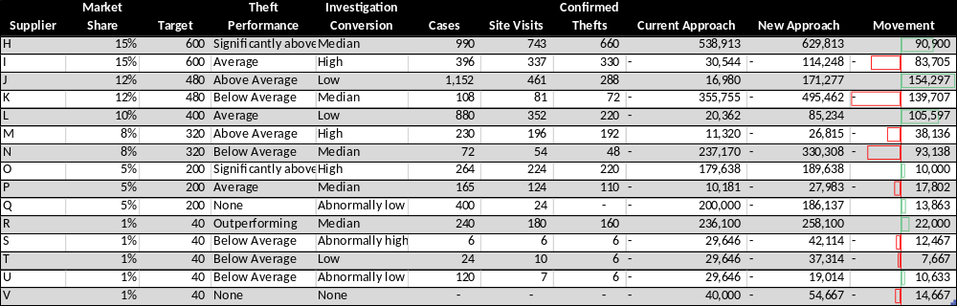
Example Scenario – Non-DOM Alternate Approach, socialisation based on target underperformance
Key Assumptions:
£4m total pot
Overall pot performance c. 55%
Site visit multiplier 50%
Desktop investigation multiplier 20%

Slide 14
Observations and Points for Discussion – apply to all options
Outcomes can vary significantly depending on assumptions applied and calculation method selected.
In the examples results are significantly impacted by assumptions on investigation conversion. This could represent genuinely varying portfolios or supplier efficiency. Any of the selected approaches could be argued to be penalising an effective and efficient supplier (although their costs should be lower), hence may be counter-productive.
To manage the risk of encouraging low-quality investigations should there be an upper limit on the number of investigations claimed, relative to target and / or confirmed thefts?
Should all calculations still operate by pot, or should the costs of investigation payments be considered at an overall market level?
All options remain net-zero scheme for each year – i.e. no carry-over of balances / credits / debits. Is this the right assumption or would allowing carry over of e.g. socialisation charge be valuable to provide greater certainty on scheme liabilities?

Slide 15
Thank YOU
Contact us: PERFORMANCEASSURANCE@recmanager.co.uk

