Slide 1
Agenda For today
 | TITLE | TIME | LEAD
1 | Welcome and Introductions | 14:00 | Chair
2 | Audit Update | 14:05 | Eric Dodd
3 | East Coast Hydrogen Project | 14:20 | Chris Varity
4 | IGEM Update | 14:35 | Dave Harper
5 | Industry Issues and Change Tracker | 14:50 | Code Manager
6 | REC Metering Hub Update | 15:05 | Chair
7 | National Energy System Operator – Energy Insights | 15:20 | Chair
8 | DESNZ Smart Meter Statistics in Great Britain | 15:35 | Chair
9 | AOB | 15:50 | All

Slide 2
2. Audit update
Eric dodd

Slide 3
3. East coast hydrogen project
Chris varity

Slide 4
4. Igem update
Dave harper

Slide 5
5. Industry issues and change tracker
Rec code manager

Slide 6
6. Rec metering hub update
chair

Slide 7
7. National energy system operator – energy insights
chair

Slide 8
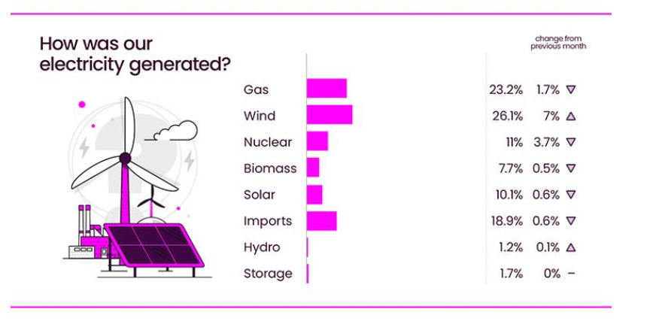
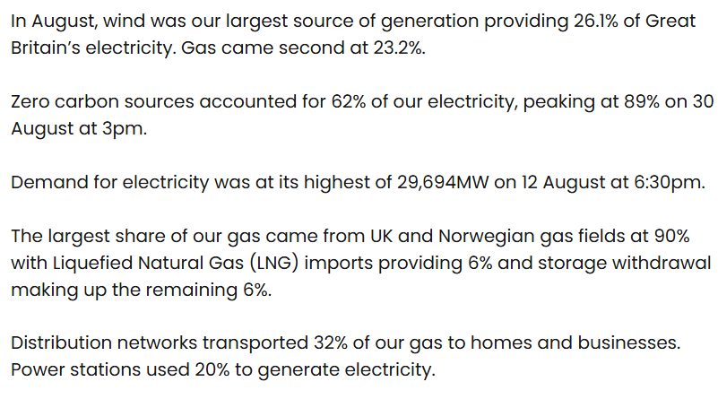
Source: National Energy System Operator – August 2025

Slide 9
8. Desnz smart meter statistics in great Britain
chair

Slide 10
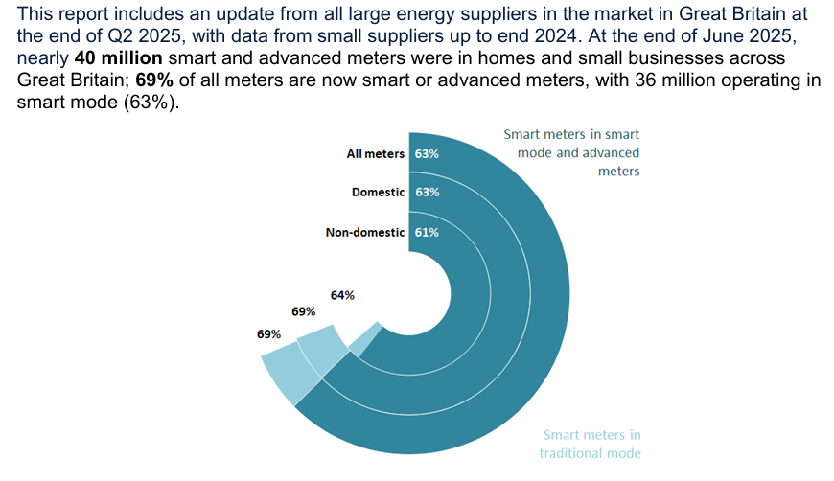
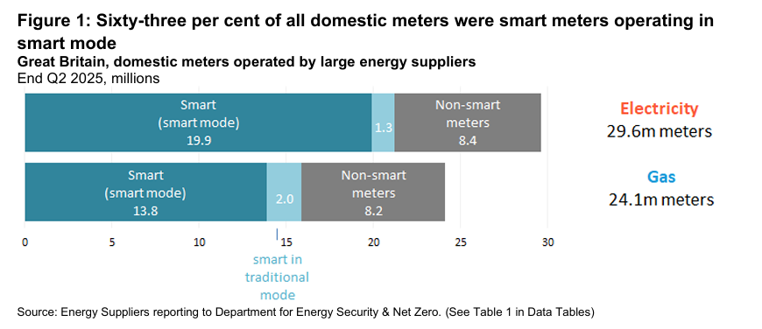
Source: DESNZ – GOV UK - Quarterly Report to end of June 2025

