Slide 1
REC e-omf
12 November 2025

Slide 2
1. Welcome and introduction
Chair

Slide 3
Agenda
Agenda Item | Presenter
Welcome and Introduction | Chair
Audit Update | Eric Dodd
ENA Dealing with Natural Disasters and Extreme Weather | Mel Swift
Safety & Technical Bulletins on the REC Metering Hub | Chair
Earth Connections on Metal Clad Cut-Outs | Richard Hill
National Energy System Operator – Energy Insights | Chair
Change Proposal Tracker | REC Change Team
Any Other Business | All

Slide 4
2. Audit update
Eric dodd

Slide 5
3. Ena dealing with natural disasters and extreme weather
Mel swift

Slide 6
4. Safety & technical bulletins on the rec metering hub
Chair

Slide 7
5. Earth connections on metal clad cut-outs
Richard hill

Slide 8
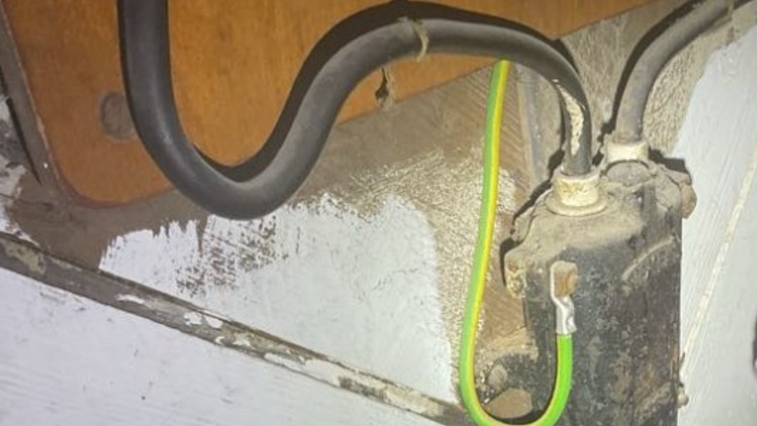

Slide 9
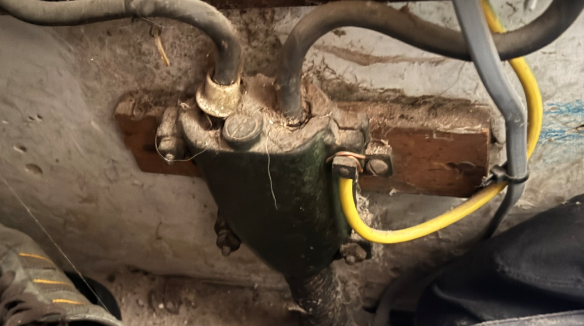

Slide 10
6. National energy system operator – energy insights
chair

Slide 11
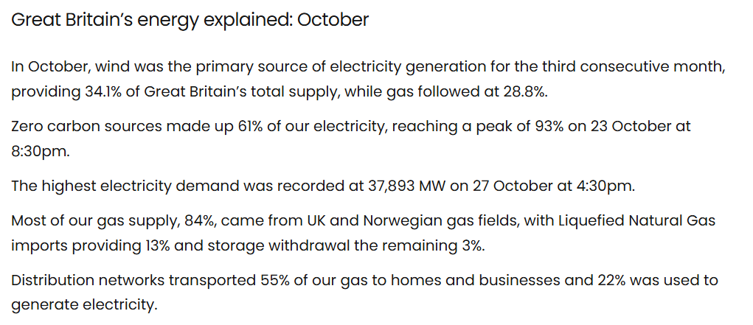
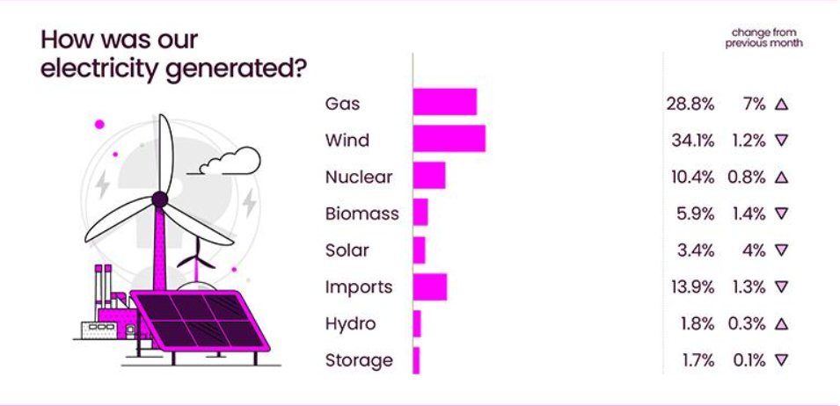
Source: National Energy System Operator – October 2025

Slide 12
7. Change tracker update
Rec change team

Slide 13
Change proposal tracker
CP | Title | Lead | Update
I0230 / I0261 | D0303 follow following MHHS design changes / Addition of Export Flag in D0303 flows | Caroline Freimuller | The Code Manager has opened an Information Request to get feedback from MAPs and MOAs on several solution options, closing 05 December 2025. The Code Manager is holding a Q&A session on 19 November 2025 to assist with this.
I0240 | Data Alignment of Meter Information Through MHHS Migration | James Hardy | The Scenario Guidance Document for I0240 has now been published on the I0240 portal page and on the MHHS Hub. As a result of this publication, I0240 has now been classed as resolved.
I0266 | REC Data Specification Clarifications | Caroline Freimuller | Party impact assessment is open; responses must be received by 23:59 28 November 2025. This is an extended impact assessment open for a total of 8 weeks due to the volume of changes proposed.
R0268 | Consequential Cross-Code Change for BSC P441 - Complex Site Classes Creation | Caroline Freimuller | This Change Proposal is at consultation, alongside BSC and DCUSA consultations, from 24 October to 14 November 2025.
I0270 | Clarification of SIP Qualification Requirements | Caroline Freimuller | The Change Report (Proposal Plan) is going to Change Panel for review on 18 November 2025.

Slide 14
Change proposal tracker
CP | Title | Lead | Update
I0275 | MHHS Related Metering Points across Market Segments | Francine Peyroux-Sissoko | Following CHIG in October and exploration done by the Code Manager, it became apparent that this issue is already catered for within BCSCP706: Supplier Meter Registration Service for MHHS Metering Systems. No REC change is now thought to be required. There is however still a potential issue regarding the transfer of Meter Technical Details (MTDs). CHIG discussed this Issue on 6 November 2025 and agreed for the issue to be resolved as REC guidance will be provided for Parties in advance of MHHS Migration and Elexon (BSCCo) will progress a BSC change.
I0278 | Establishing the Safe Isolation Provider (SIP) as a Standalone REC Metering Party | Francine Peyroux-Sissoko | The Code Manager is currently reviewing eight REC legal texts and the Service Termination Issue Reporting Guidance (STIRG) document to establish a clear governance framework for individuals or organisations to accede to the REC as SIPs without requiring MEM status.

