Slide 1
REC e-omf
13 August 2025

Slide 2
1. Welcome and introduction
Chair

Slide 3
Agenda
Agenda Item | Presenter
Welcome and Introduction | Chair
Audit Update | Eric Dodd
Priority Services Register | Matt Baker
New C21 Item | Warren Lacey
Metering Hub Update | Rebecca Griffiths
Safety & Technical Bulletins on the REC Metering Hub | Chair/Rebecca Griffiths
Change Proposal Tracker | REC Change Team
DNO New Equipment and Seal | Richard Hill
National Energy System Operator – Energy Insights | Chair
Any Other Business | All

Slide 4
2. Audit update
Eric dodd

Slide 5
3. Priority services register
Matt baker

Slide 6

Vulnerability Landscape

Slide 7
The PSR
Where the personal circumstances and characteristics of each Domestic Consumer create a situation where he or she is:
• Significantly less able than a typical Domestic Customer to protect or represent his or her interests; and or
• Significantly more likely than a typical Domestic Customer to suffer detriment or that detriment is likely to be more substantial.(Ofgem definition)
A vulnerable consumer is someone who, due to their personal circumstances, is especially susceptible to detriment, particularly when a firm is not acting with appropriate levels of care.
(FCA definition)
Priority Services Register (PSR)
What is it?
The Priority Services Register is a free, confidential service offered by energy and water companies in the UK. It provides extra help to customers who need it due to age, disability, health conditions, or other circumstances.
Who Can Register?
You may be eligible if you:
Are of pensionable age
Have a disability or long-term health condition
Have young children at home
Need priority support during power/water outages
Require accessible communication formats
What Support Is Offered?
Advance notice of planned power cuts
Priority support during emergencies
Meter reading support
Bills in accessible formats (e.g. large print, Braille)
Nominee scheme – a trusted person can manage your bills

Slide 8
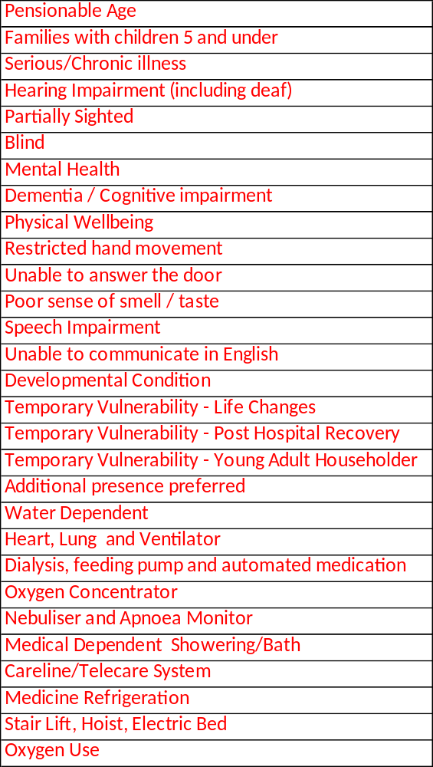
The PSR
1. Age-related
  - Pensionable (state pension) age
2. Disabilities & Health Conditions
  - Physical or mobility impairments
  - Long-term/chronic illness
  - Sensory impairments (sight, hearing, speech, taste/smell loss)
  - Mental health conditions
  - Cognitive impairments, dementia, learning disabilities
3. Dependence on Utilities
  - Medical equipment needing power or water
  - (e.g., oxygen, ventilators, feeding pumps)
4. Family Circumstances
  - Pregnant
  - Living with young children (under 5)
5. Communication Needs
  - Language barriers
  - Requires alternative formats (Braille, large print, audio)
6. Mobility & Access Issues
  - Difficulty answering the door
  - Housebound or restricted movement
7. Life Disruptions
  - Post-hospital recovery
  - Bereavement
  - Job loss or other major change

Slide 9
A brief history of the PSR
2000 The PSR established as a voluntary scheme for energy firms (suppliers and networks/DNOs)
2008 Ofgem make the PSR mandatory; Ofwat encourage water firms to adopt similar registers
2016 Ofgem expand the range of needs recorded by the PSR and require firms to promote and register more people on the PSR
2017 Initial meetings held to explore the potential for sharing consumer data between energy and water and an industry project starts….
As a result of the differing regulatory regimes, the project mandate is as follows:
In Energy: Standardisation of priority services and sharing of data within the energy sector is a licence condition, and the exchange of data is facilitated via the central market data system. Energy participants share appropriate data to provide excellent customer services and fulfil their licence obligations. Energy companies have also recognised the benefits of alignment with the water sector and extending data sharing to the water sector, and have committed to do so by April 2020
In Water: While there is no current licence condition in the water sector mandating the sharing of data for priority services, water companies have recognised the benefits for customers of doing so. Via the Water UK Council, water companies have committed to align the approaches to priority services between water and energy and implement data sharing between the sectors by April 2020
2019 Energy and water firms define a common set of ‘needs codes’ to allow data-sharing, largely adopting existing energy codes; PR19 includes a Common Performance Commitment for water companies to increase PSR numbers to a minimum of 7% of households served by 2024/25
2020 Common needs codes implemented and some water companies and DNOs begin data sharing

Slide 10
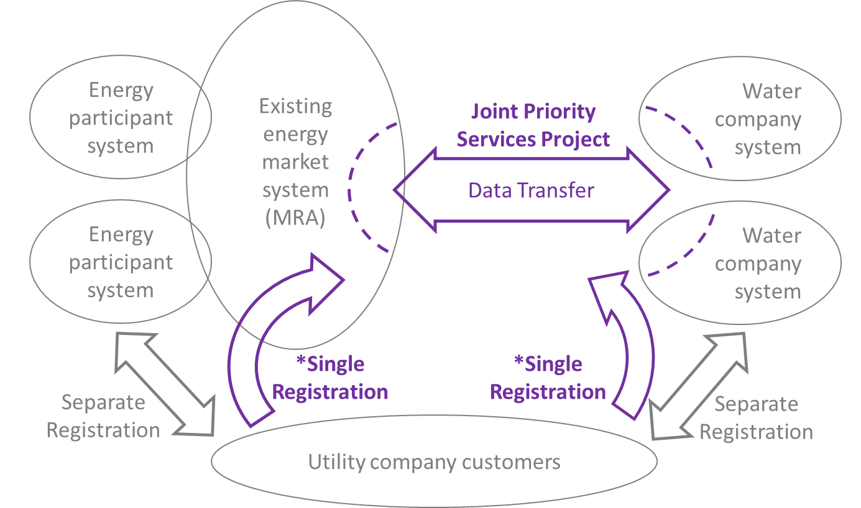
A brief history of the PSR
2021 Ofgem, Ofwat, and ICO engage on the appropriate legal basis for data sharing
2022 (April) Current project begins, led jointly by Water UK and Energy Networks Association (ENA)

Slide 11
The current project
2022 Decision taken to share data bi-laterally between pairs of water companies and DNOs rather than waiting for an industry-wide solution to be available. Each pair of companies signs Data Sharing Agreements (DSAs) and agree systems for sharing data, ranging from reasonably automated to very manual
2023 (April) All water companies (bar one) and all DNOs begin sharing data
2023 (October) Work begins with Ofgem and Energy UK to move energy suppliers from Explicit Consent to SPI
2024 (April) The Retail Energy Code Company (RECCo), which oversees energy industry PSR data sharing, amends its code to make it possible for energy supplier data to be shared with water companies (via DNOs) and vice versa. Energy suppliers begin receiving water company data, but water companies do not receive energy supplier data because (a) some energy suppliers are still using Explicit Consent and (b) water companies are concerned about the volumes of data they might receive from suppliers and their capacity to process those volumes; Matt Baker joins as joint Water UK/ENA funded Project Manager; Government announces plans for future ‘universal PSR’ or SSR (details tbc)
2025 Last of the major energy suppliers moves to SPI

Slide 12
The legal and regulatory bases
Legal
The Information Commissioner’s Office (ICO) advised Water UK in the summer of 2021 that explicit consent (i.e. asking the customer’s permission) was not a practical legal basis for capturing and sharing PSR data between industries, citing the example of a customer in a coma who would be unable to give their consent.
Instead, they recommended we use Legitimate Interest/Substantial Public Interest (SPI).
All water companies and DNOs moved to SPI by April 2022. Energy suppliers are currently completing the move to SPI.
ICO confirmed that IDNO’s and NAV’s are included in SPI
Regulatory
There are no specific regulatory obligations requiring cross-industry data sharing but both Ofwat and Ofgem have made it clear that they expect this to happen voluntarily.
Ofwat set Common Performance Commitments for the PSR in PR19. There are no PSR PCs in PR24 but the PSR Standards Review (issued 07/11/24) has set an expected ‘direction of travel’ – i.e. continued growth in PSR numbers.

Slide 13
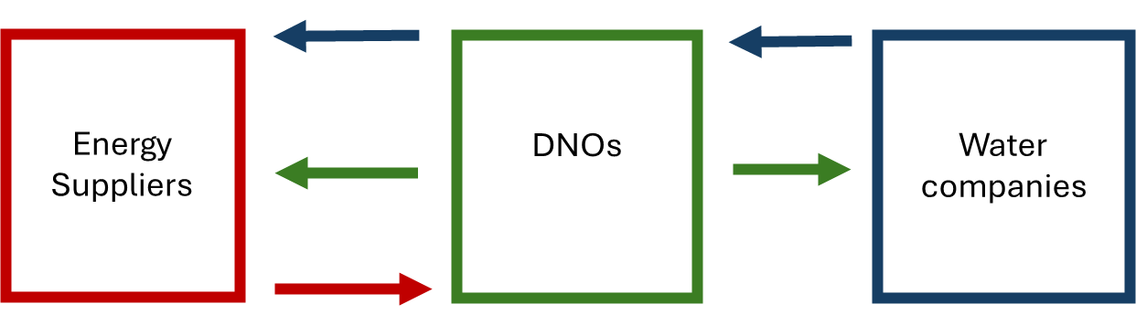
The current project
Water companies are not currently receiving energy supplier data because of concerns over the volumes that might be involved and the challenge of managing exceptions.
Ofwat and Ofgem originally wanted energy supplier data to flow to water companies from 1 January 2024. We have gained their support for a delay pending
Getting energy suppliers on to SPI (this is now in place)
Finding an automated collective solution to smooth file transfers and deal with data exceptions

Slide 14
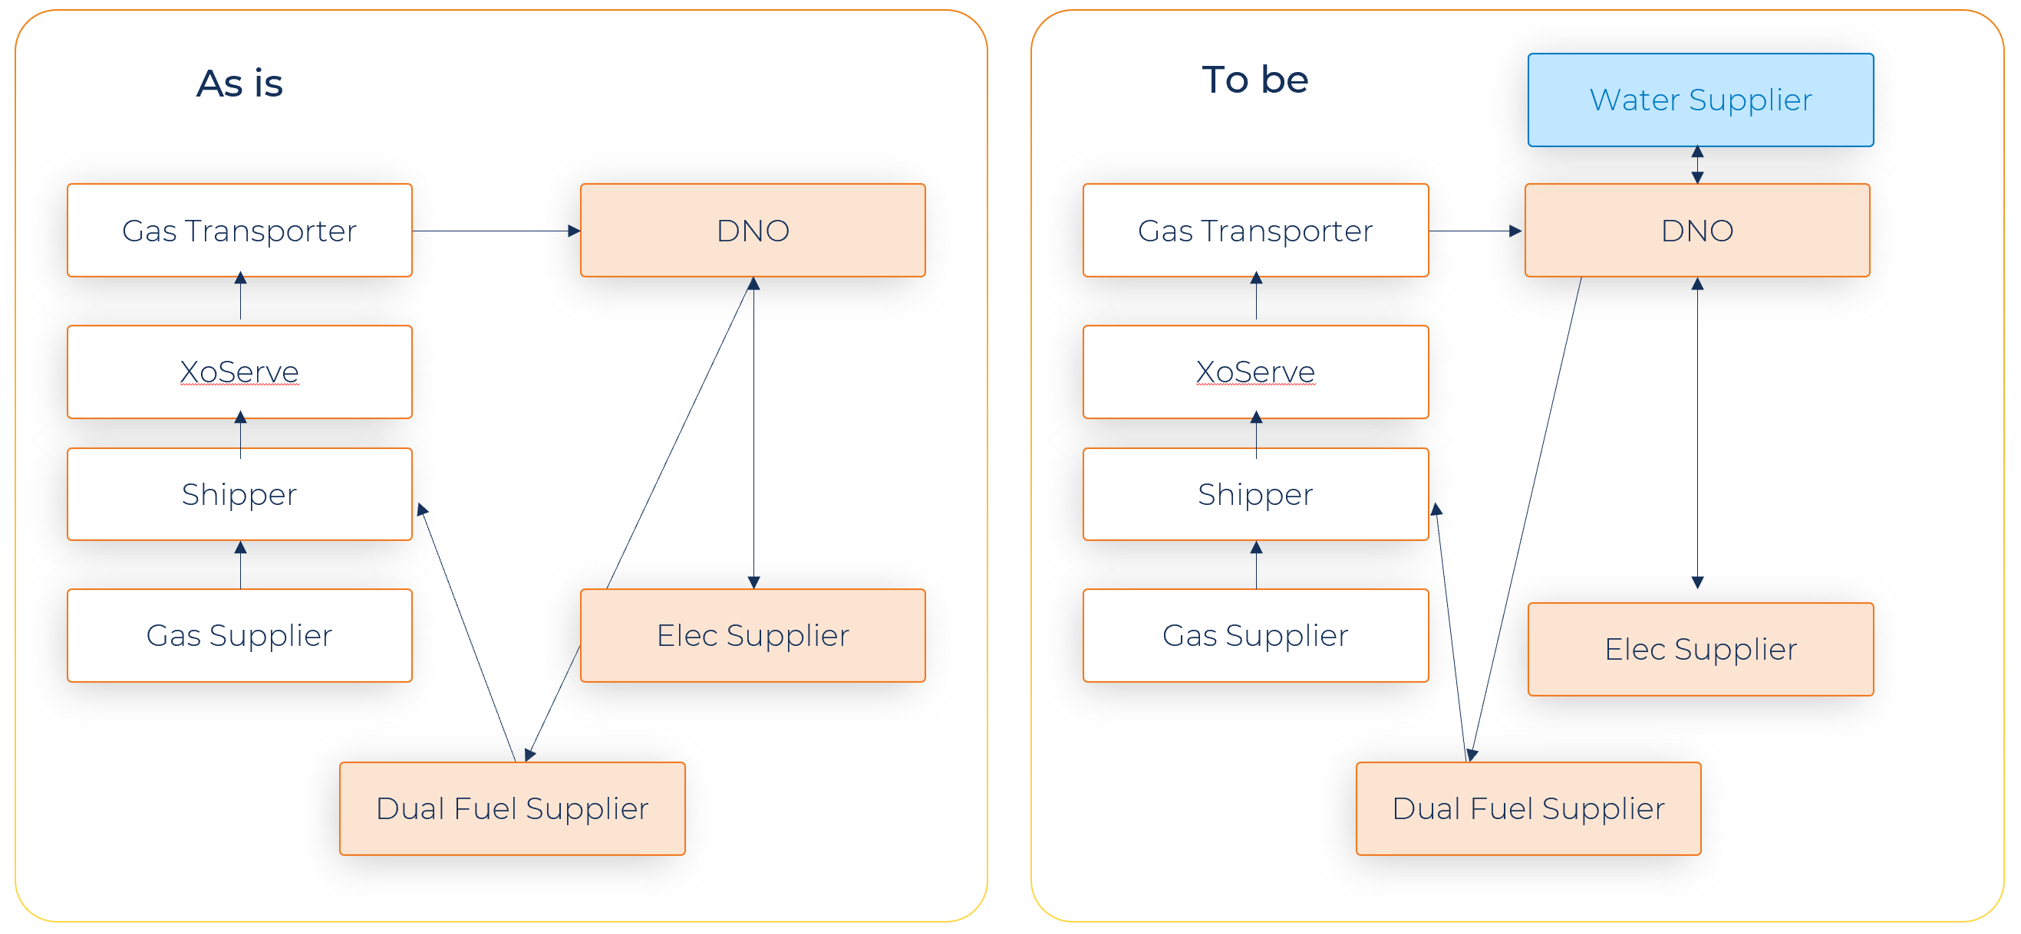
The WD0225 Data Flow
The model could be adapted going forwards in future phases for water to supplier, water to IDNO, water to water and if required water to GT via Xoserve (and vice-versa).
We are extending existing DTS PSR processes into the water market. This approach requires no energy code changes to the Retail Energy Code (REC) as water and energy PSR data share is not regulated.
Water companies will use the existing infrastructure, already used by Suppliers and DNOs to share PSR information (and vice-versa) in the Electricity market; utilising this process will enable speed of implementation into a trusted platform as well as affording the lowest cost to end users.
The ElectraLink solution will use a mirror version of the D0225 file [WD0225] with additional fields; files will be transmitted via the Data Transfer Network.

Slide 15
Benefits
Key Benefits:
Timely Data Access: Water companies will have immediate access to the most up-to-date information, enabling quicker responses to emergencies and reducing risks for vulnerable customers.
Improved Service Delivery: Automated data sharing will eliminate the delays caused by manual processes, ensuring vulnerable customers receive priority services
Enhanced Security and Compliance: Centralised governance and encrypted data transmission will ensure full compliance with GDPR and other relevant data protection laws, reducing the risk of data breaches.
Cost and Time Savings: By eliminating manual data entry the solution will save resources and reduce the burden on administrative staff and data teams.
Energy and Water Alignment: Consistent process across Water Industry will be the enabler for full energy supplier volumes to be shared plus direct sharing with energy suppliers in future phases.
Alignment with Project Objectives:
This solution aligns with the PSR Data Sharing objectives and the broader goals of safeguarding vulnerable customers by ensuring uninterrupted access to essential services. It also supports regulatory objectives and compliance around data sharing and improves operational efficiency.

Slide 16
4. New c21 item
Warren lacey

Slide 17
5. Metering hub update
Rebecca griffiths

Slide 18
6. Safety & Technical bulletins on the rec metering hub
Chair / rebecca griffiths

Slide 19
7. Change tracker update
Rec change team

Slide 20
Change proposal tracker
CP | Title | Lead | Update
I0197 | Introducing a Process to Provide Updates During Fault Resolutions | James Hardy | I0197 Working Group is currently in progress. There are separate sessions to review the Metering Job process for both Gas and Electricity. Previous meeting minutes can be found on the REC Portal. The Code Manager will confirm the next meeting dates for both Gas and Electricity in due course, but if you would like to attend the working group, please contact us at change.management@recmanager.co.uk .
R0207 | Import / Export MOA Charging Clarification | Caroline Freimuller | On 30 May 2025, the Authority made the decision to send back R0207. The letter detailing the reasons for the send back can be found here Decision to send back Retail Energy Code modification R0207: Import and Export MOA Clarification | Ofgem The Code Manager is reviewing and preparing next steps.
R0216 | REC Changes to tie in with DCP419 | Caroline Freimuller | Consultation closed on 08 August 2025, and the Code Manager will be at the September Metering Expert Panel for the final vote.
I0240 | Data Alignment of Meter Information through MHHS Migration | James Hardy | Solution options were discussed at Change Issues Group on 07 August 2025 and reviewed at the Metering Expert Panel on 13 August 2025. The solution to be taken forward is provision of guidance to support the existing contract arrangements (where Energy Suppliers inform each other between themselves). A draft solution will be taken to Change Issues Group in September.
R0241 | MHHS Incremental Changes for Go Live | Harriet Truss | On 07 August 2025, the Authority approved the Change Proposal for implementation at MHHS Milestone M8, which is 22 September 2025.

Slide 21
8. Dno new equipment and seal
Matt baker

Slide 22
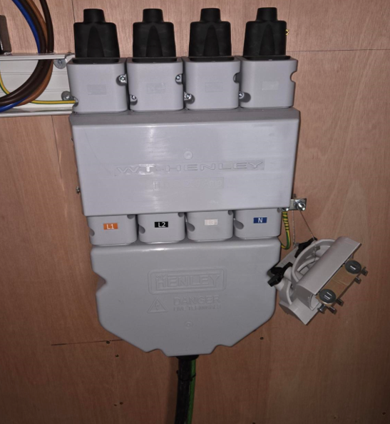

New DNO equipment – WT Henley cut-out
5mm hex key terminal

Slide 23
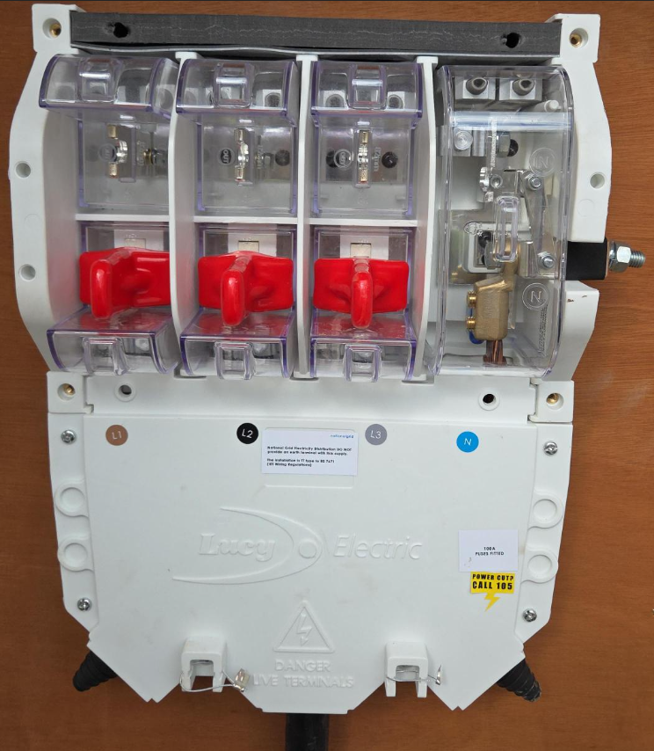
New DNO equipment – LUCY cut-out
6mm hex key terminal
Appendix 13:
Exchange of Information Between DNOs, MOAs and EMOs

Slide 24
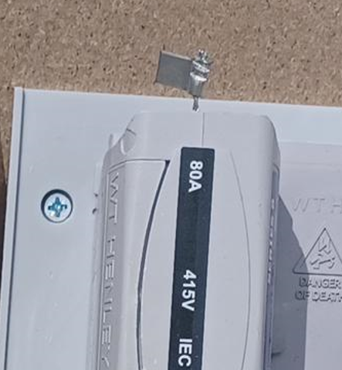

SEALING OF EQUIPMENT AFTER a DNO VISIT

Slide 25

SEALING OF EQUIPMENT AFTER a dno visit
Appendix 19:
Requirements for the sealing of Metering Equipment and related DNO Equipment

Slide 26
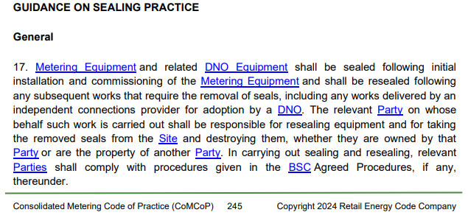
SEALING OF EQUIPMENT – comcop, App 19, Section 17

Slide 27
9. National energy system operator – energy insights
chair

Slide 28
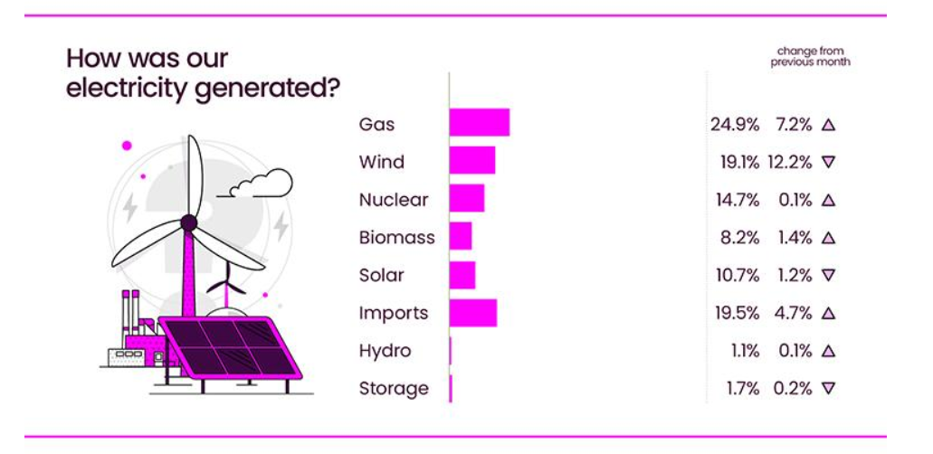
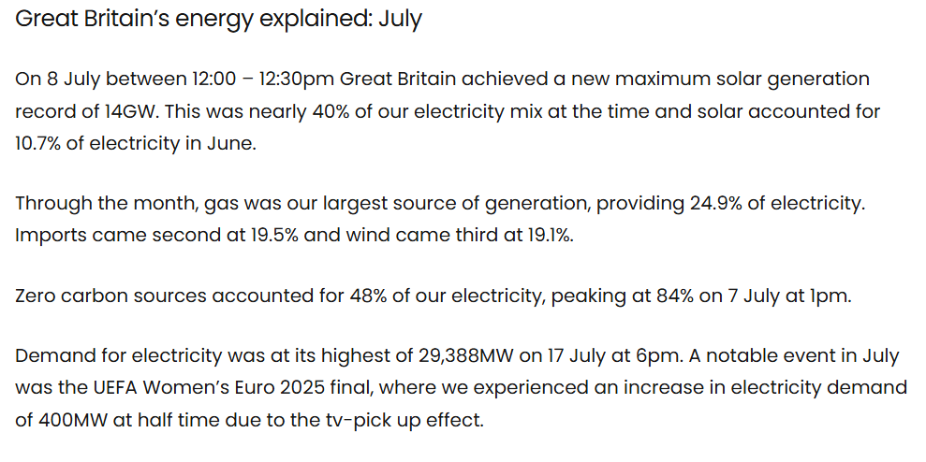
Source: National Energy System Operator – July 2025

