Slide 1
THEFT ISSUES GROUP
26 November 2025

Slide 2
Agenda For today
 | TITLE | PAPER REF. | TIME | LEAD
1 | Welcome and Introduction | Verbal | 10:00 | Chair
2 | Confirmation of the Agenda | Verbal | 10:05 | Chair
3 | Approval of Previous Minutes For Decision | Verbal | 10:10 | Chair
4 | R0253 – Theft – DNO/Networks Not Providing Photos For Discussion | RECTIG_25_11_26_04 | 10:15 | Lydia Bentley
5 | I0265 - Theft Calculator Usage and Suitability Assessment For Discussion | RECTIG_25_11_26_05 | 10:30 | Francine Peyroux-Sissoko
6 | I0187 – Schedule 8 Review and Best Practice Guidance Development For Discussion | Verbal | 10:45 | James Hardy
7 | Any Other Business | Verbal | 11:00 | Chair
8 | Change Update | Verbal | 11:10 | James Hardy
8 | Future Meetings | Verbal | 11:20 | Chair

Slide 3



Do not edit
How to change the design
Join at slido.com
#4144226
The Slido app must be installed on every computer you’re presenting from

Slide 4
Approval of Previous Minutes
Chair

Slide 5
I0253 – Theft – DNO/Networks Not Providing Photos
Lydia Bentley

Slide 6
Overview
Issue
Network Parties attend sites where Energy Theft is suspected or confirmed during the course of their visit.
Energy Supplies may not have enough evidence to support a claim for Energy Theft against the Theft Detection Incentive Scheme (TDIS) as the Network Party has removed it during their visit.
Network Parties will be required to record evidence of suspected or confirmed Energy Theft during visits.
Proposed Solution
Impact
Network Parties have a responsibility to make sites safe.
In making a site safe, a Network Party may need to makes changes to the site that remove the evidence of Theft.
Network Parties will then be required to make this evidence available to Energy Suppliers to support TDIS claims.

Slide 7

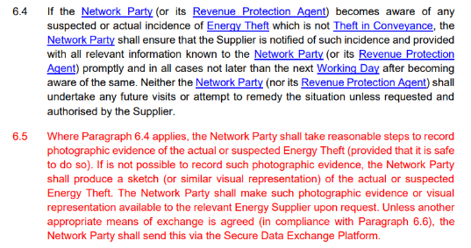
Solution
Proposed Solution – Intent
The draft legal text achieves the following:
Obligates a Network Party to take a photo documenting Energy Theft when attending a site.
Obligates a Network Party to produce a sketch, where taking a photo was not possible.
Obligates a Network Party to send the photo or sketch to the Energy Supplier, using either SDEP or any other mutually agreed method.

Slide 8
Impact Assessment
Summary
Scope
The Code Manager published an Impact Assessment between 16 October and 07 November.
15 responses were received: 7 from Network Parties, and 8 from Suppliers.
The Code Manager wanted to understand the following:
Network Party Costs
Supplier Benefits
Implementation Considerations
General feedback on proposed solution.

Slide 9
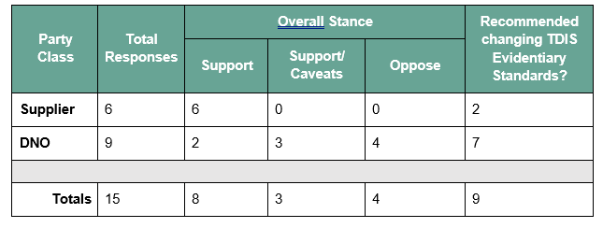
Impact Assessment: Response Summary

Slide 10
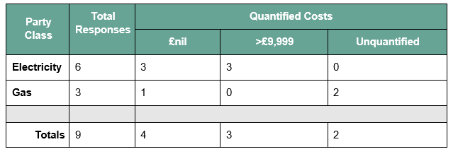
Impact Assessment: Response Summary

Slide 11
Impact Assessment: Response Summary
Undefined Benefits Case
Request to re-visit TDIS Standards
Lead Time
No Supplier respondent was able to quantify their anticipated benefit from the Proposed solution.
9/15 respondents indicated that they are in favour of revising TDIS standards to review photographic evidence requirements.
4 Network Party respondents indicated that they would need at least 6 months to implement the proposed solution.

Slide 12
Cost Benefit – Provisional Minded-To Position
Cost-Benefit Case Not Met
Unquantified Supplier Benefit Case
Substantial Network Party Costs
No overwhelming position for either support or oppose

Slide 13
Questions for TIG
Are you able to provide any additional quantification to substantiate the cost-benefit assessment?
Do you have any views on the provisional minded-to position?
Do you have any other comments?
Would you support the introduction of a new Issue to review of TDIS standards should I0253 be rejected?

Slide 14

Do not edit
How to change the design
Given a choice between rejecting the Change, or a non-mandatory obligation, what would you rather?
The Slido app must be installed on every computer you’re presenting from

Slide 15
Do not edit
How to change the design
Do you support rejecting this issue and raising in it's place a new issue to change TDIS standards
The Slido app must be installed on every computer you’re presenting from

Slide 16
Do not edit
How to change the design
Which would you prefer?
The Slido app must be installed on every computer you’re presenting from

Slide 17
I0265 – Theft Calculator Usage and Suitability Assessment
Francine Peyroux-Sissoko

Slide 18
I0265 – Theft Calculator Usage and Suitability Assessment
Gather input on challenges REC Parties encounter when using the Theft Calculators
Support with the solution development stage
Open for 6 weeks
Responses

Slide 19
I0265 – Theft Calculator Usage and Suitability Assessment
Sensitive topic
2 use the REC Theft Calculators
2 use an alternative calculator
4 use a mix of the REC Theft Calculators and an alternate/estimated calculations
Respondents unanimously acknowledged the need for improvement

Slide 20
I0265 – Theft Calculator Usage and Suitability Assessment
System barriers
Some tampers not covered
New technologies not covered
Equipment not covered
Not adapted to certain types of energy theft
Outdated for I&C properties and appliances

Slide 21
I0265 – Theft Calculator Usage and Suitability Assessment
Clamp meter readings/tong test results
Regular review of tampers
Incorporate EPC
Incorporate EAC and AQ
Location of REC Calculators & guidance
Avoid manual/estimated calculations

Slide 22
I0265 – Theft Calculator Usage and Suitability Assessment
Outdated calculator not delivering its intended purpose effectively
PAB supportive of a redesign and AI tools to help
Inconsistent application across Parties due to clear challenges

Slide 23
I0265 – Theft Calculator Usage and Suitability Assessment
TIG Members are invited to:
NOTE the contents of this presentation; and
DISCUSS the responses of the information request to determine next steps.

Slide 24
Do not edit
How to change the design
Do these results reflect your experience with the REC Theft Calculators?
The Slido app must be installed on every computer you’re presenting from

Slide 25

Do not edit
How to change the design
Do you experience other challenges that have not been discussed today? If yes, please tell us what they are.
The Slido app must be installed on every computer you’re presenting from

Slide 26
Do not edit
How to change the design
Are there other improvements that could be added to the REC Theft Calculators?
The Slido app must be installed on every computer you’re presenting from

Slide 27
Do not edit
How to change the design
Are there any other comments or feedback on this Issue you would like to share?
The Slido app must be installed on every computer you’re presenting from

Slide 28
I0187 – schedule 8 review and best practice guidance development
James Hardy

Slide 29
I0187 – Schedule 8 Clause 6.16
Each Supplier shall provide the Code Manager with such theft contact as may be requested from time to time included:
A) Energy Supplier name;
B) MPID;
C) Contact name/department, telephone and email for primary contact; and
D) contact name, telephone and email for escalation contact
1) Should the Code Manager obtain operational contact information from Network Operators (in addition to Suppliers) for theft/unregistered site meters?
2) Do you agree that the heading “Exchange of Information Between Energy Suppliers” is misleading or too narrow given the obligation in Clause 6.16?
3) If the heading should be changed, which of the following do you support?
  a. Change to “Exchange of information between Parties and the Code Manager”,
  b. Change to “Exchange of information for Theft and Unregistered Site matters”
  c. Keep the current heading but add a sub-heading specific to exchange of information with the Code Manager)

Slide 30
Do not edit
How to change the design
Should the Code Manager obtain operational contact information from Network Operators (in addition to Suppliers) for theft/unregistered site meters?
The Slido app must be installed on every computer you’re presenting from

Slide 31
Do not edit
How to change the design
Do you agree that the heading “Exchange of Information Between Energy Suppliers” is misleading or too narrow given the obligation in Clause 6.16?
The Slido app must be installed on every computer you’re presenting from

Slide 32
Do not edit
How to change the design
If the heading should be changed, which of the following do you support?
The Slido app must be installed on every computer you’re presenting from

Slide 33
Do not edit
How to change the design
Do you have any other comments or suggestions for Clause 6.16?
The Slido app must be installed on every computer you’re presenting from

Slide 34
I0187 – Schedule 8 Clause 6.19
Energy Suppliers and Network Parties shall use the relevant contact details set out in the published theft contacts register when there are no other applicable avenues to report matters relating to the identification of theft, revenue protection activities and/or untraded energy.
1) Should there be a separate set of operational contacts for unregistered sites or new connection queries, distinct from theft contacts?
2) If we retain a single register, should it include clearly defined sub-categories? E.g. Theft Contacts and Unregistered Site Contacts, to avoid misrouting?
3) Should the contact register distinguish between different types of contacts, for example: Operational contacts for day-to-day queries or reporting (ideally via a shared mailbox), and Escalation points for higher-priority or complex issues? If so, what levels should be included? Is a two-tier structure sufficient, should this increase to 3 tiers?
4) Should Clause 6.19 be updated to replace the phrase “when there are no other applicable avenues” with “where the use of SDEP may not be appropriate or possible” to provide greater clarity and alignment with operational practice?

Slide 35
Do not edit
How to change the design
Should there be a separate set of operational contacts for unregistered sites or new connection queries, distinct from theft contacts?
The Slido app must be installed on every computer you’re presenting from

Slide 36
Do not edit
How to change the design
If we retain a single register, should it include clearly defined sub-categories? E.g. Theft Contacts and Unregistered Site Contacts, to avoid misrouting?
The Slido app must be installed on every computer you’re presenting from

Slide 37
Do not edit
How to change the design
Should the contact register distinguish between different types of contacts? If so, what levels should be included? Is a two-tier structure sufficient, should this increase to 3 tiers?
The Slido app must be installed on every computer you’re presenting from

Slide 38
Do not edit
How to change the design
Should Clause 6.19 be updated to replace the phrase “when there are no other applicable avenues” with “where the use of SDEP may not be appropriate or possible” to provide greater clarity and alignment with operational practice?
The Slido app must be installed on every computer you’re presenting from

Slide 39
Do not edit
How to change the design
Do you have any other comments or suggestions on Clause 6.19?
The Slido app must be installed on every computer you’re presenting from

Slide 40
I0187 – Schedule 8 Clause 6.9
If an Energy Supplier receives a report of suspected Energy Theft relating to one or more Consumers for whom the Energy Supplier is not responsible for investigating reports of theft, then the Energy Supplier shall record the details and pass these through to the Network Party by the end of the next Working Day.
1) Do you agree that Clause 6.9 should be amended so reports are passed to the Registered Supplier or Network Party, rather than only to the Network Party?
2) Do you support relocating or restructuring this clause so that responsibilities to Suppliers and responsibilities to Network Parties sit in their respective sections?
3) Would splitting out the onward-reporting requirements (to Registered Suppliers vs. to Network Parties) improve clarity?

Slide 41
Do not edit
How to change the design
Do you agree that Clause 6.9 should be amended so reports are passed to the Registered Supplier or Network Party, rather than only to the Network Party?
The Slido app must be installed on every computer you’re presenting from

Slide 42
Do not edit
How to change the design
Do you support relocating or restructuring this clause so that responsibilities to Suppliers and responsibilities to Network Parties sit in their respective sections?
The Slido app must be installed on every computer you’re presenting from

Slide 43
Do not edit
How to change the design
Would splitting out the onward-reporting requirements (to Registered Suppliers vs. to Network Parties) improve clarity?
The Slido app must be installed on every computer you’re presenting from

Slide 44
Do not edit
How to change the design
Do you have any other comments or suggestions on Clause 6.9?
The Slido app must be installed on every computer you’re presenting from

Slide 45
aob
chair

Slide 46
Change Update
James Hardy

Slide 47
Change Update
REF | TITLE | STAGE | TIG MEETING | COMMENT
I0175 | Introducing a Reasonable Endeavours Scheme within the REC | On hold | TBC | On hold pending the development of the Theft Strategy Proposals Paper.
I0176 | Creation of an Energy Theft Detection and Resolution Body | On hold | TBC | On hold pending the development of the Theft Strategy Proposals Paper.
I0187 | Schedule 8 Review and Best Practice Guidance Development | Solution Development | November | Solution Development via the Theft Issues Group
R0212 | Protecting Crimestoppers and their Contacts | Implemented | N/A | Implemented on 7 November 2025.
R0253 | Theft - DNO/Networks not providing photos | Change Proposal | November | Issue has now progressed to a Change Proposal.
R0263 | Sharing Confirmed Energy Theft Data with the BSCCo | Implemented | N/A | Implemented on 7 November 2025.
I0265 | Theft Calculator Usage and Suitability Assessment | Definition | November | Extended Information Request responses to be reviewed to determine the next steps. Overview to be provided to Theft Issues Group at the TIG and the Performance Assurance Board in November.

Slide 48
Future meetings
Chair

