Slide 1
THEFT ISSUES GROUP
29 October 2025

Slide 2
WELCOME, INTRODUCTION AND CONFIRMATION OF AGENDA
chair

Slide 3
Agenda For today
 | TITLE | PAPER REF. | TIME | LEAD
1 | Welcome and Introduction | Verbal | 10:00 | Chair
2 | Confirmation of the Agenda | Verbal | 10:05 | Chair
3 | Approval of Previous Minutes For Decision | Verbal | 10:10 | Chair
4 | I0253 – Theft – DNO/Networks Not Providing Photos For Discussion | RECTIG_25_1029_04 | 10:15 | Lydia Bentley
5 | I0265 - Theft Calculator Usage and Suitability Assessment For Information | Verbal | 10:30 | Francine Peyroux-Sissoko
6 | Any Other Business | Verbal | 10:45 | James Hardy
7 | Change Update | Verbal | 10:55 | James Hardy
8 | Future Meetings | Verbal | 11:00 | Chair

Slide 4
Approval of Previous Minutes
Chair

Slide 5
I0253 – Theft – DNO/Networks Not Providing Photos
Lydia Bentley

Slide 6
I0253 – What’s new?
New Lead Analyst: Lydia Bentley
Updated Solution
New Milestone Plan approved
Party Impact Assessment Published

Slide 7
I0253 – Background
Issue
Network Parties attend sites where Energy Theft is suspected or confirmed during the course of their visit.
Energy Supplies may not have enough evidence to support a claim for Energy Theft against the Theft Detection Incentive Scheme (TDIS) as the Network Party has removed it during their visit.
Network Parties will be required to record evidence of suspected or confirmed Energy Theft during visits.
Proposed Solution
Impact
Network Parties have a responsibility to make sites safe.
In making a site safe, a Network Party may need to makes changes to the site that remove the evidence of Theft.
Network Parties will then be required to make this evidence available to Energy Suppliers to support TDIS claims.

Slide 8
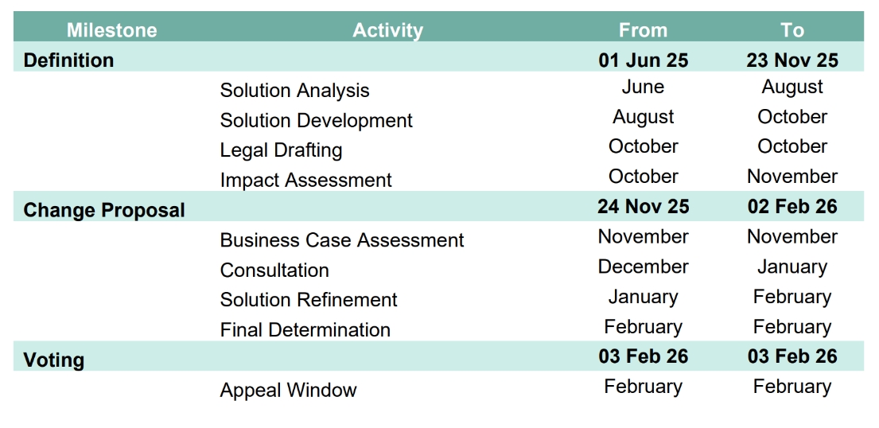
I0253 – Milestone Plan

Slide 9

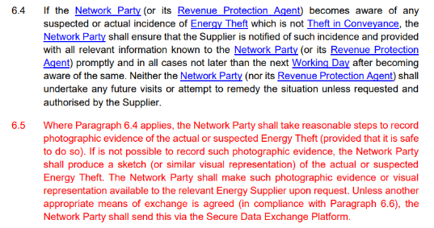
I0253 – Updated Solution
Proposed Solution – Intent
The draft legal text achieves the following:
Obligates a Network Party to take a photo documenting Energy Theft when attending a site.
Obligates a Network Party to produce a sketch, where taking a photo was not possible.
Obligates a Network Party to send the photo or sketch to the Energy Supplier, using either SDEP or any other mutually agreed method.

Slide 10
I0253 – Party IA
When?
Who?
What?
Party IA Published on 16 October
Closes on 07 November
The Code Manager would primarily like to hear from DNOs, GTs and Energy Suppliers
The Code Manager wants to understand how:
Energy Suppliers may benefit in respect of improved evidence to support TDIS claims.
Network Parties are impacted by the proposed solution, and any anticipated costs or process changes needed.

Slide 11
I0253 – Next Steps
Party IA Closes
07 November
Consultation:
December>January
(Extended)
Final Vote at Change Panel:
03 February

Slide 12
I0265 – Theft Calculator Usage and Suitability Assessment
Francine Peyroux-Sissoko

Slide 13





I0265 -Theft Calculator Usage and Suitability Assessment
Information Request open from 26th September until 24th October 2025
Six responses received
Respondents unanimously acknowledged that the Theft Calculator requires improvement, even if they are currently facing no access issues
Would extending the Information Request help with receiving a few more responses?
A summary of the responses will be given at the TIG November meeting

Slide 14
Any other business
James Hardy

Slide 15
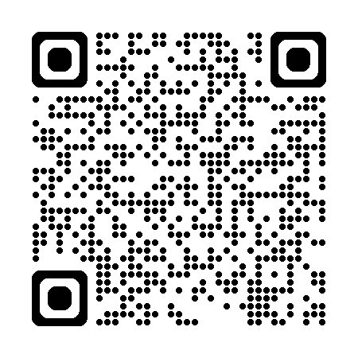
Have your say: our Annual Stakeholder
Satisfaction Survey is Live
Your voice matters. Our Annual Stakeholder Satisfaction Survey is now open, allowing you to share direct feedback on how we’re managing the Retail Energy Code (REC) Services.
Why participate?
This is your chance to tell us what’s working well in how the Theft Issues Group operates, and where we need to improve.
Your feedback will directly shape our priorities for 2026–27.
Our main Annual Satisfaction Survey has also been launched. Please look out for an email from Researchcraft in your mailbox (researchcraft@qrs-research.net).
All responses are completely confidential, and results will be shared in early 2026.
https://online1.snapsurveys.com/l9blyt?Q1a=TIG

Slide 16
Change Update
James Hardy

Slide 17
Change Update
REF | TITLE | STAGE | TIG MEETING | COMMENT
R0173 | Improvements to the TDIS | Implemented | N/A | Implemented on 22 September 2025 (effective from date of 1 October 2025).
I0175 | Introducing a Reasonable Endeavours Scheme within the REC | On hold | TBC | On hold pending the development of the Theft Strategy Proposals Paper.
I0176 | Creation of an Energy Theft Detection and Resolution Body | On hold | TBC | On hold pending the development of the Theft Strategy Proposals Paper.
I0187 | Schedule 8 Review and Best Practice Guidance Development | Solution Development | November | Solution Development via the Theft Issues Group
R0212 | Protecting Crimestoppers and their Contacts | Awaiting Implementation | N/A | Awaiting implementation on 7 November 2025.
I0253 | Theft - DNO/Networks not providing photos | Definition | October | Issue currently out for Party impact assessment. This will close for responses on 07 November 2025.
R0263 | Sharing Confirmed Energy Theft Data with the BSCCo | Awaiting Implementation | N/A | Awaiting implementation on 7 November 2025.
I0265 | Theft Calculator Usage and Suitability Assessment | Definition | October | Information Request responses to be reviewed to determine the next steps. Overview to be provided to Theft Issues Group on 29 October and the Performance Assurance Board in November.

Slide 18
Future meetings
Chair

