Slide 1
THEFT ISSUES GROUP
31 July 2024

Slide 2
WELCOME, INTRODUCTION AND CONFIRMATION OF AGENDA
chair

Slide 3
Agenda For today
 | TITLE | PAPER REF. | TIME | LEAD
1 | Welcome and Introduction | Verbal | 09:30 | Chair
2 | Confirmation of the Agenda | Verbal | 09:30 | Chair
3 | Approval of Minutes from the previous meeting For Approval | RECTIG_24_0731_03 | 09:35 | Chair
4 | Desktop and Site Visit Definitions for Theft Investigations For Discussion | RECTIG_24_0731_04 | 09:40 | Lynne Fallon RECCo
5 | I0173 – Improvements to the Theft Detection Incentive Scheme For Discussion | RECTIG_24_0731_05 | 10:00 | Walter Carlton REC Code Manager
Comfort Break
6 | I0175 – Introducing a Reasonable Endeavours Scheme within the REC For Discussion | Verbal | 11:30 | Chair
7 | I0176 – Creation of an Energy Theft Detection and Resolution body For Discussion | Verbal | 12:00 | Michelle Simpson Electralink
8 | Any Other Business | Verbal | 12:25 | Chair

Slide 4
Approval of minutes from the previous meeting
chair

Slide 5
DESKTOP AND SITE VISIT DEFINITIONS FOR THEFT INVESTIGATIONS
Lynne fallon
recco

Slide 6
Energy desktop investigation
Means that the holder of and Energy Licence (or person acting on their behalf) conducts a desktop investigation to determine the potential likelihood of Energy Theft and requirements of further investigation in response to a report of a suspicion of Energy Theft which may be in the form of a Tip-Off or a data generated lead. As a minimum the desktop investigation shall include and evidence:
The source, date of initial report and details of the initial report of suspicion of Energy Theft.
If theft in conveyance that the address is in the Network Party's area of responsibility; If Energy Theft other than Theft in Conveyance, the Energy Supplier must confirm that they are the current Energy Supplier and the Supply Start date and any known future Change of Supplier.
Obtain and validate where possible the Consumer name, address, MPAN/MPRN any potential change of tenancy or ownership and period of occupancy.
Any consumer or 3rd party contact or activity on the account.
Review of meter details, any metering work, meter readings, consumption, alerts and payment activity in context to the initial report.
Any previous known theft investigations at the premises or linked to the Consumer.
A determination that the suspicion of theft is invalid and the Energy Theft Investigation may be closed or that the suspicion of theft is valid and should progress to an Energy Theft Site Visit Investigation.

Slide 7
Energy theft site visit investigation
Means that the holder of an Energy Licence (or person acting on their behalf) visits the premises where energy theft is suspected to determine if a Confirmed Energy Theft has occurred following the completion of an Energy Theft Desktop Investigation. As a minimum the site visit investigation shall include and evidence:
Assigned a priority as per Schedule 8, 7.1
Any known or suspected vulnerability status or any known or suspected potential hazards documented
Access to the metering point and installation has been gained, or where theft in conveyance the point of the illegal connection, and an inspection made that satisfies the nature of the initial report of the suspicion of theft. This may include multiple visits to the premises and a warrant of entry if required.
Photograph of premises and photo of Metering Point or point of illegal connection.
Detailed report of all visits made to premises including, dates, times, persons spoken to, potential Perpetrator outcome of metering point inspection including if theft or another issue identified and any action taken to remedy, including but not limited to any metering work undertaken.
If Energy Theft or Unbilled Energy is identified information should be obtained to enable an assessment of amount of Energy that may have been stolen or unrecorded.

Slide 8
Proposed TDIS Change – Adding Payment for Investigations
Walter carlton
Rec code manager

Slide 9
Change overview
Incentive payment available for all investigations completed.
  Confirmed thefts continue to be valued based on existing scheme mechanism.
  Investigations concluded as not confirmed theft receive payment, with differential levels for desktop and site-visit investigations.
Propose payment for non-confirmed theft investigations are based on a fixed percentage of TDV, with cost socialised based on market share. This is the simplest calculation and hence more understandable and predictable for parties.
Identified the following specific changes required:
  Definition of what constitutes a Desktop Investigation and Site-Visit. To be progressed as part of separate but parallel change.
  Data Submission including PARC change
  Calculations for debit/credit determination
  Requirements for Theft Target Methodology

Slide 10
Changes – Data Submission
Suppliers are already required to report all investigations at the point this commences under existing drafting, specifically paragraph 6.2 of Annex 3 of the Energy Theft Reduction Schedule:
6.2 Each Energy Supplier shall record all Energy Theft investigations at the point the theft investigation commences and shall submit such records to the Code Manager via the REC Portal. Once the investigation is concluded, details of the Energy Theft investigation must be re-submitted together with the outcome. Submissions must be compliant with the data specification set out in the Performance Assurance Reporting Catalogue.
Change arguably not required, however propose small change in wording for clarification:
6.2 Each Energy Supplier shall record all Energy Theft investigations at the point the theft investigation commences and shall submit such records to the Code Manager via the REC Portal. Once the investigation is concluded, details of the Energy Theft investigation must be re-submitted together with the outcome (including specifying whether the investigation concluded as a Desktop Investigation or Site-Visit). Submissions must be compliant with the data specification set out in the Performance Assurance Reporting Catalogue.

Slide 11
Changes – Data Submission (PARC)
PARC definition for the Residential and Commercial Outcome files to be amended :to include a new field in the Investigation Outcome Block:
Investigations will then be categorised for calculation purposes as follows:
  Confirmed Theft – as-is definition, Investigation Type would need to be populated as “Site Visit” (consistent with existing REC Interpretation Schedule definition)
  Site Visit, no confirmed theft – Investigation Type = “Site Visit”, Date Investigation Closed populated (indicating investigation complete), Current investigation code not A, B or C.
  Desktop Investigation, no confirmed theft - Investigation Type = “Desktop Investigation”, Date Investigation Closed populated (indicating investigation complete), Current investigation code not A, B or C.
Field Name | Mandatory / Conditional / Preferred | Type | Length | Column Number in File Validation | Description / Permitted values
Investigation Type | M | Char | 40 | 58 (Commerical) 40 (Domestic) | Latest / final investigation type at point of data submission. Permitted values: Desktop Investigation Site Visit

Slide 12
Changes – Calculations
Completed but Unconfirmed Theft Investigation should be added to the Interpretations and Definitions Schedule, i.e.
Completed but Unconfirmed Theft Investigation means the Holder of an Energy Licence (or person acting on their behalf) has completed an investigation into potential Energy Theft but has determined it does not meet the definition of a Confirmed Energy Theft
Numerous updates required to paragraphs in Annex 3 of the Energy Theft Reduction Schedule (14):
7.3 The Code Manager shall produce and provide to each Energy Supplier and the REC PAB, an overall Indicative TDIS Summary Report. The Code Manager shall provide each Energy Supplier with a copy of the Indicative TDIS Summary Report with the Confirmed Energy Thefts and Completed but Unconfirmed Theft Investigation for all other Energy Suppliers anonymised. The Code Manager shall provide the REC PAB with a non-anonymised copy of the Indicative TDIS Summary Report.
7.4 The content of the Indicative TDIS Summary Report will detail the aggregate number of Confirmed Energy Thefts and Completed but Unconfirmed Theft Investigation recorded for the relevant scheme month for each Energy Supplier against each of their relevant Theft Targets. The specific format of the Indicative TDIS Summary Report may be revised from time to time subject to the approval of the REC Performance Assurance Board.
8.2 All debits and credits associated with the TDIS Reporting Year will be calculated by the Code Manager based on the total number of Confirmed Energy Thefts and Completed but Unconfirmed Theft Investigation shown within the final TDIS Reporting Year Summary Report, covering the full TDIS Reporting Year and utilising Energy Supplier market share figures based on the figures utilised at the commencement of that TDIS Reporting Year.

Slide 13
Changes – Calculations (continued)
Updates required as follows, all paragraphs are from Annex 3 of the Energy Theft Reduction Schedule (14):
8.2 All debits and credits associated with the TDIS Reporting Year will be calculated by the Code Manager based on the total number of Confirmed Energy Thefts and Completed but Unconfirmed Theft Investigation shown within the final TDIS Reporting Year Summary Report, covering the full TDIS Reporting Year and utilising Energy Supplier market share figures based on the figures utilised at the commencement of that TDIS Reporting Year

Slide 14
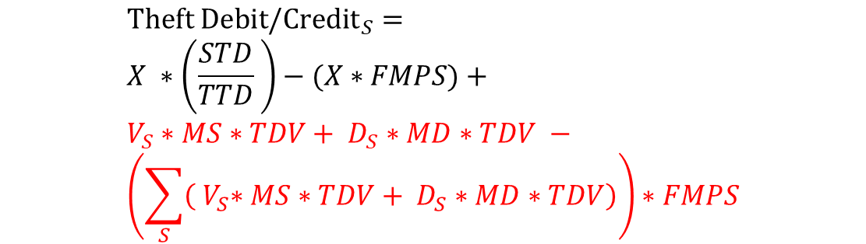
Changes – Calculations (continued)
8.3 Debits and credits resulting from the TDIS will be calculated for each consumer segment within the scheme using the following formula:
Where:
[existing definitions retained]
V_{s} = Number of Completed but Unconfirmed Theft Investigation that were concluded as a Site Visit for supplier S
D_{s} = Number of Completed but Unconfirmed Theft Investigation that were concluded as a Desktop Investigation for supplier S
MS = Site Visit Multiplier (i.e. the proportion of TDV payable for a Site Visit Completed but Unconfirmed Theft Investigation)
MD = Desktop Investigation Multiplier
= Sum over all suppliers
$${Theft Debit/Credit}_{S}= \\ X ∗\left(\frac{STD}{TTD} \right)−(X∗FMPS)+ \\ V_{S}∗MS∗TDV+ D_{S}∗MD∗TDV − \\ \left(\sum_{S}{\left({ V}_{S}∗MS∗TDV+ D_{S}∗MD∗TDV\right)}\right)∗FMPS$$
$$\sum_{S}{}$$
Reminder: FMPS already defined as final Metering/Supply Meter Point Market Share

Slide 15
Changes – Theft Target Methodology
Updates required to allow the determination of new parameters as part of the TTM process to section 4 of the Energy Theft Reduction Schedule (14):
4.2 Each Completed but Unconfirmed Theft Investigation will qualify for an incentive payment, the value of which will be calculated as a percentage of the Theft Detection Value. This percentage will be set such that the value of the payment is no more than the estimated likely net cost to an Energy Supplier of having undertaken the associated investigation activity, as compared with having taken no action.
4.3 The Code Manager, shall, at the same time as it determines and publishes the Theft Targets for a TDIS Reporting Year, establish and publish a Theft Detection Value for each consumer segment to be used in that TDIS Reporting Year and the associated percentage multipliers for calculation of payments for Completed but Unconfirmed Theft Investigation as outlined in paragraph 4.2.

Slide 16
Example Scenarios
Example scenarios created to help understand potential outcomes of changes
Data created for these scenarios and is not based on actual suppliers, although attempts to reflect some of the varying results seen in current TDIS reporting
Scenarios based on assigning assumptions regarding performance of confirmed thefts compared to target and conversion rate of investigations (i.e. how many investigations needed to identify confirmed theft):
Theft Performance
Outperforming
Significantly above average
Above Average
Average
Below Average
None
Investigation efficiency
Abnormally high
High
Median
Low
Abnormally low
None

Slide 17
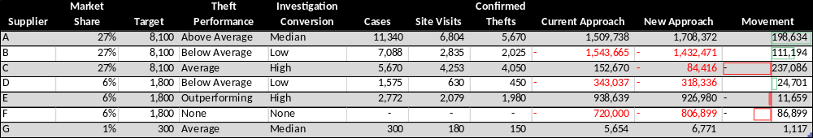
Example Scenario – Domestic
Values driven by assumptions regarding performance against target and investigation conversation, including proportion of investigations leading to site visits.
Key Assumptions:
£12m total pot
Overall pot performance c. 45%
Site visit multiplier 50% (does not also receive desktop payment)
Desktop investigation multiplier 20%

Slide 18
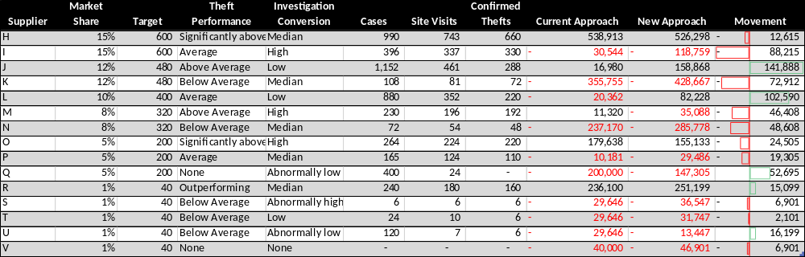
Example Scenario – Non-Domestic
Key Assumptions:
£4m total pot
Overall pot performance c. 55%
Site visit multiplier 50%
Desktop investigation multiplier 20%

Slide 19
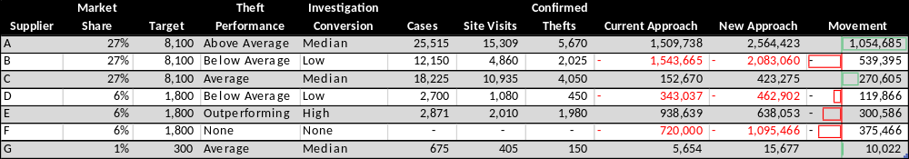
Example Scenario – Domestic
Scenarios updated based on current year to have higher number of site visits and investigations per confirmed theft
Supplier 3 also amended to have average theft performance and median conversion
Key Assumptions:
£12m total pot
Overall pot performance c. 45%
Site visit multiplier 50% (does not also receive desktop payment)
Desktop investigation multiplier 20%

Slide 20
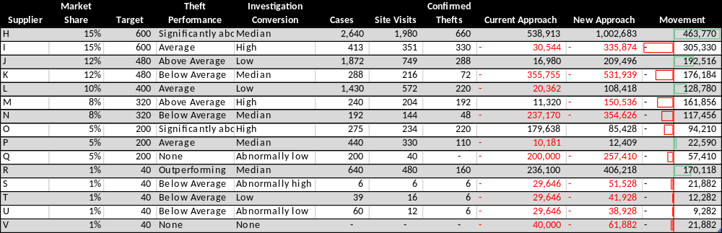
Example Scenario – Non-Domestic
Key Assumptions:
£4m total pot
Overall pot performance c. 55%
Site visit multiplier 50%
Desktop investigation multiplier 20%

Slide 21
Domestic Scenarios Compared

Slide 22
Non Domestic Scenarios Compared

Slide 23
Open Questions / Input Required
Should a different multiplier be determined for each pot, or is a single multiplier for all pots feasible? TDV varies by pot so the payment would differ by pot with a single multiplier.
The change will need to define the initial values for the multipliers – input from TIG members would be appreciated. For information:
  Based on 2023/24 data¹ there are approximately three times as many site visits for each confirmed theft reported (i.e. two site visits that would be eligible for payment under the change). Individual performance (by party and pot) varies significantly from 8-100%.
  It would appear many parties have only reported site visits. Excluding those parties, there were approximately seven times as many investigations as confirmed theft (i.e. a further four desktop investigations).
Is there a need to explicitly call out that the parameters will be set in the first year as part of the change?
Are there other changes needed not captured here? Is there a need for any changes to the general description of the scheme? Are there changes needed to the Unbilled Energy Code of Practice?
1 – Based on 2023/24 Theft Data submitted prior to 18 July 2024, note although parties are required to submit investigations once they commence the current level of reporting suggests that not all suppliers are doing so.

Slide 24
I0175 – Introducing a reasonable endeavours scheme within the rec
chair

Slide 25
Usage of the scheme over the last 5 years
The number of REDs claims received per category per year.
 | Year
Allowance | 2019 | 2020 | 2021 | 2022 | 2023
1 | 2 | 0 | 20 | 86 | 76
2 | 2 | 0 | 0 | 0 | 0
3 | 4 | 0 | 19 | 85 | 78
4 | 5 | 104 | 286 | 768 | 238
5 | 9 | 104 | 305 | 854 | 316
6 | 0 | 0 | 0 | 0 | 0
7 | 0 | 0 | 2 | 0 | 0

Slide 26
Successful claims
Of those received, the number of REDs claims processed (and paid) per category, per year.
 | Year
Allowance | 2019 | 2020 | 2021 | 2022 | 2023
1 | 1 | 0 | 17 | 75 | 71
2 | 1 | 0 | 0 | 0 | 0
3 | 2 | 0 | 17 | 75 | 73
4 | 5 | 83 | 240 | 679 | 198
5 | 7 | 83 | 257 | 754 | 271
6 | 0 | 0 | 0 | 0 | 0
7 | 0 | 0 | 0 | 0 | 0

Slide 27
Successful claims (percentage)
 | Year
Allowance | 2019 | 2020 | 2021 | 2022 | 2023
1 | 50% | N/a | 85% | 87% | 93%
2 | 50% | N/a | N/a | N/a | N/a
3 | 50% | N/a | 89% | 88% | 93%
4 | 100% | 79% | 84% | 79% | 83%
5 | 77% | 79% | 84% | 88% | 85%
6 | N/a | N/a | N/a | N/a | N/a
7 | N/a | N/a | 0% | N/a | N/a

Slide 28
RED scheme allowances
1 | Has a meter tamper been discovered and reported to the police? | £125 (Fixed Amount) | TOG Report to Xoserve (TOG CRN); Evidence of police notification; Crime Reference Number; Witness Statement
Or 2 | Has an illegal reconnection been discovered and reported to the police | £125 (Fixed Amount) | TOG Report to Xoserve (TOGCRN); Evidence of police notification; Crime Reference Number; Witness Statement
Or 4 | Was the theft conducted by an unlawful occupant or by a person who has absconded leaving no forwarding address, and the following actions been taken?: 3 2 or 4 5 | £125 (Fixed Amount) | TOG Report to Xoserve (TOG CRN); Evidence of police notification; Crime Reference Number; Witness Statement
3 | Have steps been taken to recover costs (Actions 3, 4 and 5) | £125 (Fixed Amount) | Details of Costs incurred; Evidence of costs issued to customer
5 | Has a meter Exchange been completed? | Actual costs up to £250 | Description of tests carried out; Dates of work carried out; Costs associated with work carried out
6 | Have forensic tests been completed? | Actual costs up to £120 | Description of work carried out; Dates of work carried out; Costs associated with work carried out
7 | In the case of a theft at an I&C site, have civil proceeding been issued and served, or have legitimate reasons for not doing so been presented? | Actual costs | Documentation to and from courts; or Evidence to support decision not to take civil action.
Multiple allowable allowance(s):
1 or 1 and 3 or 1,3 and 5 or 1,3,5 and 6
2 or 2 and 3 or 2, 3 and 5 or 2,3,5 and 6
4 or 4 and 3 or 4,3 and 5 or 4,3,5 and 6
7
*In all cases only one allowance of 1, 2 and 4 can be made

Slide 29
Payments Processed
The total financial value of the processed REDs claims per year
Year
2019 | 2020 | 2021 | 2022 | 2023
-£ 2,210.00 | -£ 22,980.00 | -£ 86,702.00 | -£ 261,246.00 | -£ 100,938.00

Slide 30
Validation checks
Validation checks include the below;
Whether it is an open TOG Contact
Ownership period
TOG period
KWh energy stolen
Stakeholder Short Code (SSC)
Meter Point Reference Number (MPRN) for the site
CMS Contact Reference Number (CRN)
Domestic or commercial usage
Shipper reference number
Which Allowance is being claiming for
If claim is rejected:
The Shipper will be contacted and receive the information relating to the rejection reasons, if agreed the Shipper can potentially resubmit the claim with amended valid info, or submit a new claim.

Slide 31
Rejections
A claim can be rejected for a number of reasons. Some of the rejections are listed below:
A valid TOG Contact does not exist on CMS
Shipper does not provide Volume or TOG period on Corresponding CMS TOG Contact
No theft details have been provided on the CMS TOG Contact
Information / evidence provided is not sufficient
Mandatory information or evidence has not been provided
Information / evidence provided does not concur with Xoserve systems
Witness Statement claims meter was removed but UK Link shows meter still in situ
Information provided on the CMS TOG Contact does not match that provided on the claim
Information / evidence provided invalidates claim
Witness Statement states “Not Reported to the police”
Evidence suggests that end user has not been issued with an invoice
Claim has been previously submitted
A previous claim has been submitted for this instance of theft
Incorrect allowance being claimed
Claim is for period outside Shipper ownership
Claim submitted is for a period which is entirely or partially for a period when the site was not supplied by the Shipper
Information / evidence provided suggests payments have been completed or are being made
Witness Statement claims payments have been completed
Letter to End User states that supply would not be reinstated until payments were made, and supply is Live

Slide 32
I0176 – Creation of an Energy Theft Detection and Resolution body
MICHELLE SIMPSON
ELECTRALINK

Slide 33
AOB
Chair

Slide 34
Thank YOU
Contact us: enquiries@recmanager.co.uk

